Slide 1
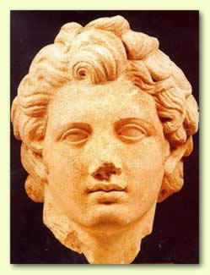
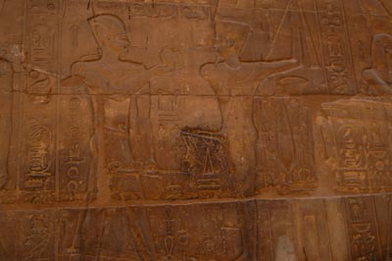
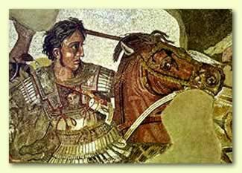
The Hellenistic Period (332-30)
Argead Dynasty (332-309)
  Alexander the Great (332-323)
  Philip III Arrhidaeus (323-317)
  Alexander IV (316-309)
Key Terms
Alexander the Great
Philip III Arrhidaeus
Perdiccas
Alexander IV
Siwa

Slide 2
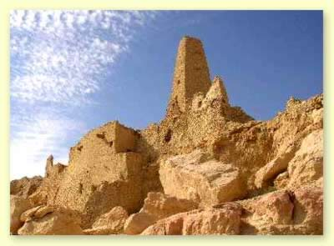
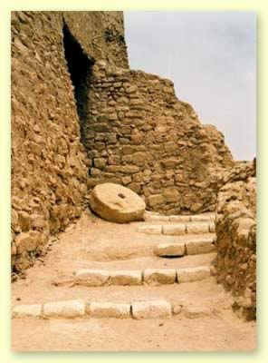
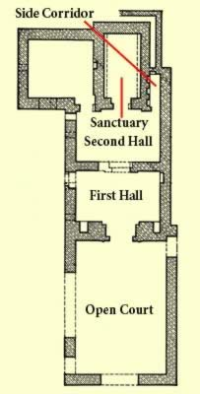
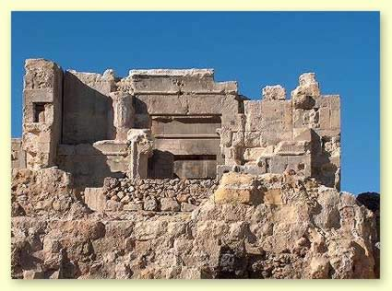
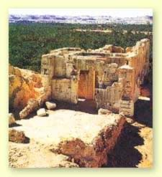
Temple of the Oracle of Amun at the Siwa Oasis

Slide 3
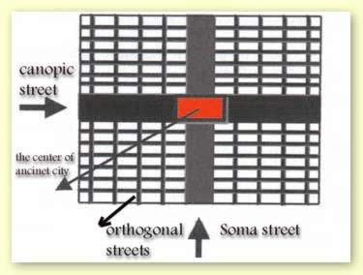
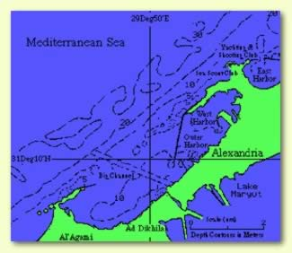
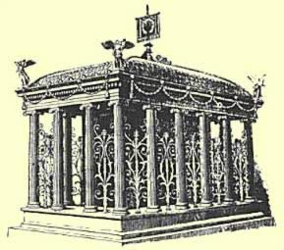
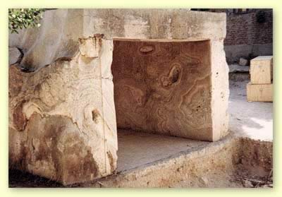
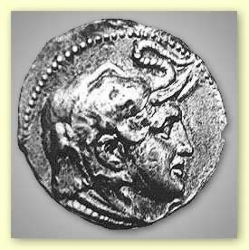

Slide 4

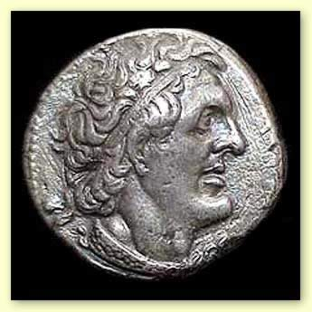
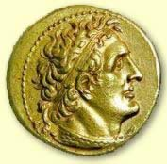
The Hellenistic Period (332-30)
Ptolemaic Dynasty (309-30)
  Ptolemy I Soter (309-282)
Key Terms
Ptolemy I Soter
Diadochi
Serapis

Slide 5
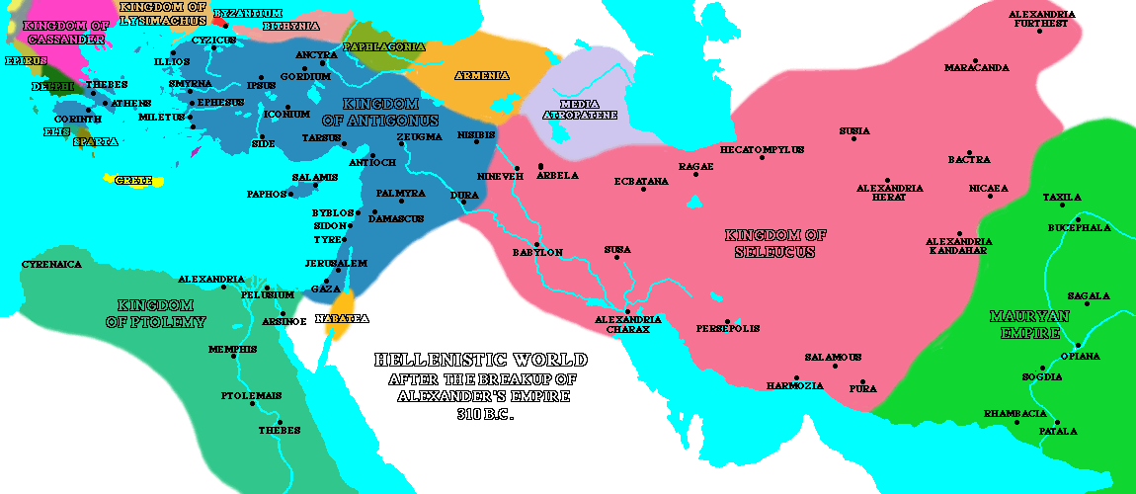
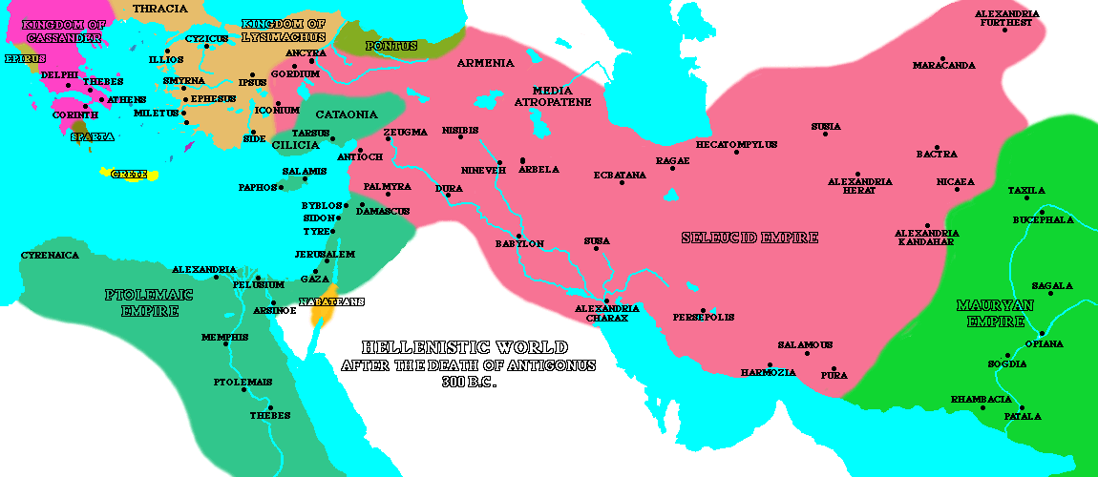

Slide 6
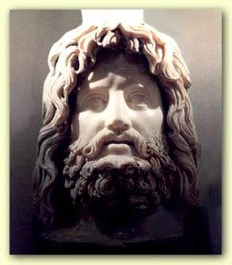
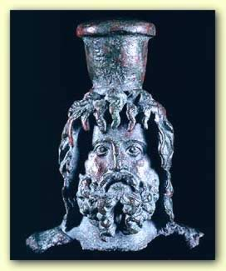
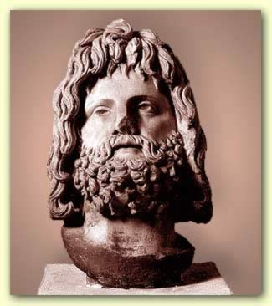
Serapis

Slide 7

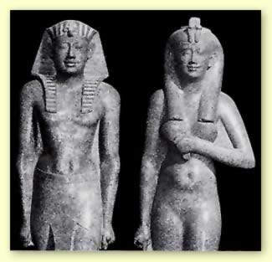
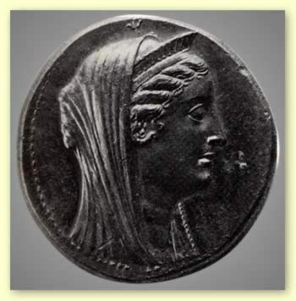
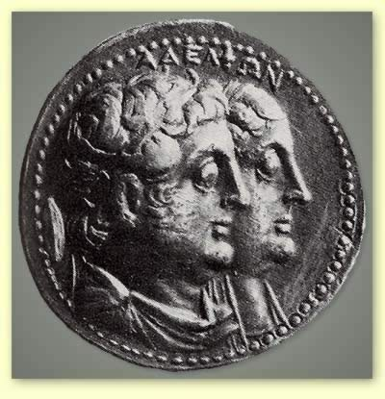
The Hellenistic Period (332-30)
Ptolemy II Philadelphos (285-246)
Key Terms
Ptolemy II Philadelphos
Arsinoe II

Slide 8
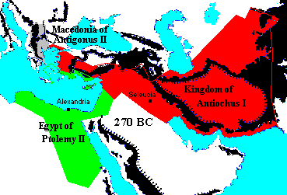

Slide 9
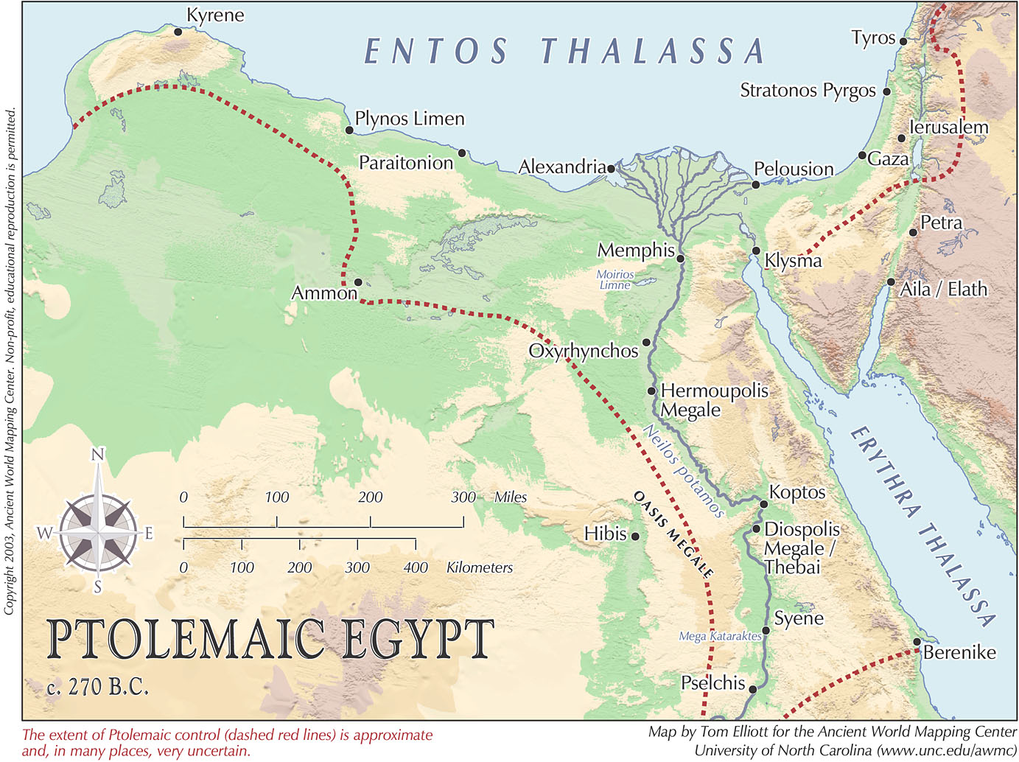

Slide 10
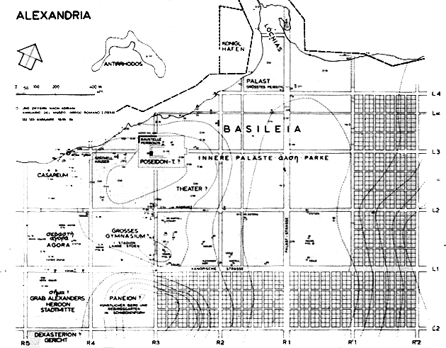
Alexandria

Slide 11
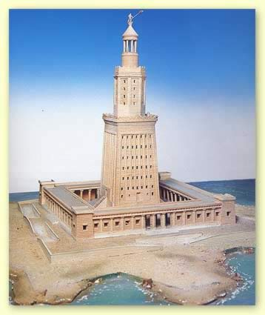
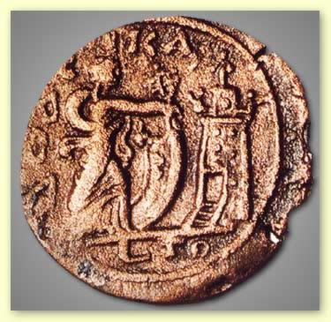
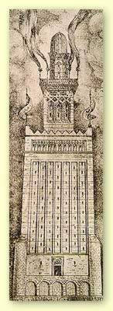
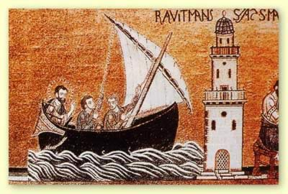
Alexandria

Slide 12
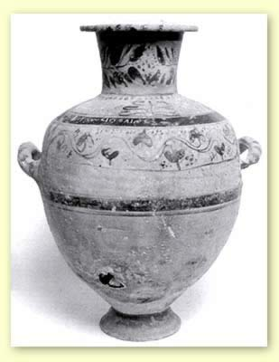
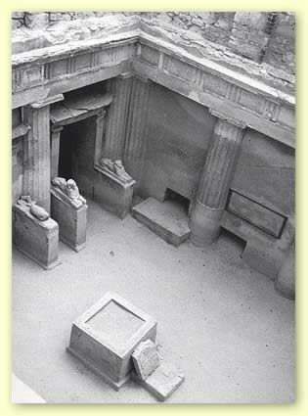
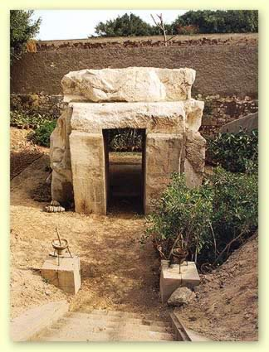
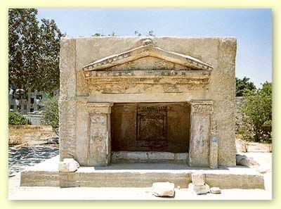
Alexandria

Slide 13
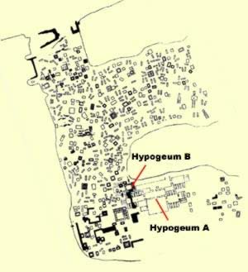
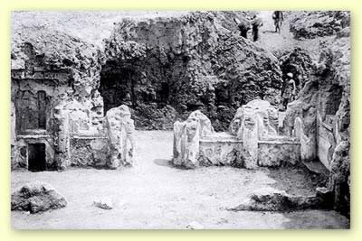
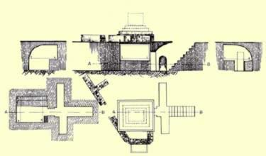
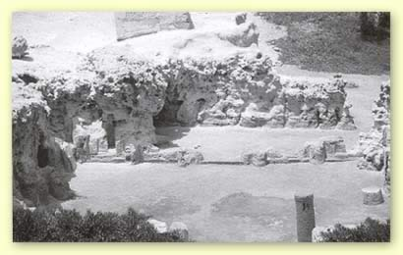
Alexandria
Above: Hypogeum A just after it was discovered
Below: Hypogeum A Today

Slide 14
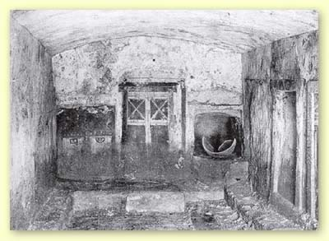
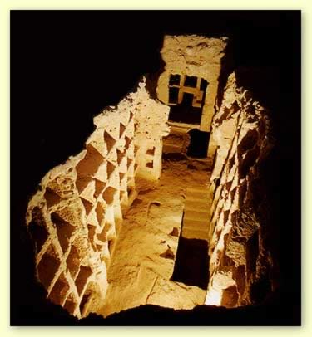
Alexandria

Slide 15
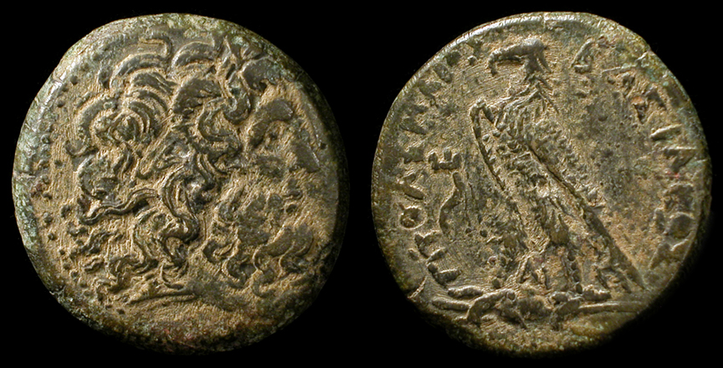
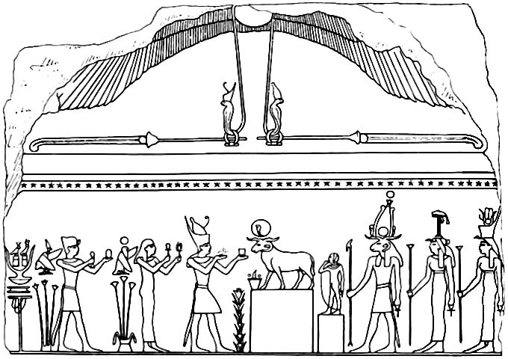
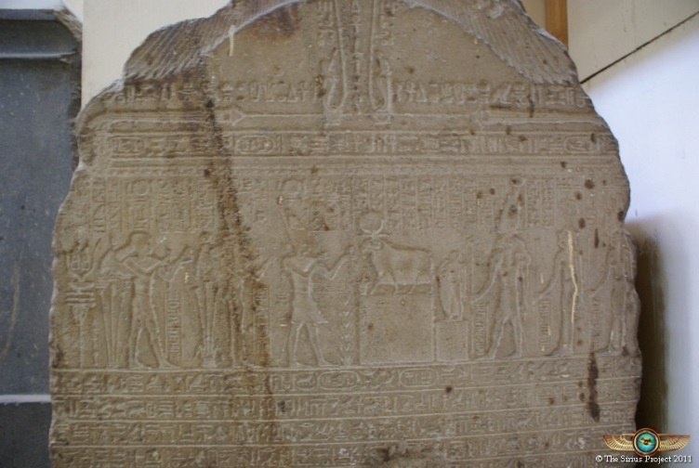
Ideology of Kingship
Key Terms
Ptolemaia
Coin of Ptolemy III
Mendes Stela

Slide 16
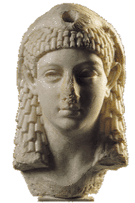
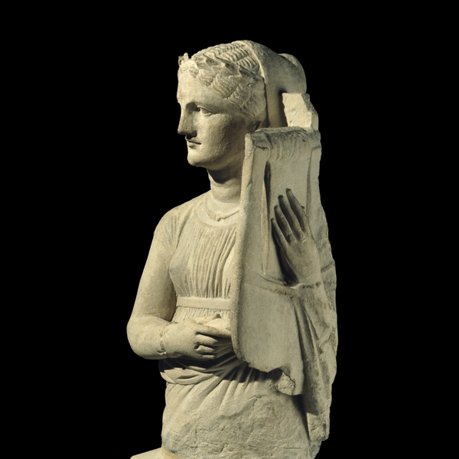
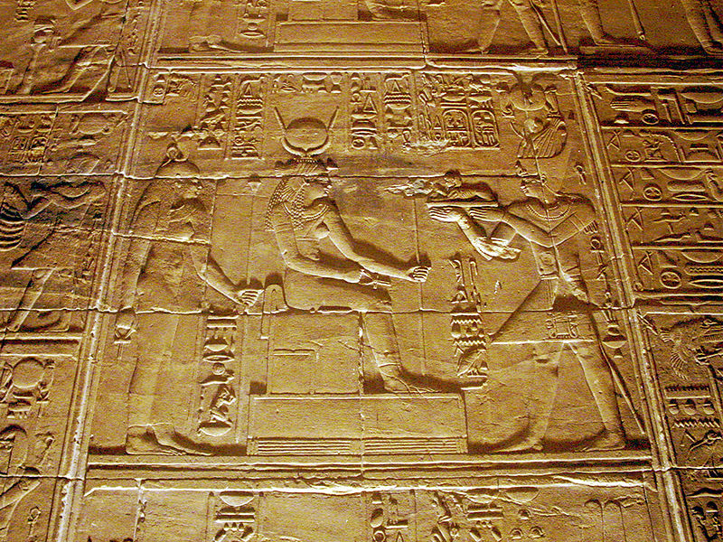
Women in Ptolemaic Egypt
The Family
Marriage and Divorce
Soldiers’ Wives
Ptolemaic Queens
Mistresses of the Ptolemies

Slide 17
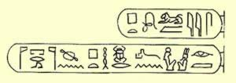
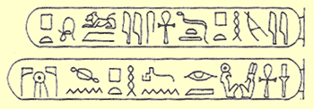
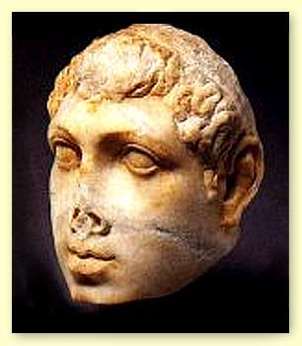
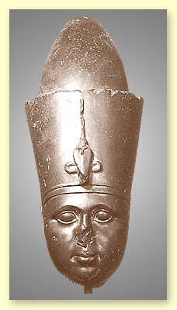



The Hellenistic Period (332-30)
Ptolemy VI Philometer (180-164, 163-145)
Ptolemy VIII Euergetes II (170-163, 145-116)
Ptolemy VI and Cleopatra II
Ptolemy VIII

Slide 18

Key Terms
Ptolemy VI Philometer
Ptolemy VIII Euergetes II
Demotic

Slide 19




Kom Ombo

Slide 20

Kom Ombo

Slide 21




Kom Ombo

Slide 22




Kom Ombo

Slide 23


Kom Ombo

Slide 24


Demotic

Slide 25




The Hellenistic Period (332-30)
Cleopatra VII (51-30)
Key Terms
Ptolemy XIII
Cleopatra VII
Caesarion
Battle of Actium

Slide 26


Cleopatra and her Son, Caesarion
Cleopatra by Michelangelo

Slide 27


Slide 28



Slide 29

Roman Egypt (30 BCE - )
Key Terms
strategoi
Coptic

Slide 30

Kush (Nubia)
Napatan Dynasty (656-275 BCE)
Kingdom of Meroë (275 BCE-350 CE)
  Arqamani (275-250 BCE)
  Amanirenase (35-20 BCE)
Key Terms
Meroe
Qore
Kandake
Amanirenas
Jebel Barkal

Slide 31



Anlamani, Aspelta, Taharqa, Tanoutamon, and Senkamanisken
Senkamanisken
Irike-takana

Slide 32

Nuri, the necropolis of Napata

Slide 33


Slide 34


Arnekhamani
Amanitore

Slide 35

Amanishaketo with the Lion God Apademak

Slide 36



Temples of Amon at Naga and Gebel Barkal

Slide 37

Meroe

Slide 38



Slide 39







