Slide 1
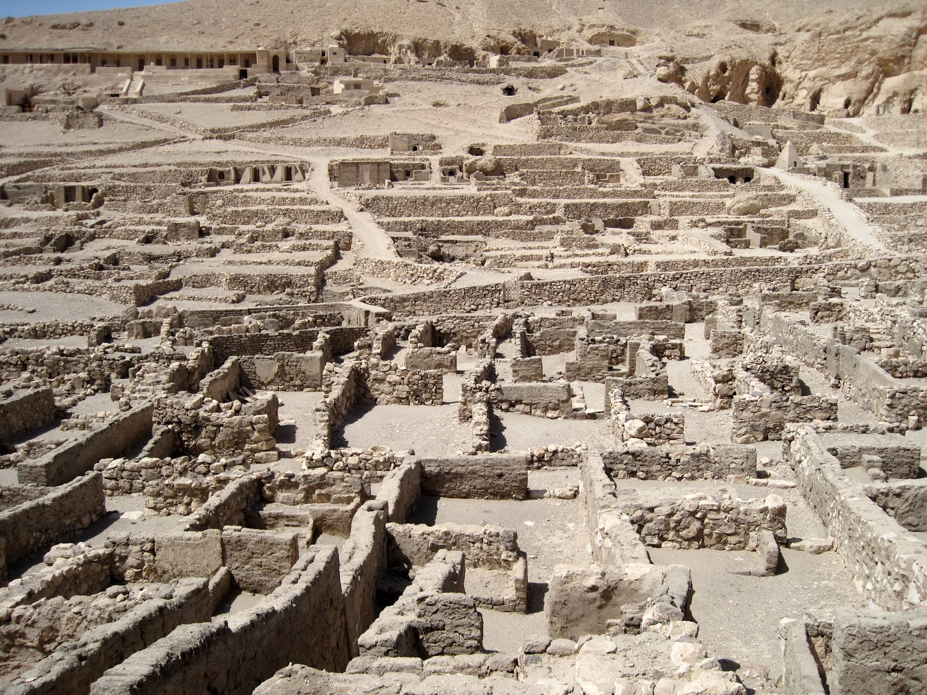
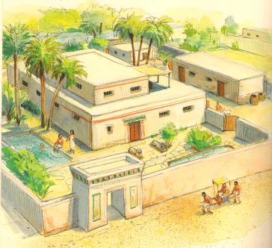
The First Intermediate Period (2151-1980)
Cities, Towns, and Villages
Nomes and Nomarchs
Deir El-Medina

Slide 2
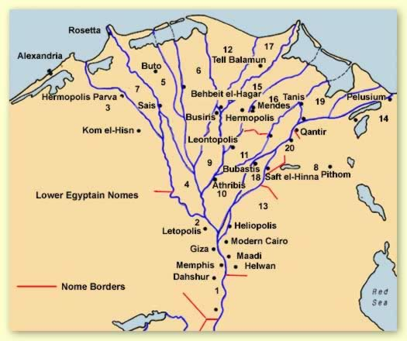
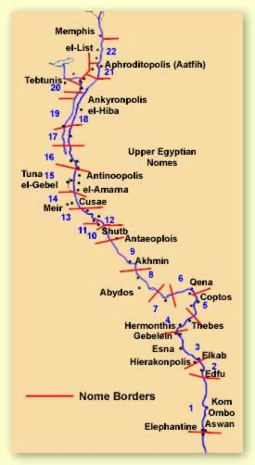
The Nomes of Ancient Egypt
Key Terms
nome
nomarch

Slide 3
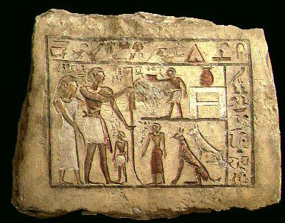
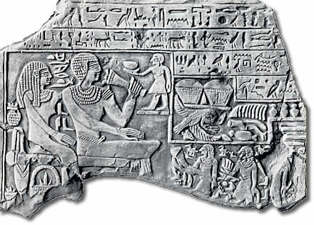
The First Intermediate Period (2151-1980)
Manetho’s 7th-11th Dynasties
Characteristics of the FIP
Causes of the Decline of the OK
Rise of the Nomarchs
Dynasty 8
Dynasties 9-10
Dynasty 11
Key Terms
Khety I
Art became cruder during the First Intermediate Period, as seen in this funerary relief from Dendara

Slide 4
