Slide 1
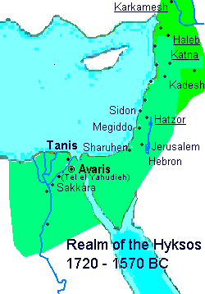
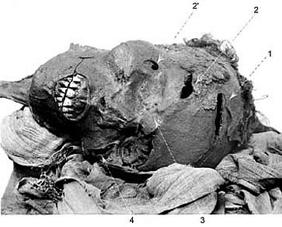
The Second Intermediate Period (1660-1539)
Dynasty 13 (crumbling Middle Kingdom dynasty)
Dynasty 14 (Lower Egypt)
Dynasties 15 and 16 (Hyksos)
Dynasty 17 (Theban)
Key Terms
Hyksos
Sheshi (Salitis)
Apepi (Apophis)
Sekenenre Tao II
Kamose

Slide 2
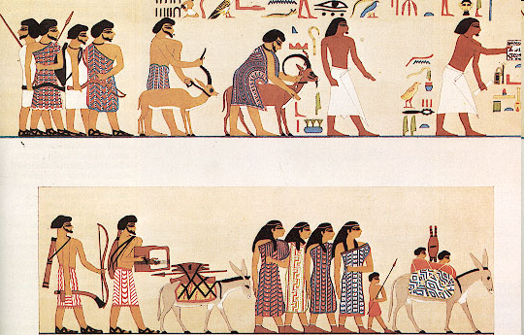
A group of people labled Hyksos entering Egypt. From the tomb of a 12th dynasty king Khnumhotep II at Beni Hasan. The glyphs above the head of the first animal spell out Hyksos.

Slide 3
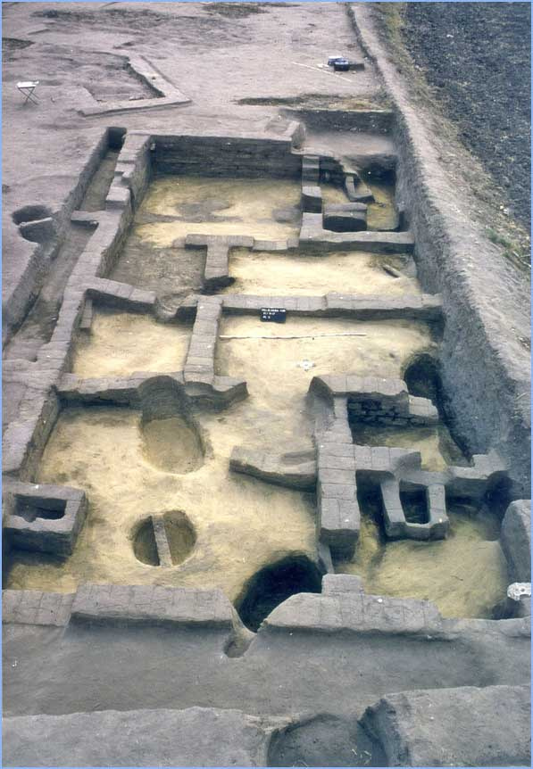
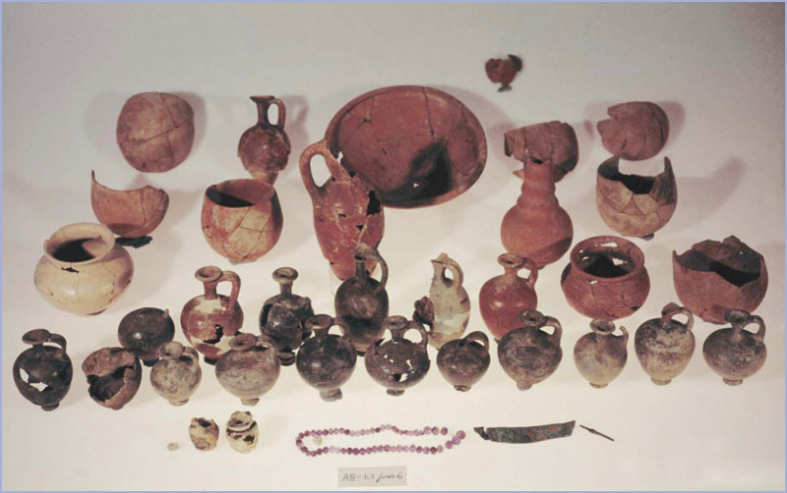
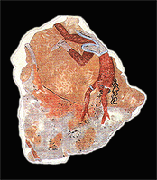
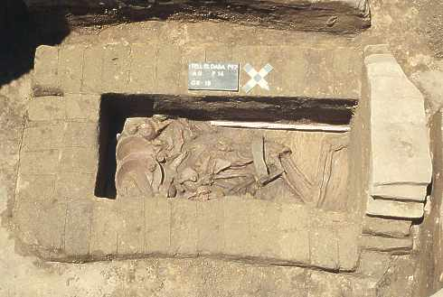
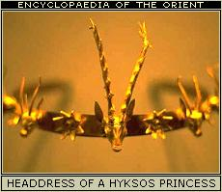
Tell el-Dab’a (Avaris)
Warrior Tomb

Slide 4
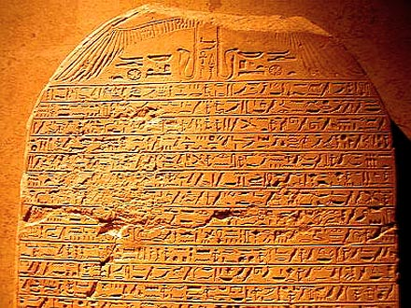
Kamose’s Stela

