Slide 1
The Third Intermediate Period (1076-723)
Three Stages of the TIP:
Divided Kingdom (Dynasty 21)
1076-943
Meshwesh Libyan Dynasty (Dynasty 22)
943-845
Fragmented Kingdom (Dynasties 23-25)
845-723

Slide 2
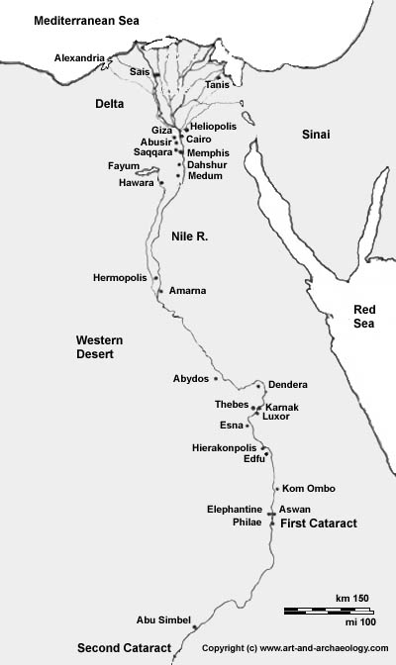
The Third Intermediate Period (1076-723)
Dynasty 21 (1076-944)
Nebanedbjed (Smendes) (1076-1052)

Slide 3
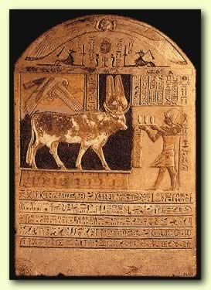
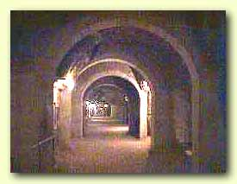
The Third Intermediate Period (1076-723)
The Libyan Dynasty (Dynasty 22)
Meshwesh
The Serapeum and the Apis Bulls
Key Terms
Apis Bull

Slide 4
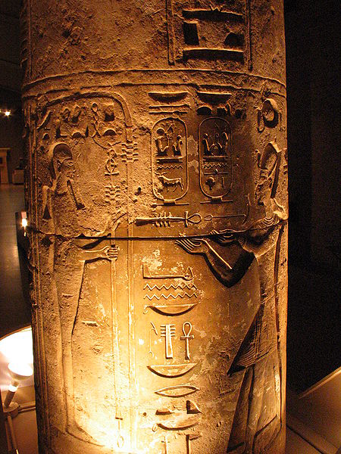
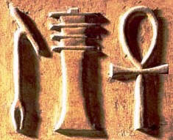
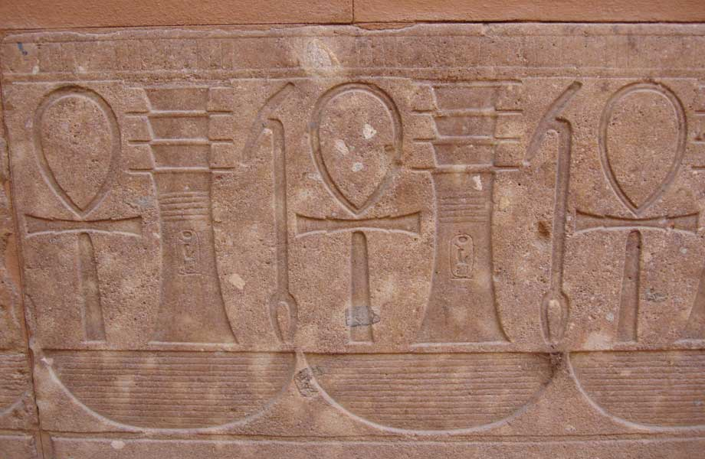
Bull Symbols
Key Terms
ankh
djed
was
Merneptah making offerings to Ptah

Slide 5
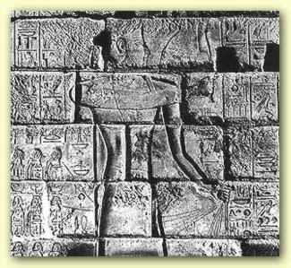
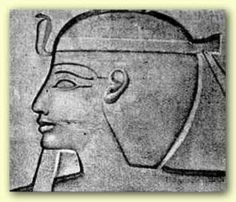
The Third Intermediate Period (1076-723)
The Libyan Dynasty (Dynasty 22)
Sheshonq I (943-923)
Key Terms
Sheshonq I

Slide 6
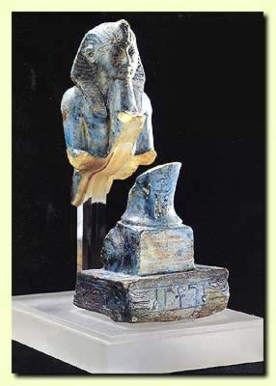
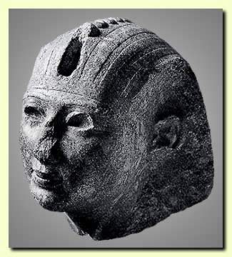
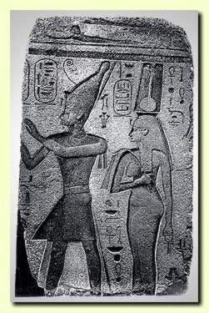
The Third Intermediate Period (1076-723)
The Libyan Dynasty (Dynasty 22)
Osorkon II (876-842)
Key Terms
Osorkon II
Bubastis

Slide 7
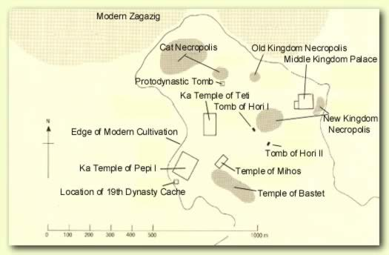
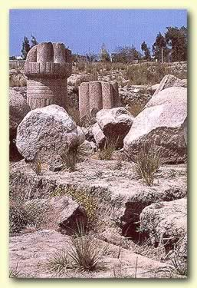
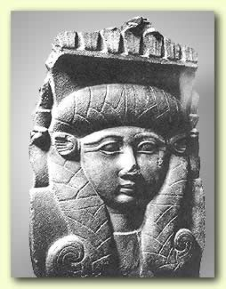
Bubastis (Tel Basta)

Slide 8
The Third Intermediate Period (1076-723)
The Fragmented Kingdom (Dynasties 23-25)
Dynasty 23 (845-723)
Ruled from Leontopolis
Dynasty 24 (736-723)
Ruled from Sais
Dynasty 25 (753-656)
Came from Napata in Kush (Nubia)
Ruled from Memphis
Key Terms
Tefnakhte

Slide 9
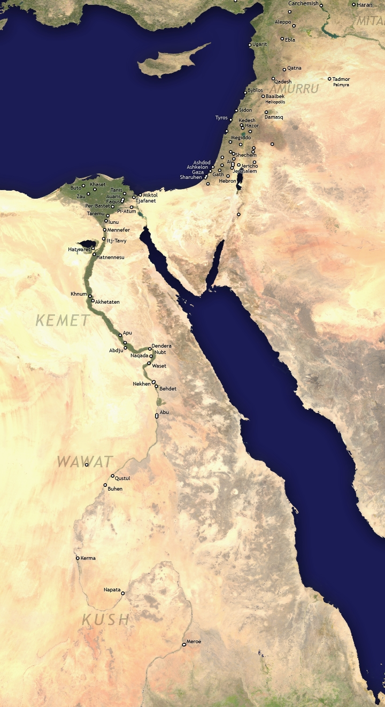
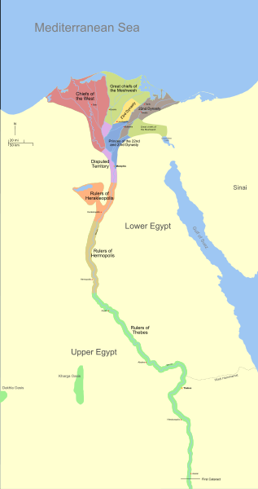

Slide 10
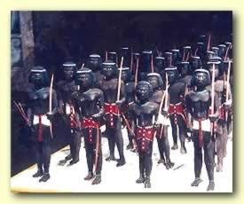
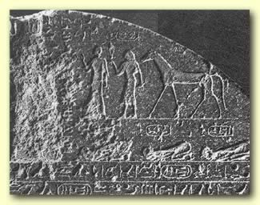
The Third Intermediate Period (1076-723)
Dynasty 25
Piye (Piankhi) (753-723)
Key Terms
Piye
The Divine Adoratrice

Slide 11
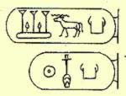
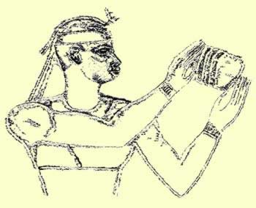
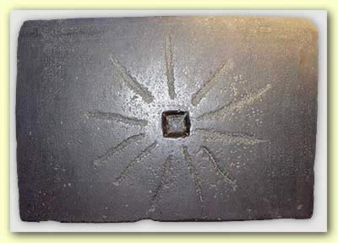
The Kushite Period (722-671)
Shabaka (716-702)
Key Terms
Shabaka

Slide 12
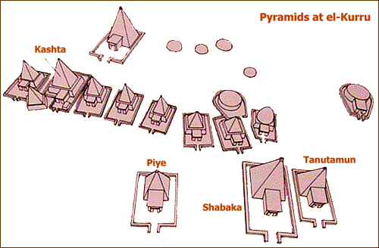
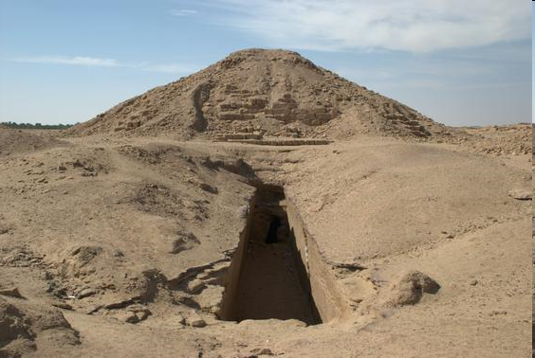

Slide 13
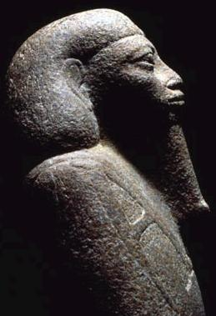
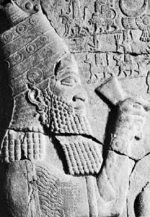
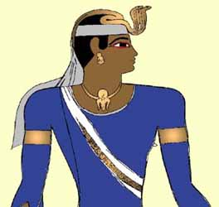
Period of Assyrian Domination (671-656)
Taharqa (690-667)
Esarhaddon (671-669)
Ashurbanipal (669-656)
Key Terms
Taharqa
Esarhaddon
Inaros I
Tanwetamani

Slide 14
