Slide 1
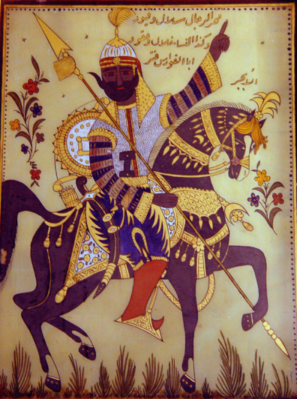
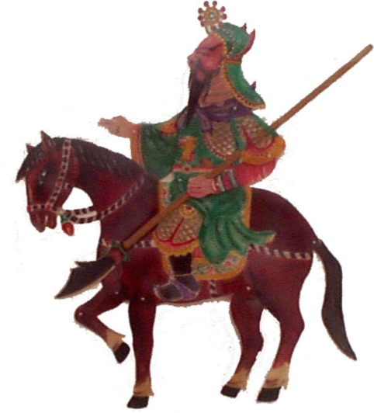
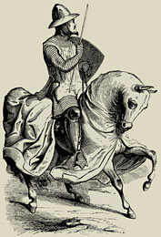
The Middle Bronze Age
The Second Phase of Civilization
(c. 2100-1600 BCE)

Slide 2
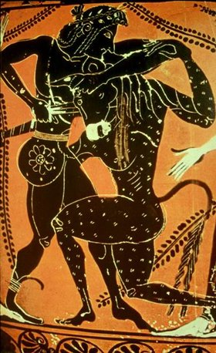
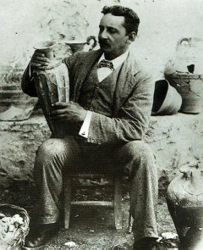
Minoa (c. 2000-1500)
Legend
History
Old Palace Period (c. 2000-1800)
New Palace Period (c. 1750-1550)
Culture
Key Terms
Minoa

Slide 3
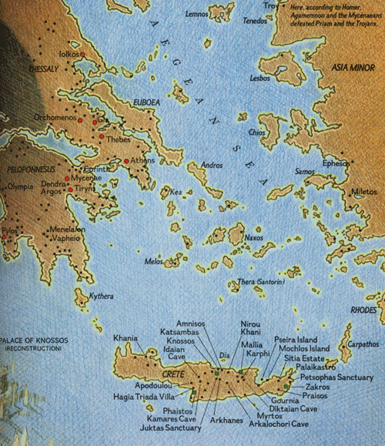

Slide 4
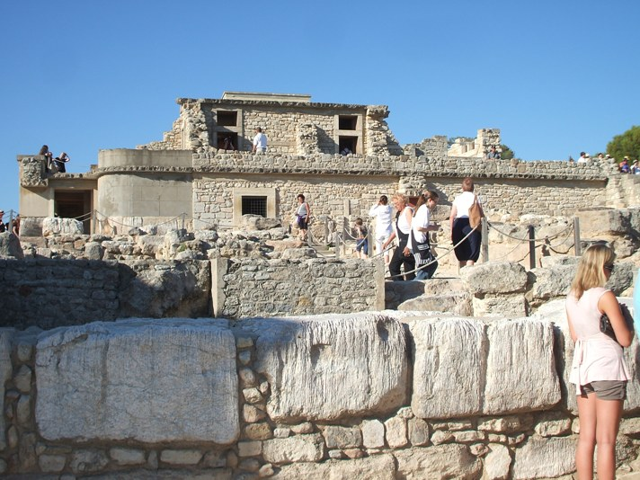

Slide 5
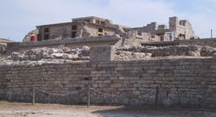
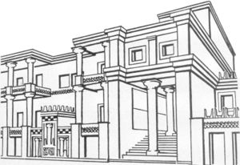
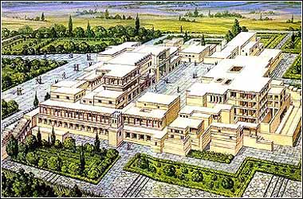
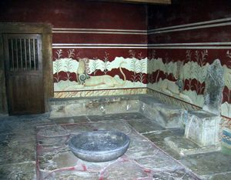
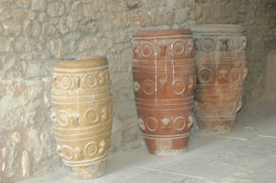

Slide 6
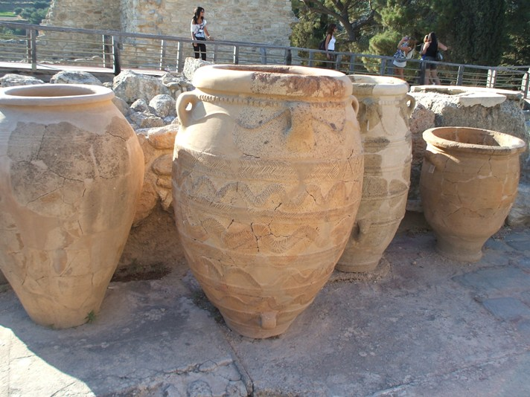

Slide 7
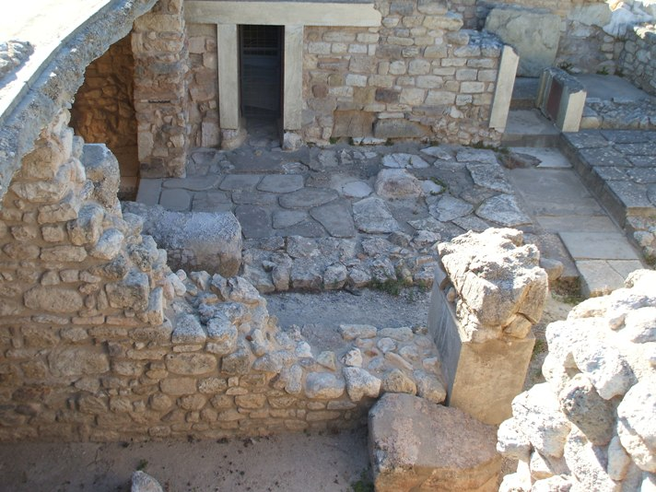

Slide 8
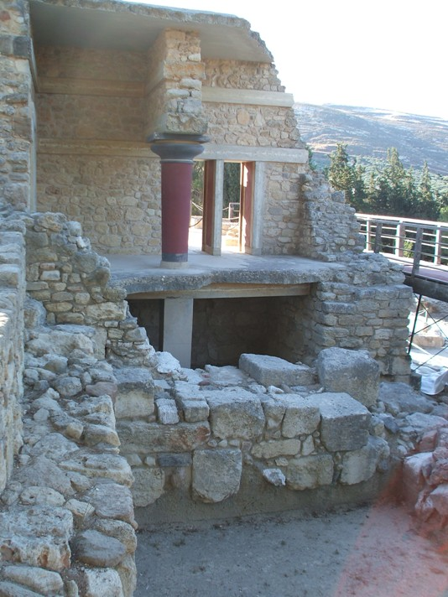
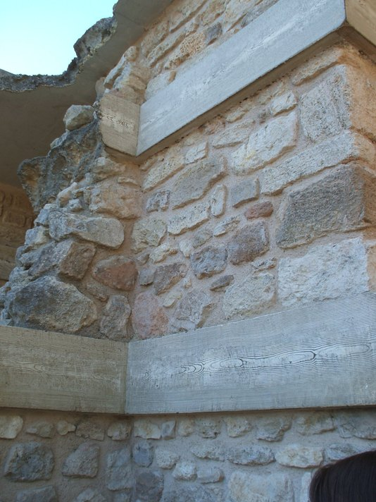

Slide 9
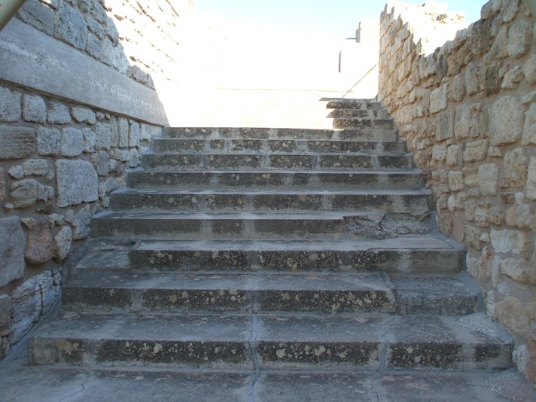

Slide 10
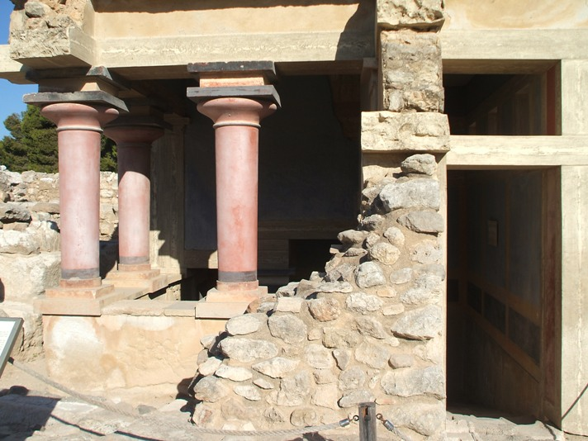

Slide 11
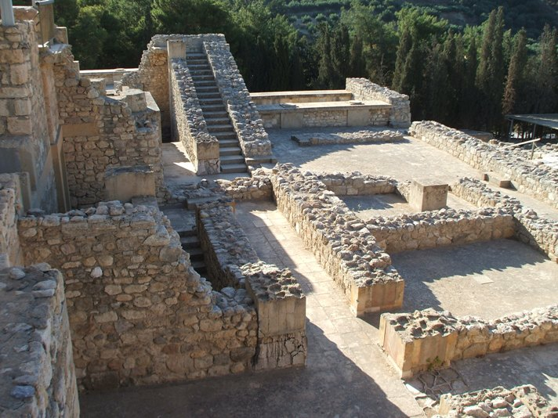

Slide 12
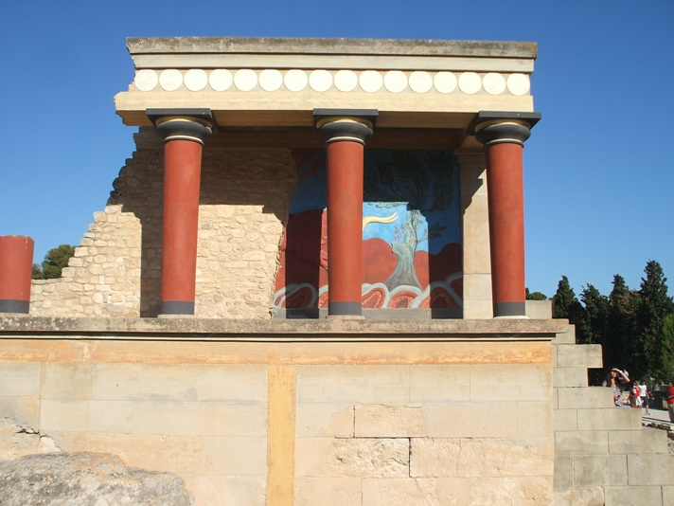

Slide 13
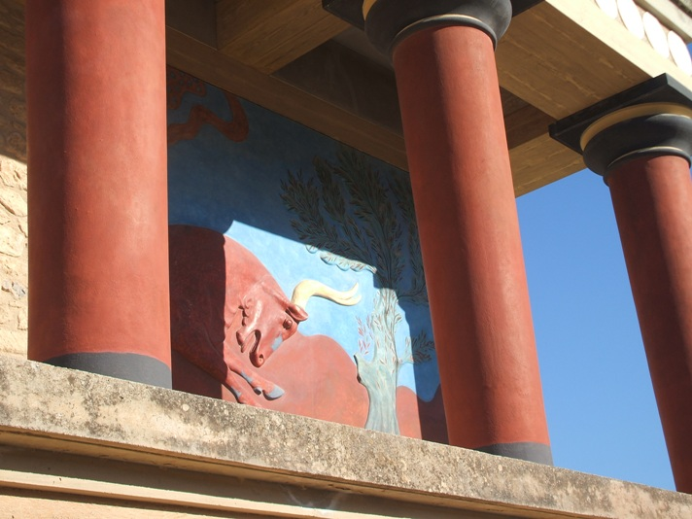

Slide 14
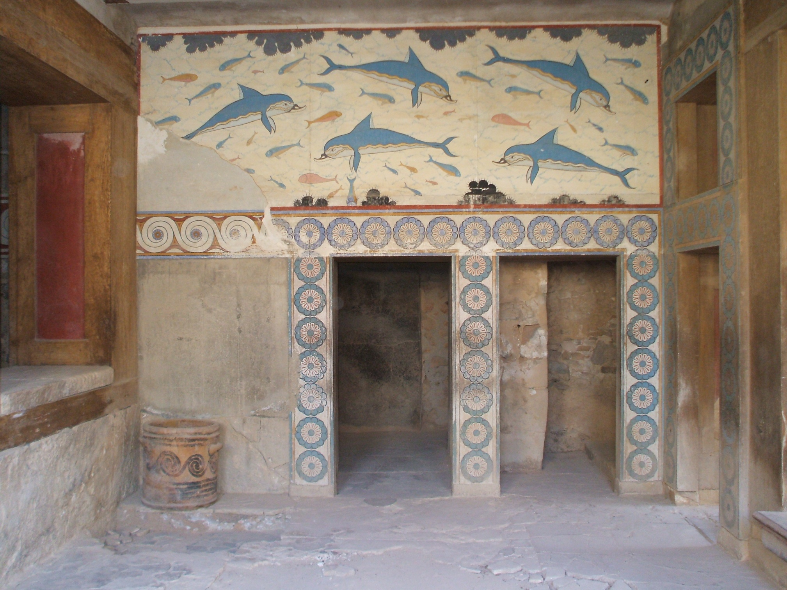

Slide 15
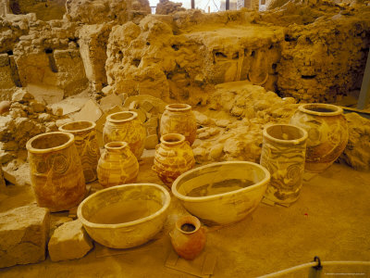
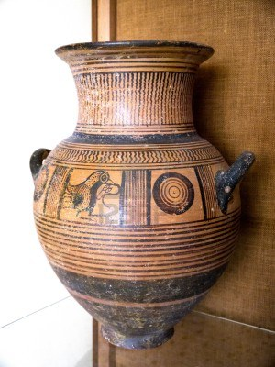
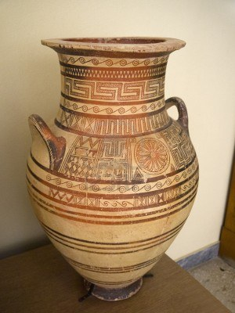
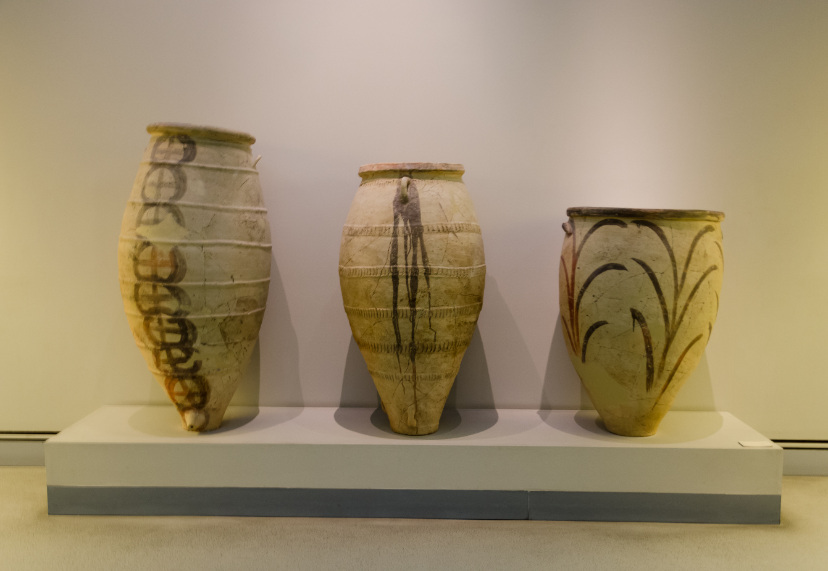
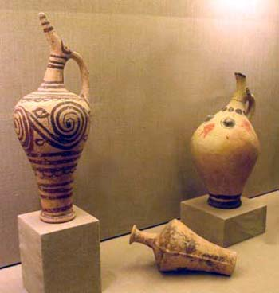

Slide 16
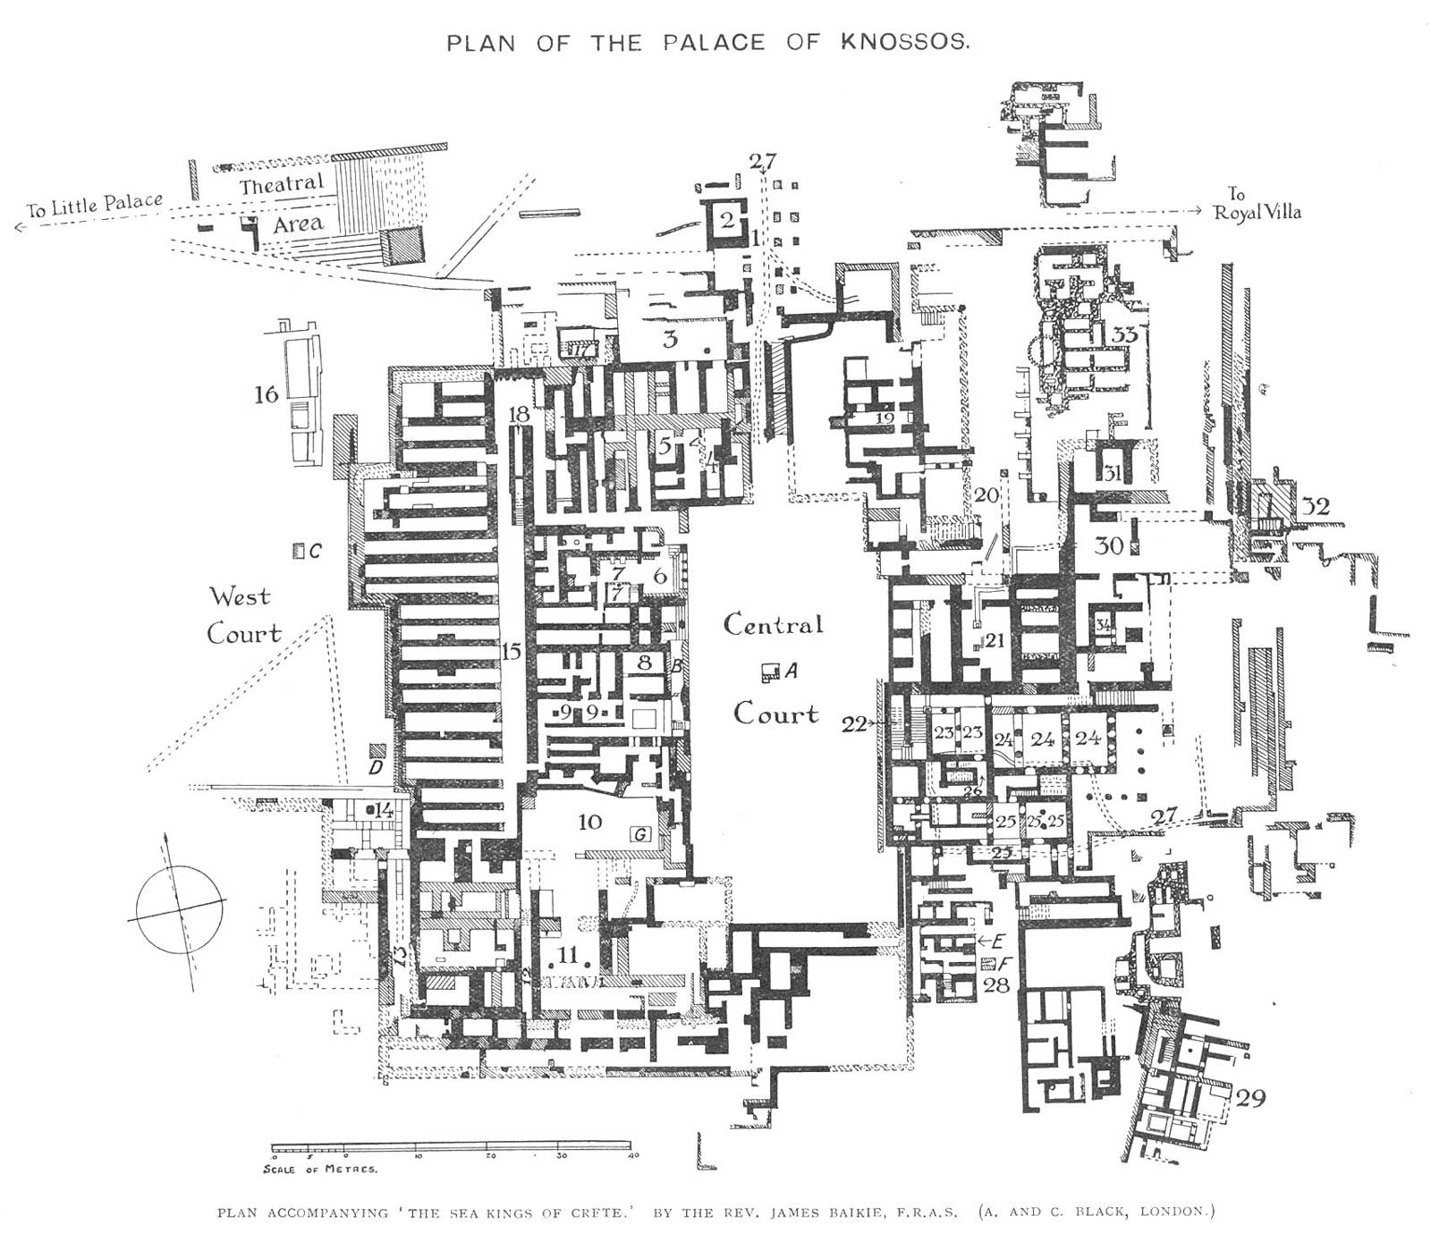

Slide 17
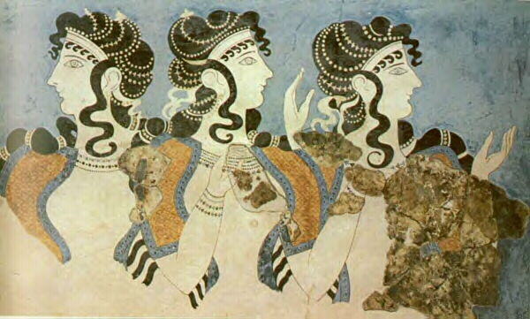
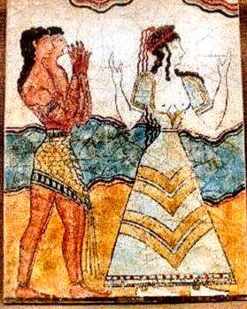
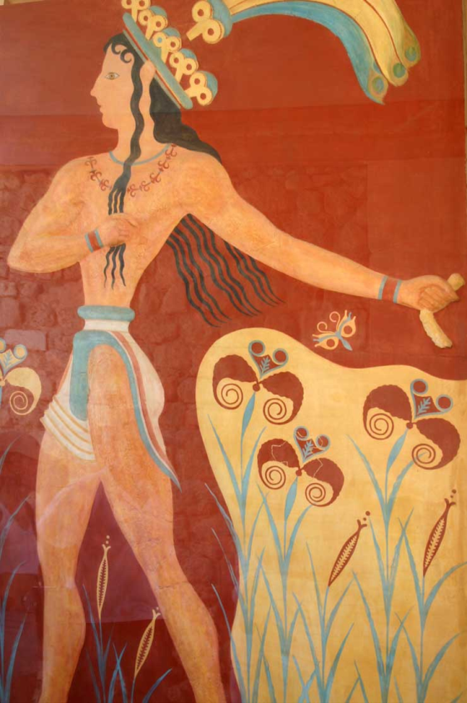
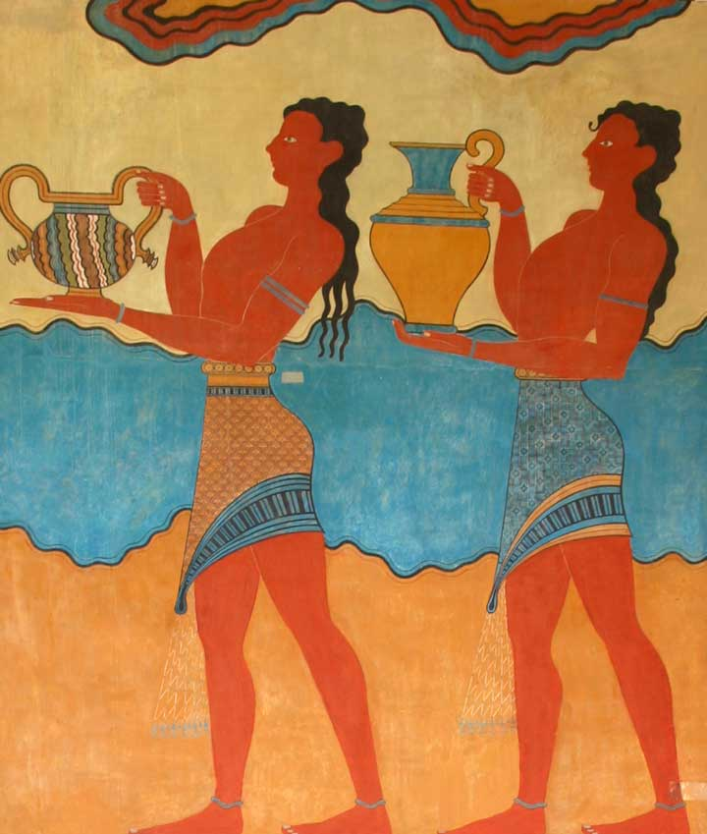
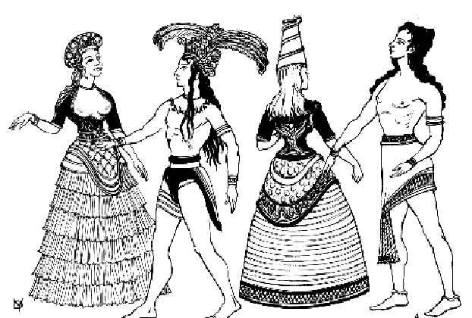

Slide 18
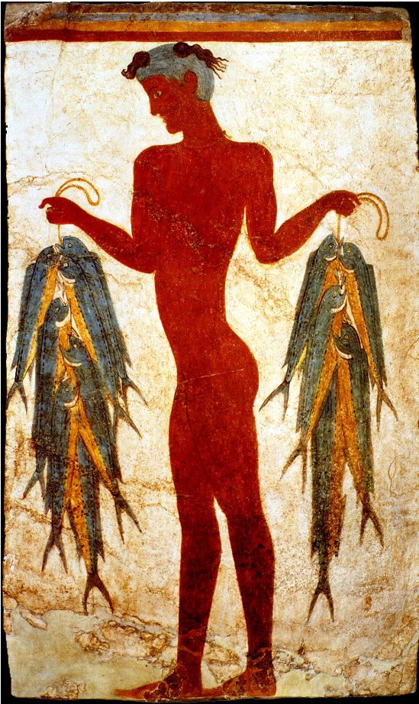
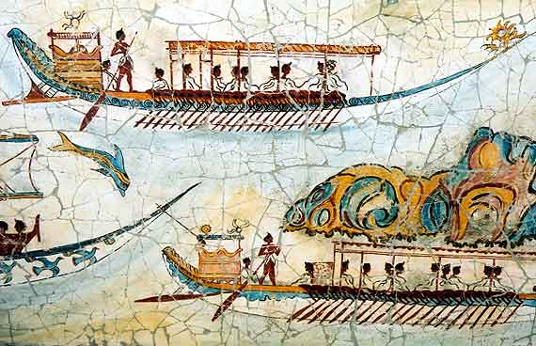
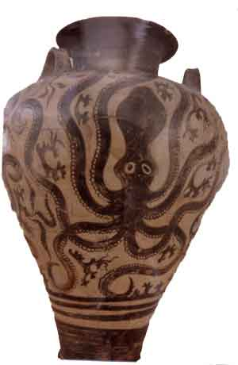
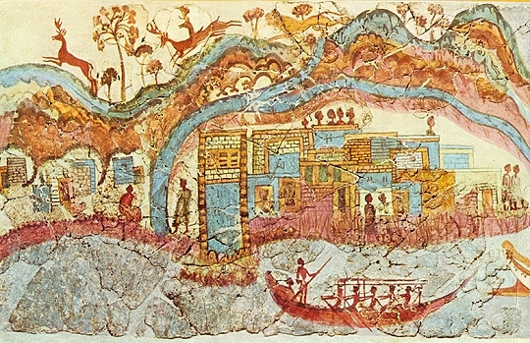

Slide 19
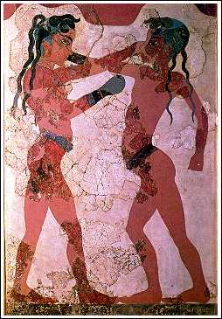
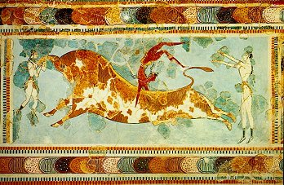
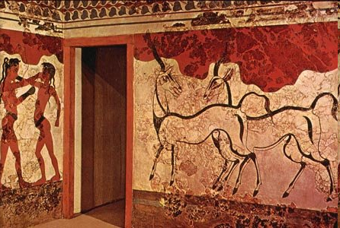
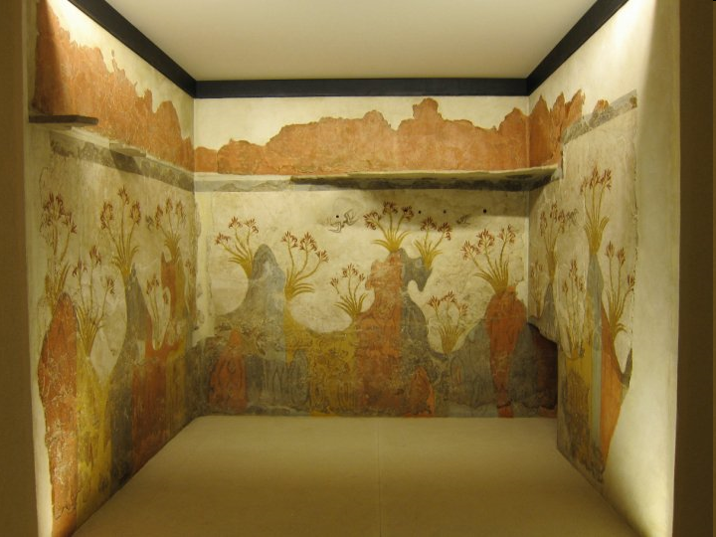

Slide 20
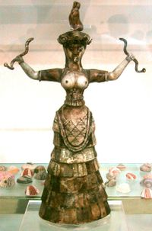
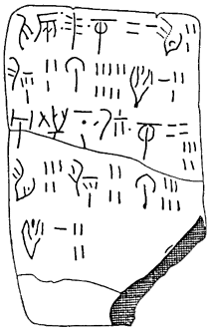
Minoa (cont’d)
New Palace Period (cont’d)
Religion
Writing
The Fall of Minoa
Key Terms
Linear A

Slide 21
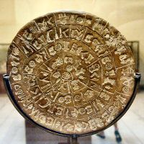
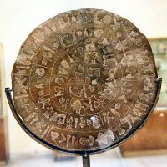
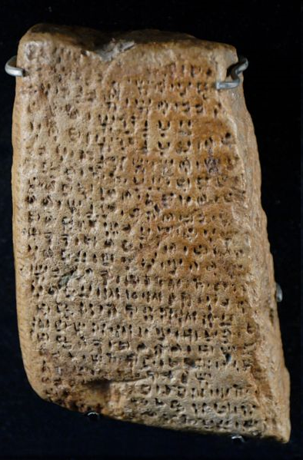
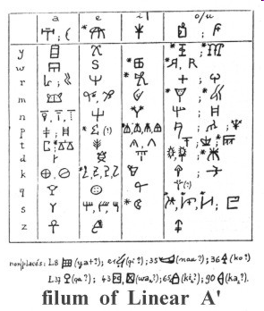
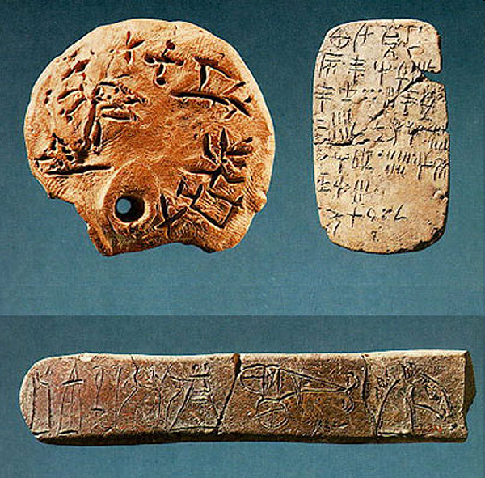

Slide 22
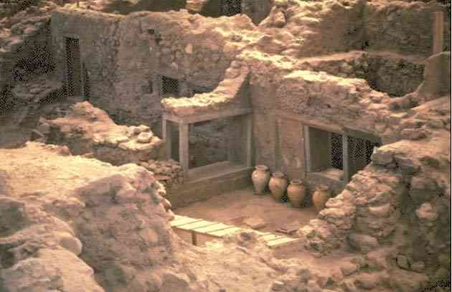
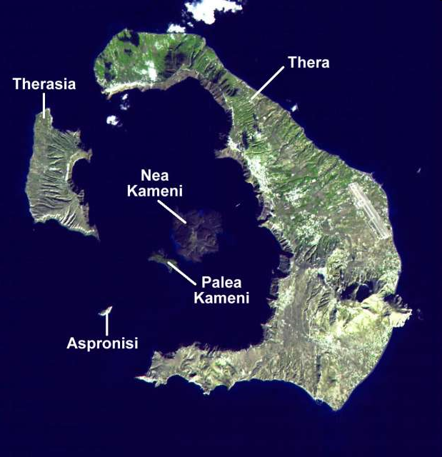

Slide 23
Egypt: Middle Kingdom (2040-1782)
Nomes and Nomarchs

Slide 24
Egyptian Writing
Key Terms
Rosetta Stone
Rosetta Stone

Slide 25
Hieratic

Slide 26
Egyptian Religion
Key Terms
Re
Osiris
ka
Gods
Priests
Afterlife

Slide 27
The Hyksos Invasion
Key Terms
Hyksos

Slide 28
The Third Dynasty of Ur c. 2112-2004 BCE
Ethnic and Intellectual Constituents
Ur-Namma
Administration
The Fall of Ur
Key Terms
Third Dynasty of Ur
ziggurat

Slide 29
Ziggurat at Ur

Slide 31
Old Babylonian Empire c. 1894-1595 BCE
Origins
Hammurabi (1792-1750)
Key Terms
Hammurabi

Slide 33
Excerpts of Hammurabi’s Code
If a man has accused another of laying a kišpu (spell) upon him, but has not proved it, the accused shall go to the sacred river, he shall plunge into the sacred river, and if the sacred river shall conquer him, he that accused him shall take possession of his house. If the sacred river shall show his innocence and he is saved, his accuser shall be put to death. He that plunged into the sacred river shall appropriate the house of him that accused him.
If a man has borne false witness in a trial, or has not established the statement that he has made, if that case be a capital trial, that man shall be put to death.
If a fire has broken out in a man’s house and one who has come to put it out has coveted the property of the householder and appropriated any of it, that man shall be cast into the self-same fire.
If a man has caused the finger to be pointed at a votary, or a man’s wife, and has not justified himself, that man shall be brought before the judges, and have his forehead branded.
If a man’s wife is caught lying with another, they shall be strangled and cast into the water. If the wife’s husband would save his wife, the king can save his servant.
If a man’s wife has been accused by her husband, and has not been caught lying with another, she shall swear her innocence, and return to her house.

Slide 34
More excerpts…
If a man’s wife has the finger pointed at her on account of another, but has not been caught lying with him, for her husband’s sake she shall plunge into the sacred river.
If a man has determined to divorce a concubine who has borne him children, or a votary who has granted him children, he shall return to that woman her marriage-portion, and shall give her the usufruct of field, garden, and goods, to bring up her children. After her children have grown up, out of whatever is given to her children, they shall give her one son’s share, and the husband of her choice shall marry her.
If a man has divorced his wife, who has not borne him children, he shall pay over to her as much money as was given for her bride-price and the marriage-portion which she brought from her father’s house, and so shall divorce her. If there was no bride-price, he shall give her one mina of silver, as a price of divorce. If he be a plebeian, he shall give her one third of a mina of silver.
If a man’s wife, living in her husband’s house, has persisted in going out, has acted the fool, has wasted her house, has belittled her husband, he shall prosecute her. If her husband has said, “I divorce her,” she shall go her way; he shall give her nothing as her price of divorce. If her husband has said, “I will not divorce her,” he may take another woman to wife; the wife shall live as a slave in her husband’s house.
If a woman has hated her husband and has said, “You shall not possess me,” her past shall be inquired into, as to what she lacks. If she has been discreet, and has no vice, and her husband has gone out, and has greatly belittled her, that woman has no blame, she shall take her marriage-portion and go off to her father’s house. If she has not been discreet, has gone out, ruined her house, belittled her husband, she shall be drowned.

Slide 35
…and a few more…
If a man has married a votary, and that votary has given a maid to her husband, and so caused him to have children, and, if that man is inclined to marry a concubine, that man shall not be allowed to do so, he shall not marry a concubine.
If a man has married a votary, and she has not granted him children, and he is determined to marry a concubine, that man shall marry the concubine, and bring her into his house, but the concubine shall not place herself on an equality with the votary.
If a man has married a votary, and she has given a maid to her husband, and the maid has borne children, and if afterward that maid has placed herself on an equality with her mistress, because she has borne children, her mistress shall not sell her, she shall place a slave-mark upon her, and reckon her with the slave-girls. If she has not borne children, her mistress shall sell her.
If a son has struck his father, his hands shall be cut off.
If a man has knocked out the eye of a patrician, his eye shall be knocked out. If he has broken the limb of a patrician, his limb shall be broken.
If he has knocked out the eye of a plebeian or has broken the limb of a plebeian, he shall pay one mina of silver.
If he has knocked out the eye of a patrician’s servant, or broken the limb of a patrician’s servant, he shall pay half his value.
If a patrician has knocked out the tooth of a man that is his equal, his tooth shall be knocked out.
If he has knocked out the tooth of a plebeian, he shall pay one-third of a mina of silver.

Slide 36
Mesopotamian Culture
The Supremacy of Marduk
Old Babylonian Literature
Key Terms
Marduk
epic

Slide 37
The Epic of Gilgamesh
What is an epic?
An epic has three main elements:
A long narrative poem that embodies the values of a culture.
A hero
A journey
A homecoming

Slide 38
The Enuma Elish

Slide 39
Excerpts from the Enuma Elish
They strove in single combat, locked in battle. The lord spread out his net to enfold her, The Evil Wind, which followed behind, he let loose in her face. When Tiamat opened her mouth to consume him, He drove in the Evil Wind while as yet she had not shut her lips As the terrible winds filled her belly, Her body was distended and her mouth was wide open.
He released the arrow, it tore her belly, It cut through her insides, splitting the heart. Having thus subdued her, he extinguished her life. He cast down her carcass to stand upon it. After he had slain Tiamat, the leader, Her band was shattered, her troupe broken up;

Slide 40
Then the lord paused to view her dead body, That he might divide the form and do artful works. He split her like a shellfish into two parts: Half of her he set up as a covering for heaven, Pulled down the bar and posted guards. He bade them to allow not her waters to escape. He constructed stations for the great gods, Fixing their astral likenesses as the stars of the Zodiac.
He determined the year and into sections he divided it; He set up three constellations for each of the twelve months. After defining the days of the year by means of heavenly figures, He founded the station of the pole star [Nebiru] to determine their bounds, That none might err or go astray. …In her belly he established the zenith. The Moon he caused to shine, entrusting the night to him. He appointed him a creature of the night to signify the days, And marked off every month, without cease, by means of his crown. … Making the mist smoke, piling up . . . These he planned himself, took into his own hand. Putting her head into position he formed thereon the mountains, Opening the deep which was in flood, He caused to flow from her eyes the Euphrates and Tigris, Stopping her nostrils he left . . . , He formed from her breasts the lofty mountains, Therein he drilled springs for the wells to carry off the water.

Slide 41
Indo-Iranian Migrations

Slide 42
Oxus Civilization (c. 2200-1800)
Characteristics
Connection to the Indo-Iranians
Key Terms
Bactria-Margiana Archaeological Complex

Slide 46
Ancient China
Xia Dynasty (c.2100-1600)
Legend
History
Key Terms
Yu the Great
Sima Qian

Slide 48
Erlitou

