Slide 1
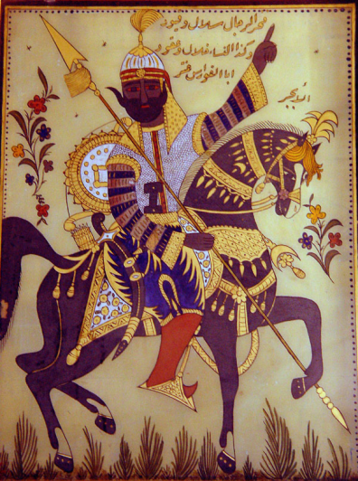
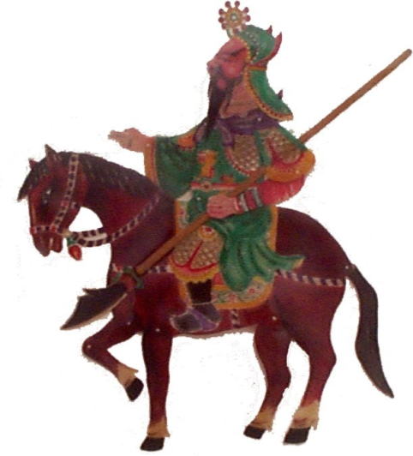
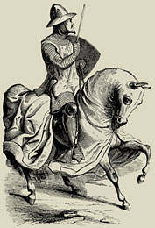
The Iron Age
  1200-500 BCE

Slide 2
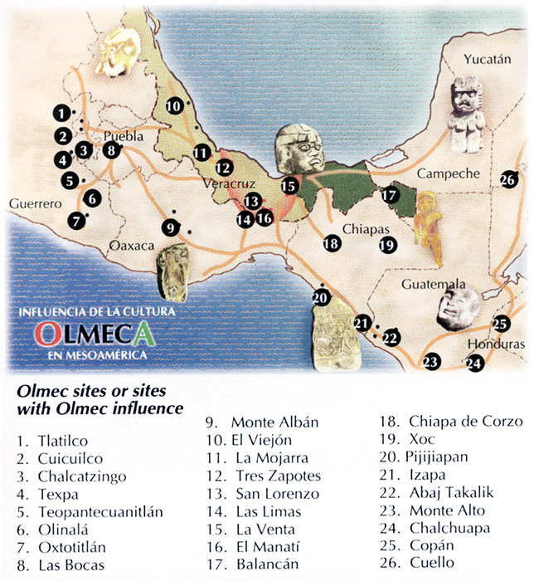
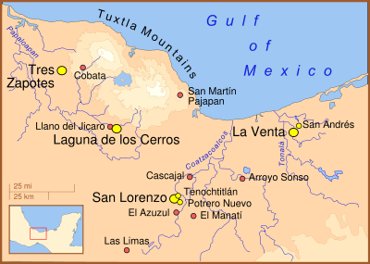
The Olmecs
(c. 1200-600 BCE)
Society
Art
Key Terms
Olmecs

Slide 3
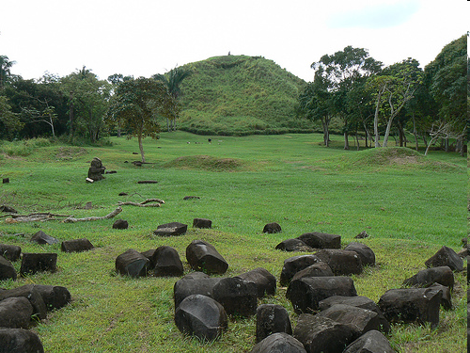
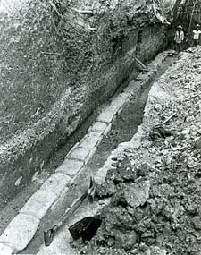
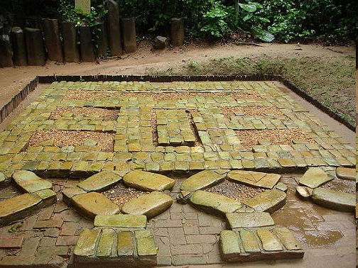
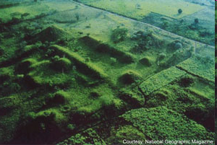

Slide 4
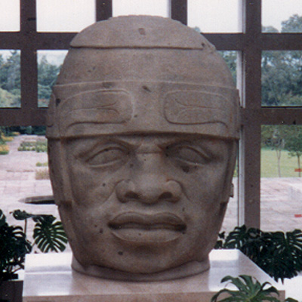
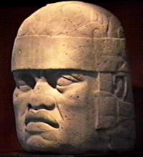
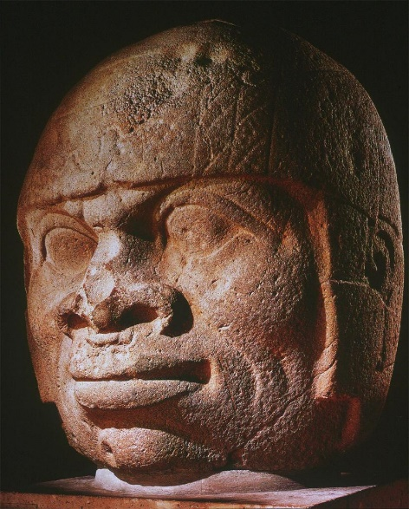
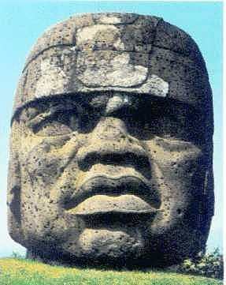
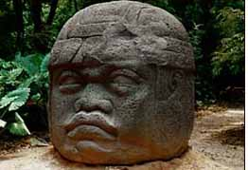

Slide 5
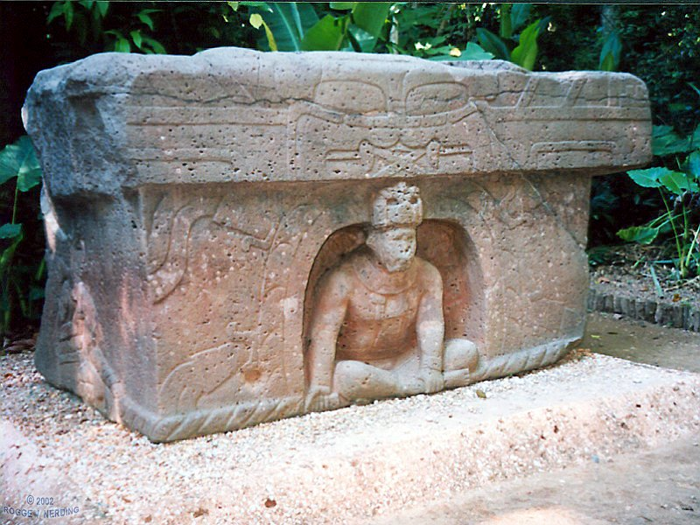
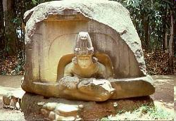
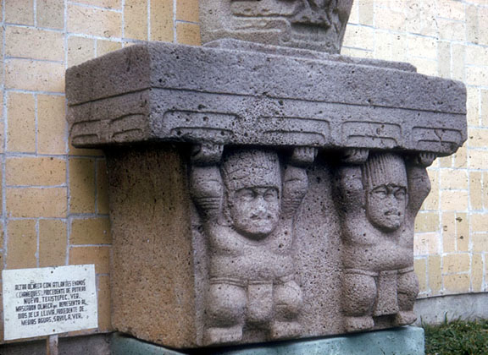
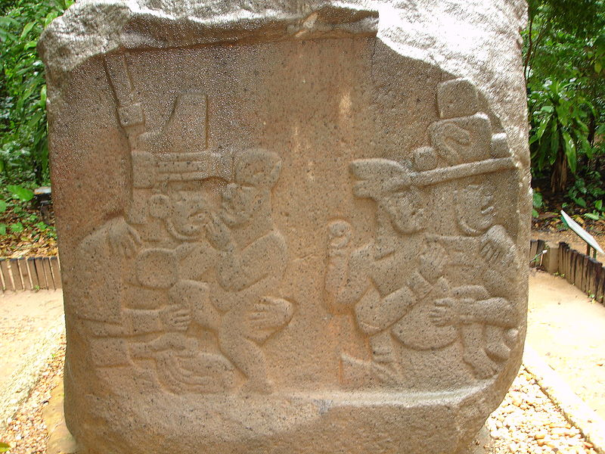

Slide 6
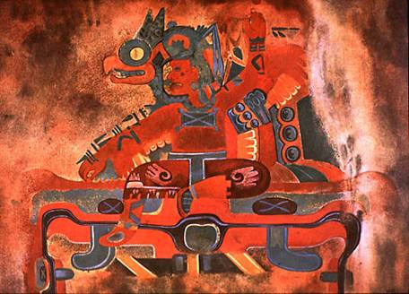

Slide 7
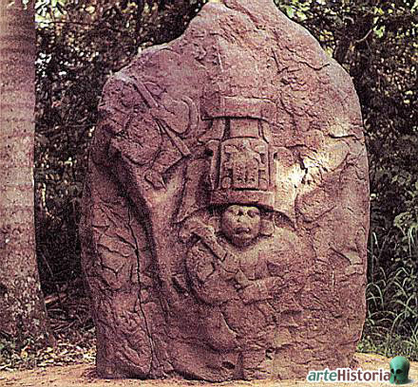
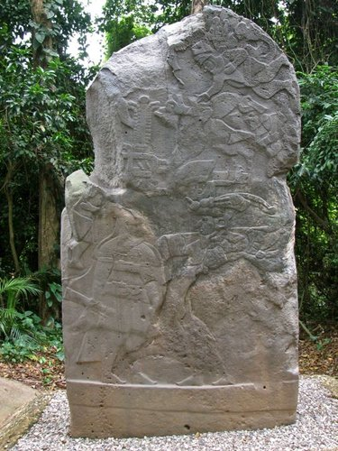

Slide 8
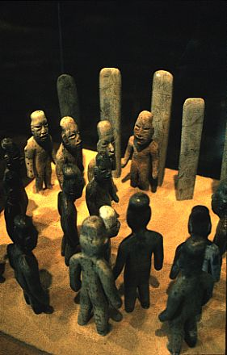
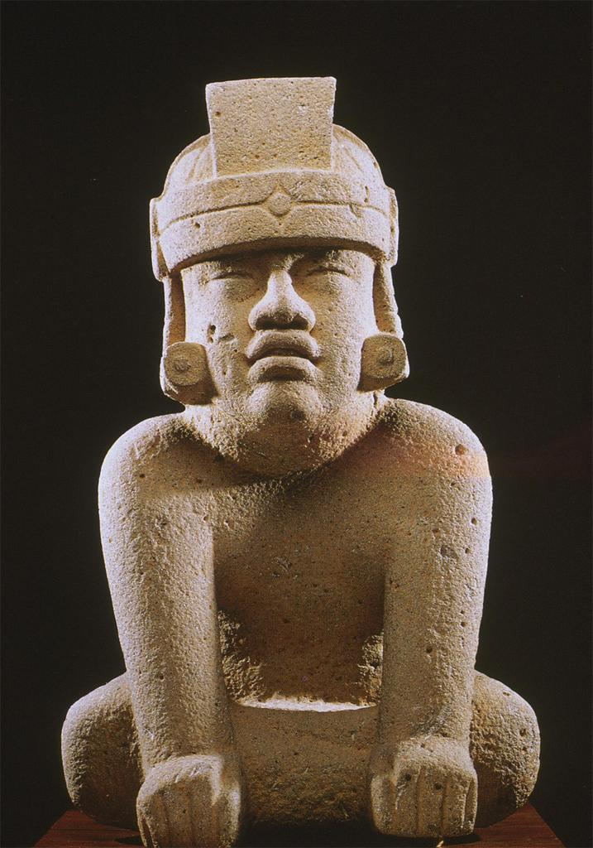
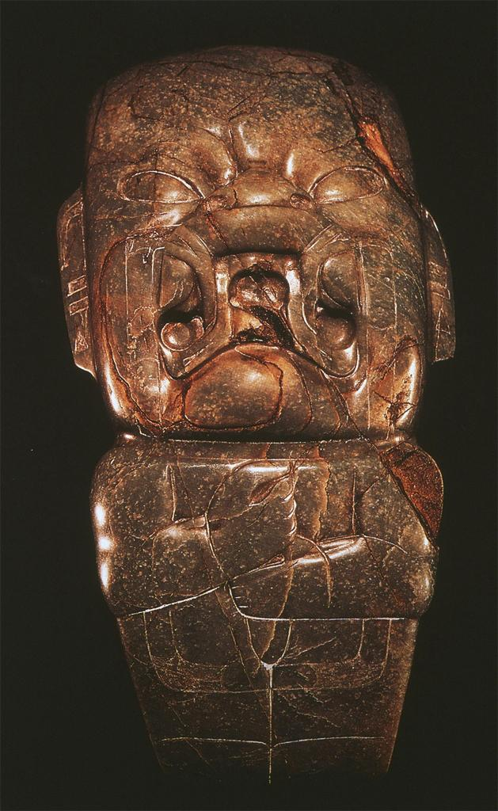
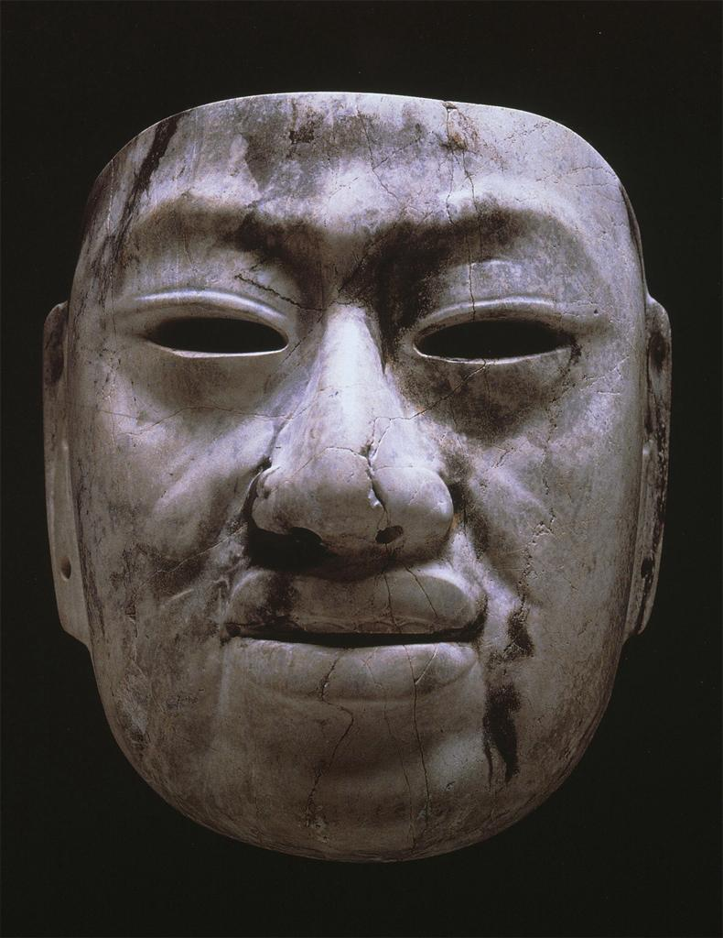
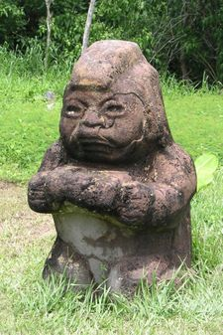
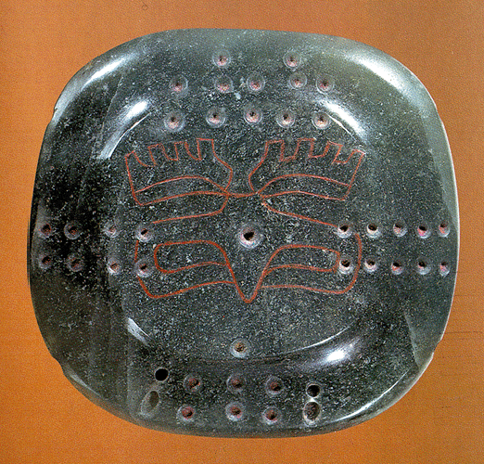

Slide 9
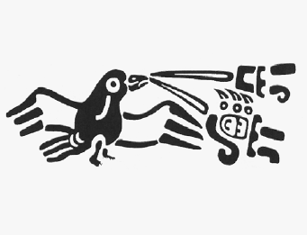
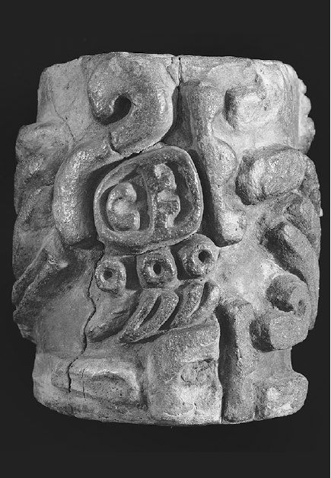
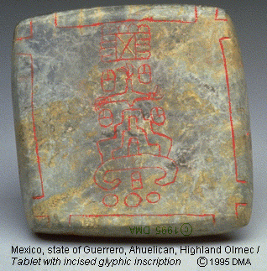
The Olmecs (cont’d)
Writing and Calendar

Slide 10
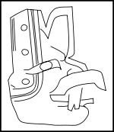
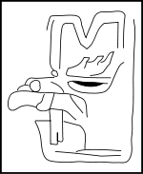
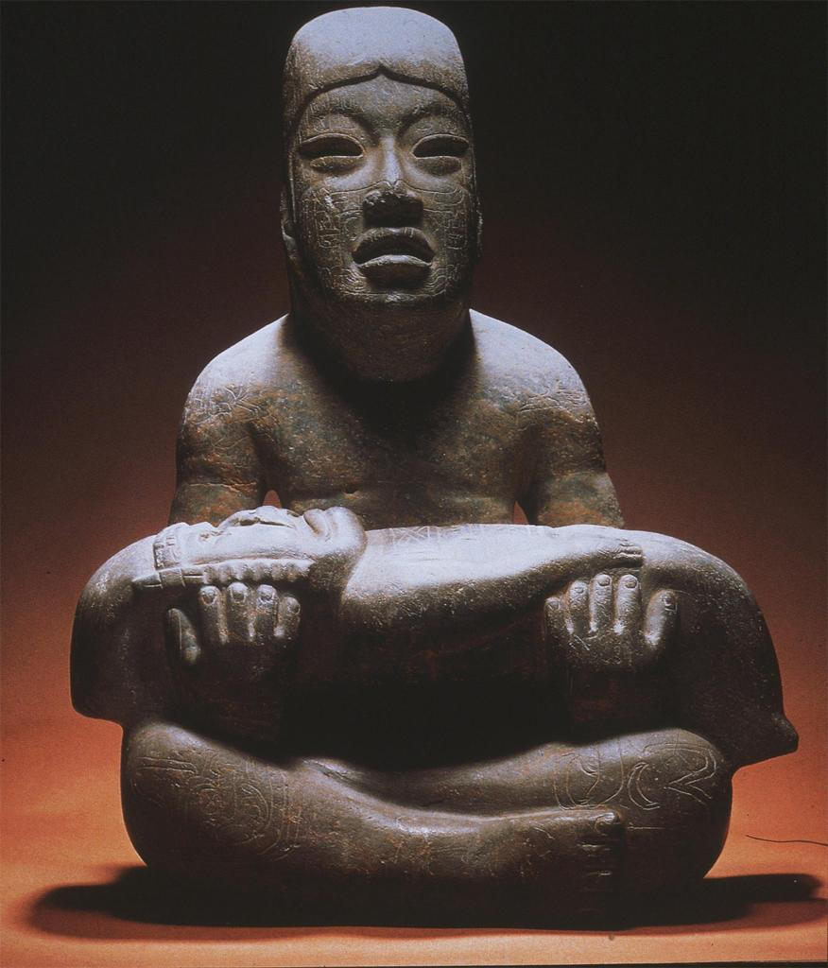
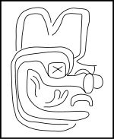
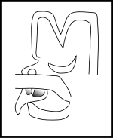
The Olmecs (cont’d)
Religion

Slide 11
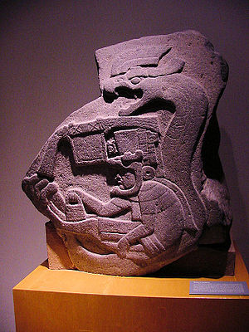
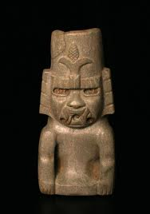
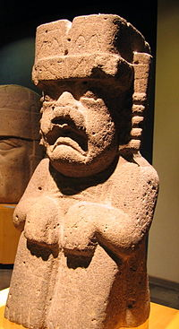
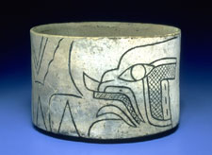
Maize God
Feathered Serpent
Water God
Banded-Eye God

Slide 12
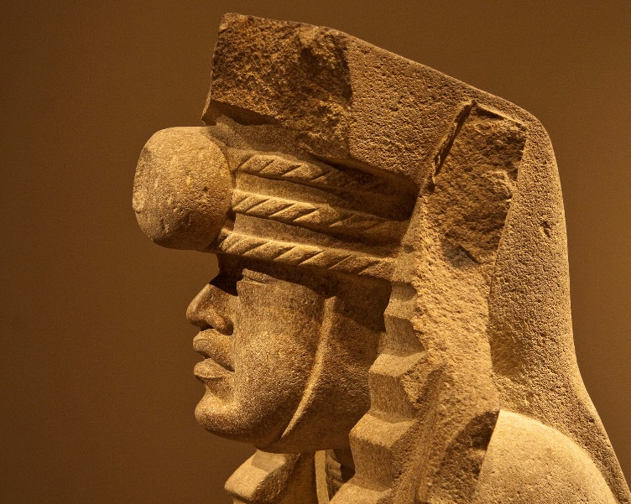
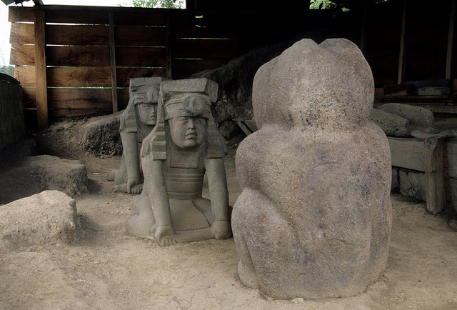
The “El Azuzul Twins” (San Lorenzo)

Slide 13
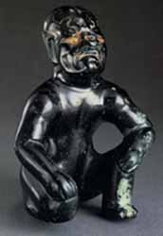
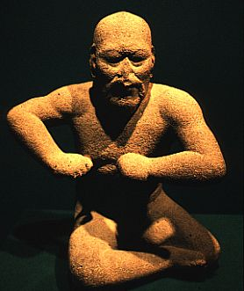
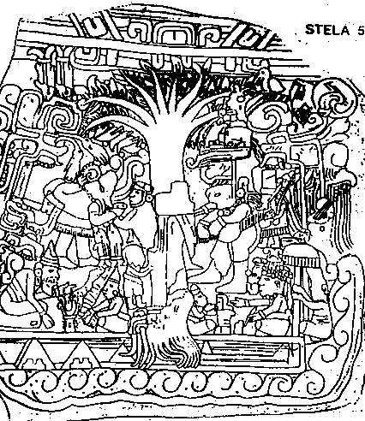
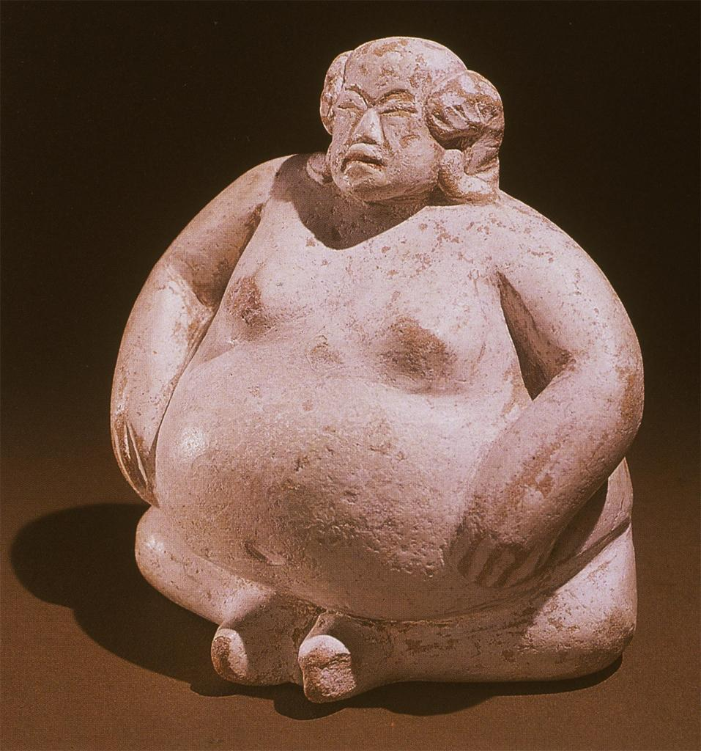

Slide 14
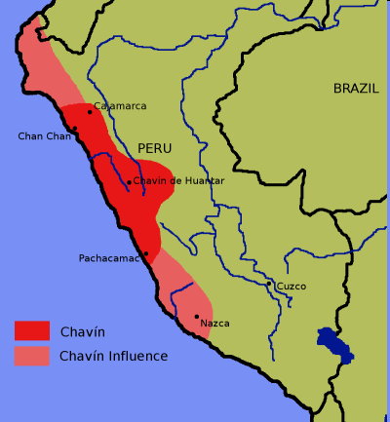
The Chavín Culture
(c. 900-200 BCE)
Art and Architecture
Society
Religion
Key Terms
Chavín

Slide 15
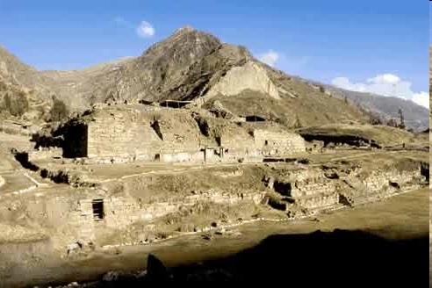
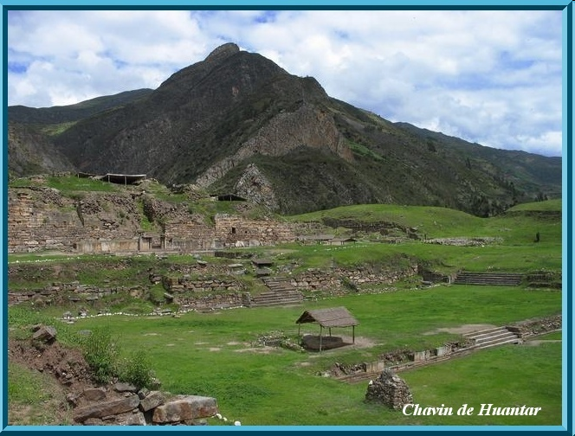
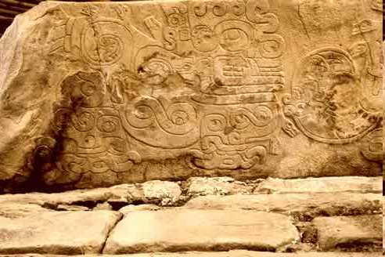
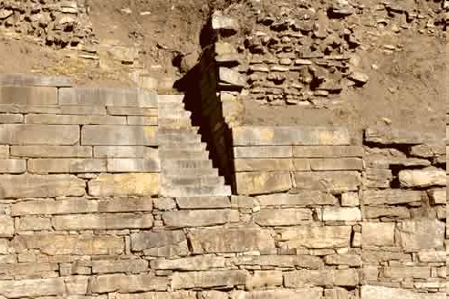

Slide 16




Slide 17


Slide 18




Slide 19


Slide 20





Slide 21

The Greek Dark Age
(c. 1050-900 BCE)
Way of Life
Homer and the Bardic Tradition
Key Terms
Homer

Slide 22
The Greek Dark Age
(cont’d)
The Epic Cycle
  The Cypria by Stasinus
  The Iliad by Homer
  The Aethiopus by Arctinus
  The Little Iliad by Lesches
  The Sack of Ilium by Arctinus
  The Returns by Hegias
  The Odyssey by Homer
  The Telegonia by Eugammon
Social Values and Ethics of the Poems

Slide 23


The Greek “Renaissance”
(c. 900-750 BCE)
Aristocratic Rule
Panhellenism
Writing and the Invention of the Alphabet

Slide 24


Greek Archaic Period
(c. 750-500 BCE)
The Rise of the Polis
Solon of Athens (594-560)
Invention of Democracy in Athens (510)
Key Terms
polis
miasma
Cleisthenes

Slide 25


The Neo-Assyrian Empire
(934-609 BCE)
The Assyrian Military
Growth
  Tiglath-pileser III (745-727)
Political Structure
Culture
Fall (627-609)
Key Terms
Tiglath-pileser III

Slide 26


Slide 27







Slide 28


Slide 29





Slide 30

The Neo-Babylonian Empire
(609-538 BCE)
Revolt against Assyria
Nebuchadnezzar II (605-562)
Culture
The Fall of Babylon
Key Terms
Nebuchadnezzar II
An engraving inside an onyx-stone-eye
in a Marduk statue that might depict Nebuchadrezzar II

Slide 31


Slide 32






Slide 33


Slide 34

Ancient Israel
Premonarchic Period (c. 1200-1020 BCE)
  The Advent of Israel
    The Mycenaean Migrations
    Merneptah Stela
    The Song of Deborah
    The Song of the Sea
  Canaanite Culture vs. Israelite Culture
Key Terms
Sea Peoples
’El
Hadad (Baal)
Yahweh

Slide 35


Slide 36



Slide 37





Slide 38

Ancient Israel (cont’d)
The United Monarchy (c. 1020-934 BCE)
  Saul
  David
  Solomon
Key Terms
David

Slide 39


Slide 40

Ancient Israel (cont’d)
The Divided Monarchy (934-720 BCE)
  Northern Kingdom = Israel/Ephraim
  Southern Kingdom = Judah
  Secession of the North
  Northern Kings
    Omri (886-874) and Ahab (874-853)
    Jehu (841-814)
  Assyria conquers Israel (722-720)
Key Terms
Jeroboam

Slide 41


Slide 42

Ancient Israel (cont’d)
Judah Alone (720-586 BCE)
  Hezekiah (726-697)
  Josiah (640-609)
    Reforms
    Assyria falls to Babylon in 612
Key Terms
Josiah

Slide 43
Laws from Ancient Judah
"I am the LORD your God, who brought you out of the land of Egypt, out of the house of bondage.
"You shall have no other gods before me.
"You shall not make for yourself a graven image, or any likeness of anything that is in heaven above, or that is on the earth beneath, or that is in the water under the earth;
you shall not bow down to them or serve them; for I the LORD your God am a jealous God, visiting the iniquity of the fathers upon the children to the third and fourth generation of those who hate me, but showing steadfast love to thousands of those who love me and keep my commandments.
"You shall not take the name of the LORD your God in vain: for the LORD will not hold him guiltless who takes his name in vain.
"Observe the sabbath day, to keep it holy, as the LORD your God commanded you.
Six days you shall labor, and do all your work; but the seventh day is a sabbath to the LORD your God; in it you shall not do any work, you, or your son, or your daughter, or your manservant, or your maidservant, or your ox, or your ass, or any of your cattle, or the sojourner who is within your gates, that your manservant and your maidservant may rest as well as you. You shall remember that you were a servant in the land of Egypt, and the LORD your God brought you out thence with a mighty hand and an outstretched arm; therefore the LORD your God commanded you to keep the sabbath day.
"Honor your father and your mother, as the LORD your God commanded you; that your days may be prolonged, and that it may go well with you, in the land which the LORD your God gives you.
"You shall not kill.
"Neither shall you commit adultery.
"Neither shall you steal.
"Neither shall you bear false witness against your neighbor.
"Neither shall you covet your neighbor's wife; and you shall not desire your neighbor's house, his field, or his manservant, or his maidservant, his ox, or his ass, or anything that is your neighbor's."

Slide 44
Laws from Ancient Judah
A single witness shall not prevail against a man for any crime or for any wrong in connection with any offense that he has committed; only on the evidence of two witnesses, or of three witnesses, shall a charge be sustained. (Deut 19:15)
There shall not be found among you any one who burns his son or his daughter as an offering, any one who practices divination, a soothsayer, or an augur, or a sorcerer, or a charmer, or a medium, or a wizard, or a necromancer. (Deut 18:10-11)
When you draw near to a city to fight against it, offer terms of peace to it. And if its answer to you is peace and it opens to you, then all the people who are found in it shall do forced labor for you and shall serve you. But if it makes no peace with you, but makes war against you, then you shall besiege it; and when the LORD your God gives it into your hand you shall put all its males to the sword, but the women and the little ones, the cattle, and everything else in the city, all its spoil, you shall take as booty for yourselves; and you shall enjoy the spoil of your enemies, which the LORD your God has given you. Thus you shall do to all the cities which are very far from you, which are not cities of the nations here. But in the cities of these peoples that the LORD your God gives you for an inheritance, you shall save alive nothing that breathes, but you shall utterly destroy them, the Hittites and the Amorites, the Canaanites and the Perizzites, the Hivites and the Jebusites, as the LORD your God has commanded; that they may not teach you to do according to all their abominable practices which they have done in the service of their gods, and so to sin against the LORD your God. (Deut 20:10-18)

Slide 45
Laws from Ancient Judah
"If any man takes a wife, and goes in to her, and then spurns her, and charges her with shameful conduct, and brings an evil name upon her, saying, `I took this woman, and when I came near her, I did not find in her the tokens of virginity,' then the father of the young woman and her mother shall take and bring out the tokens of her virginity to the elders of the city in the gate; and the father of the young woman shall say to the elders, `I gave my daughter to this man to wife, and he spurns her; and lo, he has made shameful charges against her, saying, "I did not find in your daughter the tokens of virginity." And yet these are the tokens of my daughter's virginity.' And they shall spread the garment before the elders of the city. Then the elders of that city shall take the man and whip him; and they shall fine him a hundred shekels of silver, and give them to the father of the young woman, because he has brought an evil name upon a virgin of Israel; and she shall be his wife; he may not put her away all his days. But if the thing is true, that the tokens of virginity were not found in the young woman, then they shall bring out the young woman to the door of her father's house, and the men of her city shall stone her to death with stones, because she has wrought folly in Israel by playing the harlot in her father's house; so you shall purge the evil from the midst of you. (Deut 22:13-21)
If there is a betrothed virgin, and a man meets her in the city and lies with her, then you shall bring them both out to the gate of that city, and you shall stone them to death with stones, the young woman because she did not cry for help though she was in the city, and the man because he violated his neighbor's wife; so you shall purge the evil from the midst of you. But if in the open country a man meets a young woman who is betrothed, and the man seizes her and lies with her, then only the man who lay with her shall die. But to the young woman you shall do nothing; in the young woman there is no offense punishable by death, for this case is like that of a man attacking and murdering his neighbor; because he came upon her in the open country, and though the betrothed young woman cried for help there was no one to rescue her. (Deut 22:23-27)
If a man meets a virgin who is not betrothed, and seizes her and lies with her, and they are found, then the man who lay with her shall give to the father of the young woman fifty shekels of silver, and she shall be his wife, because he has violated her; he may not put her away all his days. (Deut 22:28-29)
When a man takes a wife and marries her, if then she finds no favor in his eyes because he has found some indecency in her, and he writes her a bill of divorce and puts it in her hand and sends her out of his house, and she departs out of his house, and if she goes and becomes another man's wife, and the latter husband dislikes her and writes her a bill of divorce and puts it in her hand and sends her out of his house, or if the latter husband dies, who took her to be his wife, then her former husband, who sent her away, may not take her again to be his wife, after she has been defiled; for that is an abomination before the LORD, and you shall not bring guilt upon the land which the LORD your God gives you for an inheritance. (Deut 24:1-4)

Slide 46
Ancient Israel (cont’d)
The Exile (586-538 BCE)
  Judahite nobles taken to Babylon
  Migration to Egypt
  Fall of Babylon to Persia (Cyrus the Great) in 539

Slide 47
The Covenants of the Bible
Definition and Types
  Covenant of Divine Commitment: Promissory, Unconditional
    Ancient Near Eastern Parallel: Treaties of Grant
  Covenant of Human Obligation: Obligatory, Conditional
    Ancient Near Eastern Parallel: Suzerainty Treaties
The Noahic Covenant (Gen 9:8-17)
The Abrahamic Covenant (Gen 15 and 17)
The Sinai Covenant (Deuteronomy)
The Davidic Covenant (2 Sam 7; Psalm 132)
Key Terms
covenant
Davidic Covenant

Slide 48
How the Covenants Work Together
Davidic
Sinai
Abrahamic

Slide 49
Prophets
Prophet as Custodian of Covenant and Community
Experience of the Prophet
Partner Prophets and Prophetic Guilds
Change in the Focus of Prophecy in the Exile
Tests of True Prophecy

Slide 50


Later Vedic Culture
(c. 1200-600 BCE)
New Territory
The Rise of a Powerful Monarchy
Social Conditions
  Caste
  Status of Women
Early Religious Developments
  Rise of the Brahmins
  Prajapati and Vishnu
  dharma
  The Vedas
Key Terms
Vishnu
avatar
dharma
Vedas

Slide 51

Later Vedic Culture
(cont’d)
Development of Writing
  Brahmi Script
  Sanskrit and Prakrits
Education
New Religious Philosophies
  The Upanishads
  Brahman and atman
  samsara and moksha
  karma
Stages of Life
Key Terms
Upanishads
Brahman
samsara
karma

Slide 52


Later Vedic Culture
(cont’d)
Later Literature
  Ramayana
  Mahabharata
  The Puranas
Key Terms
Ramayana
Mahabharata

Slide 53


Later Vedic Culture
(cont’d)
Literature (cont’d)
  Bhagavad Gita
Key Terms
Bhagavad Gita

Slide 54

Zhou China (1045-256 BCE)
Zhou Conquest of the Shang
Divisions of the Zhou Dynasty
  Western Zhou (1045-770)
  Eastern Zhou (770-256)
    Spring and Autumn Period (770-481)
    Warring States Period (481-221)

Slide 55


1045-770 BCE
770-256 BCE

Slide 56

Zhou China (cont’d)
Western Zhou Period (1045-770)
  The Duke of Zhou and the Mandate of Heaven
  Written Sources
  Concerns of Women
  Ancestor Worship
Key Terms
Mandate of Heaven

Slide 57





Slide 58





Slide 59

Zhou China (cont’d)
Spring and Autumn Period (770-481)
  The Weakening of the King
  Double Ears (636-628)
  Confucius (551-479)
    Li and Ren
    Filial Piety
    View of Rulership
Key Terms
Confucius

Slide 60



Slide 61



