Slide 1
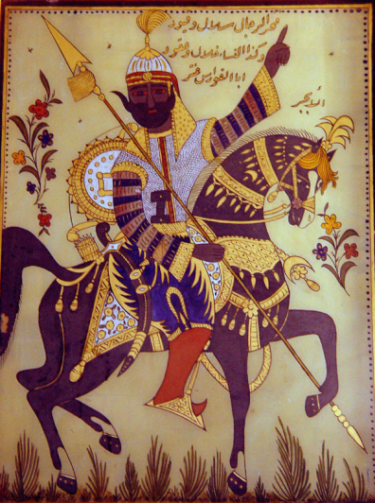
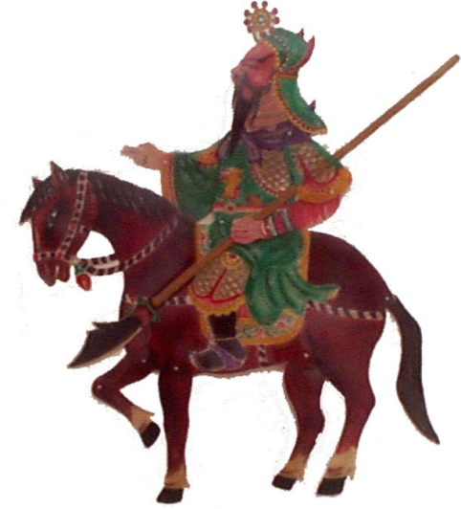
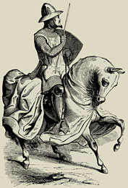
The Early Classical Period
500-200 BCE

Slide 2
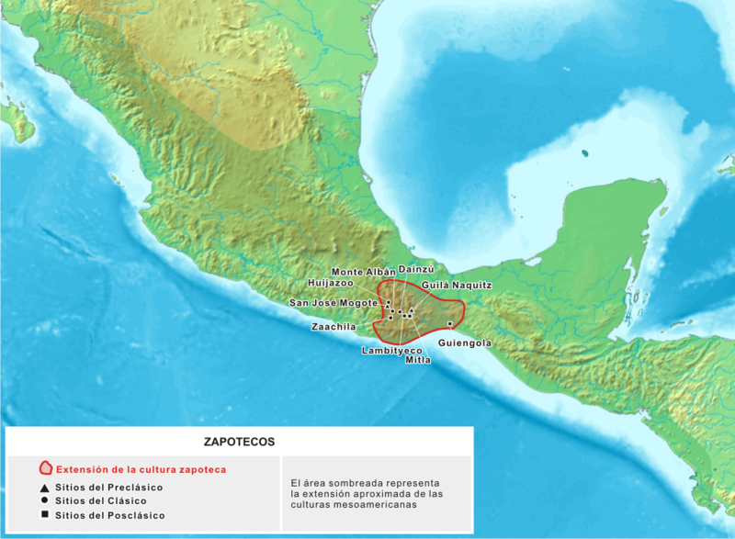
Zapotec Civilization (400 BCE-200 CE)
The Valley of Oaxaca
Government
Writing
Religion
Key Terms
Zapotecs

Slide 3
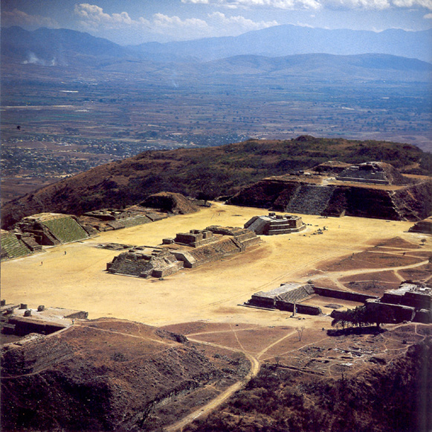
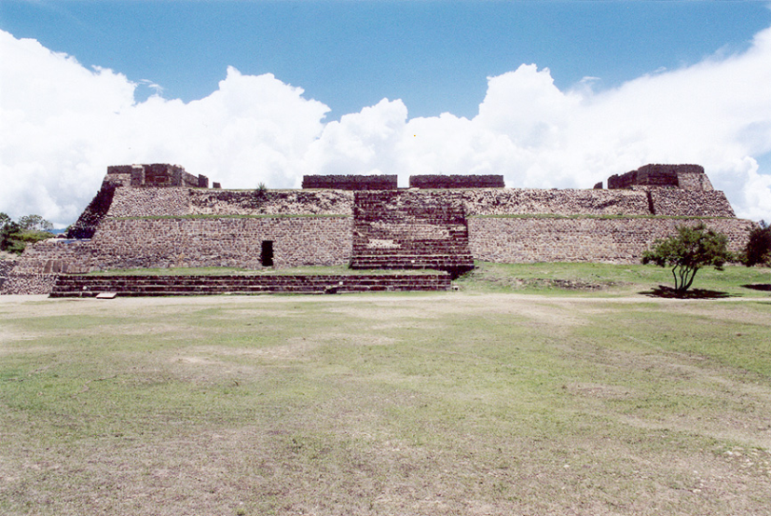
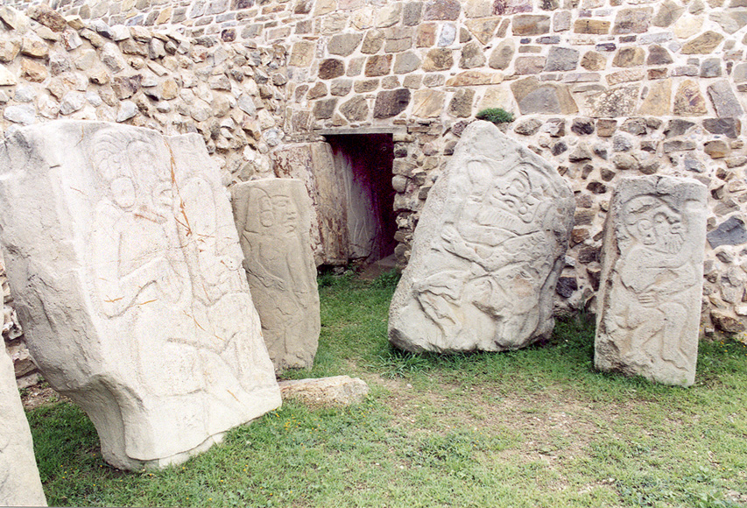
Monte Alban

Slide 4
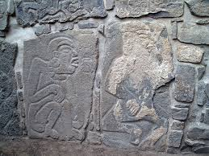
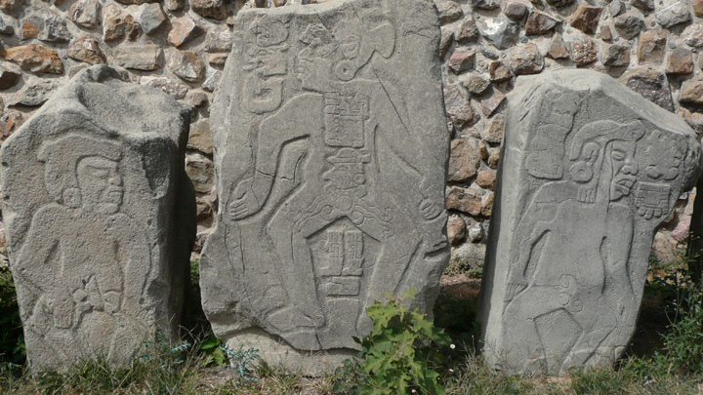

Slide 5
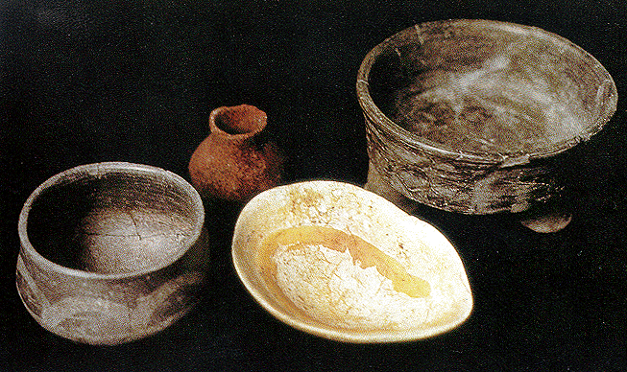
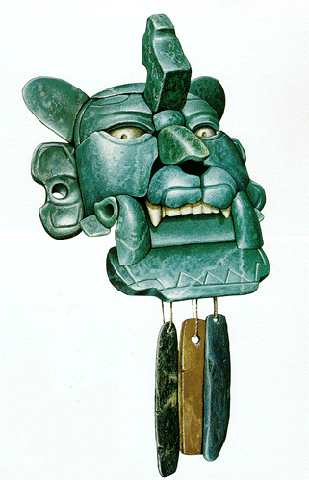
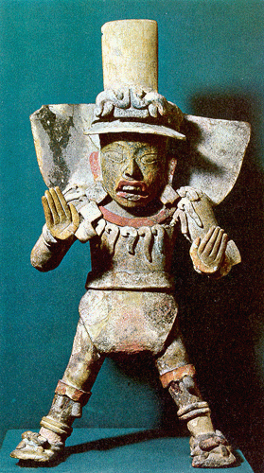
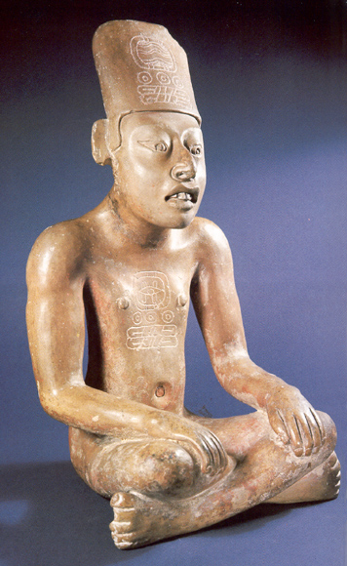
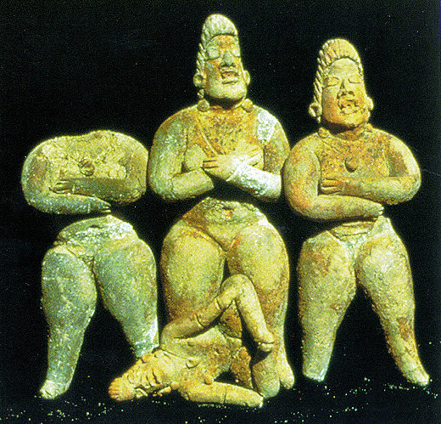

Slide 6
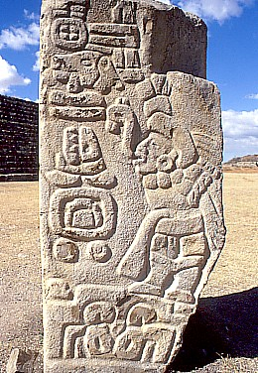
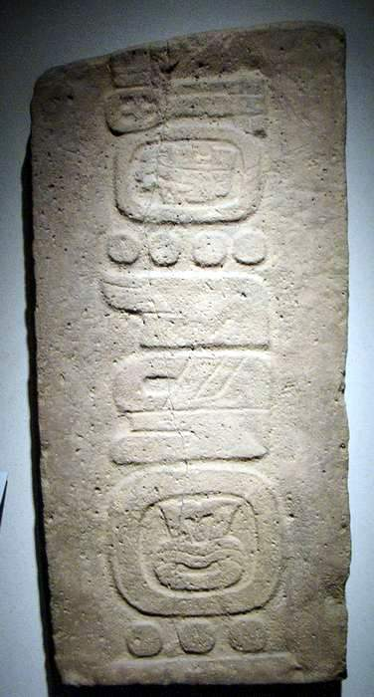
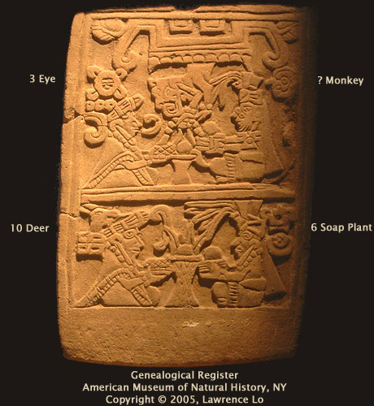

Slide 7
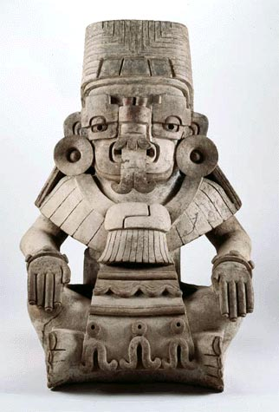
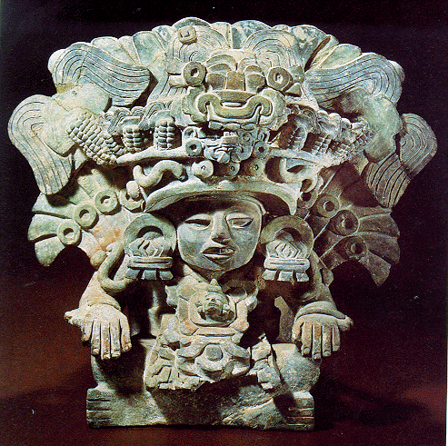
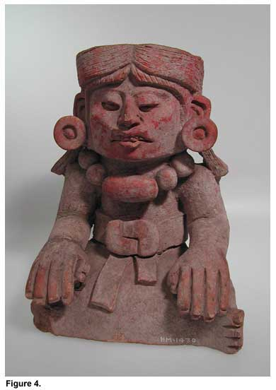
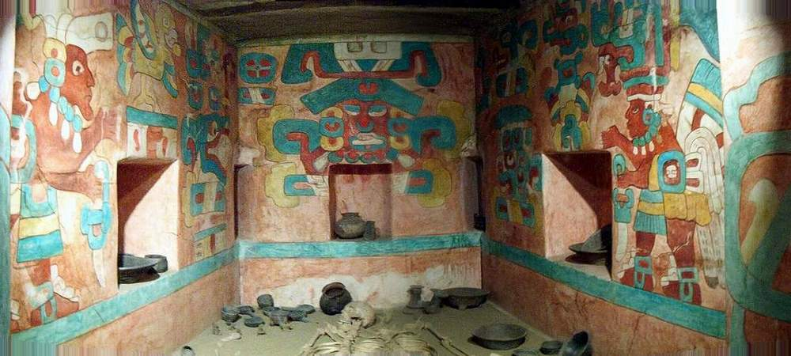
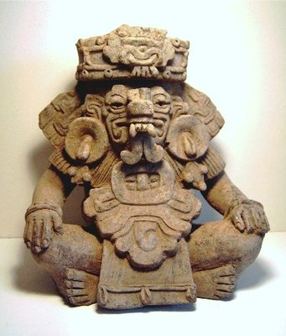

Slide 8
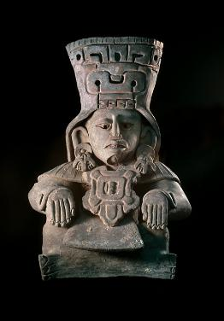
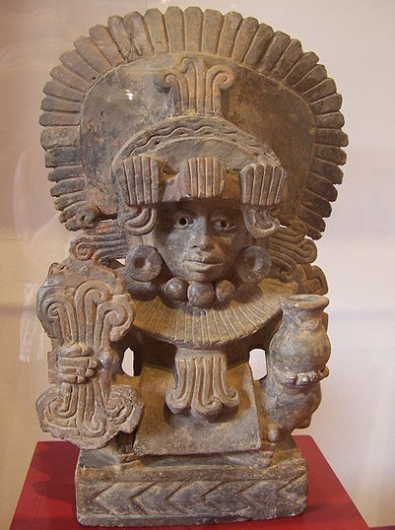
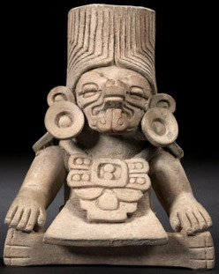
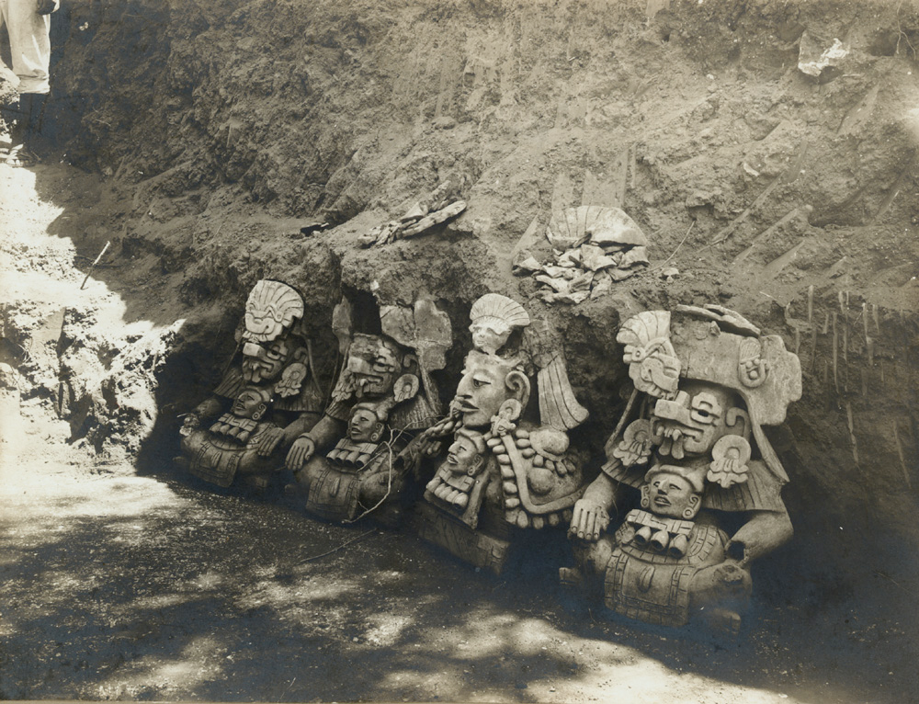
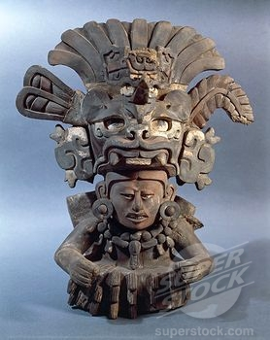

Slide 9
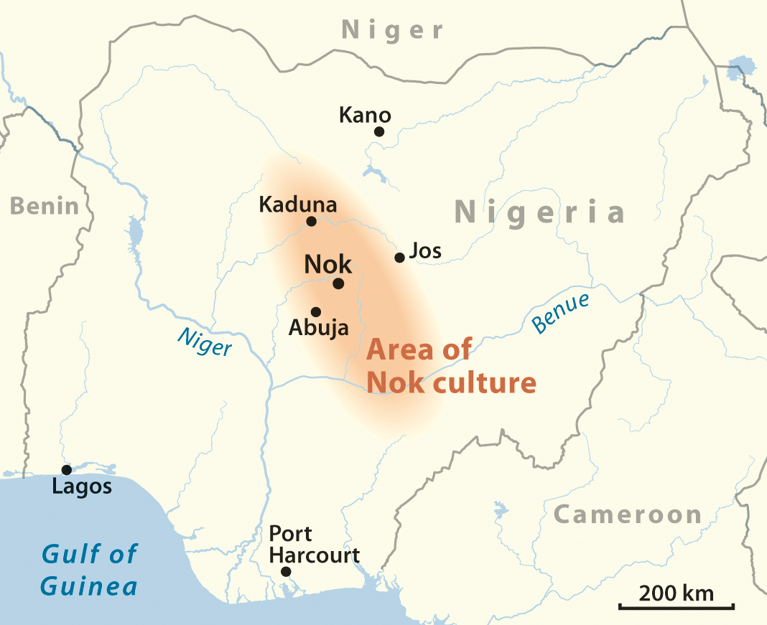
Ancient Africa
Nok Culture (c. 600 BCE to 200 CE)
Key Terms
Nok Culture

Slide 10
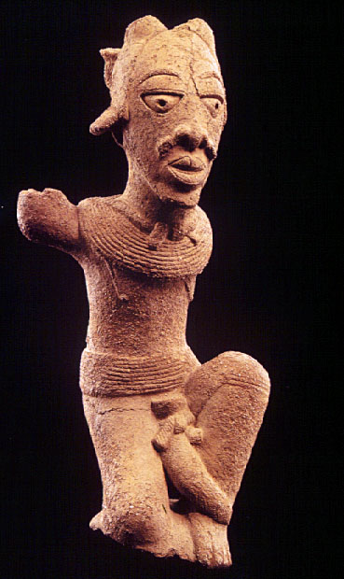
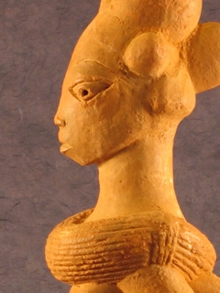
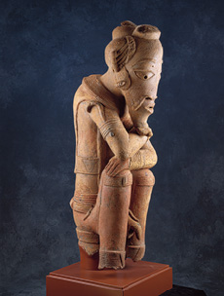
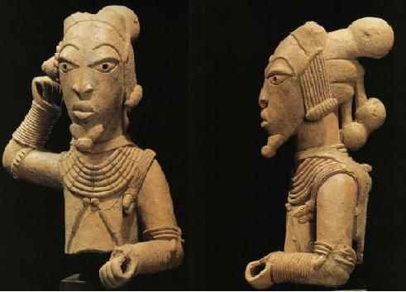
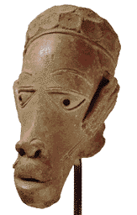
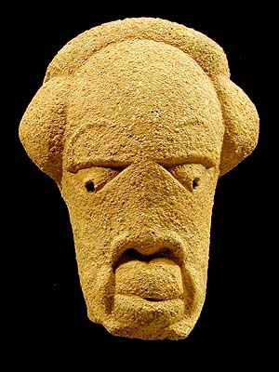
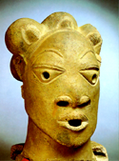

Slide 11
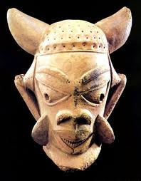
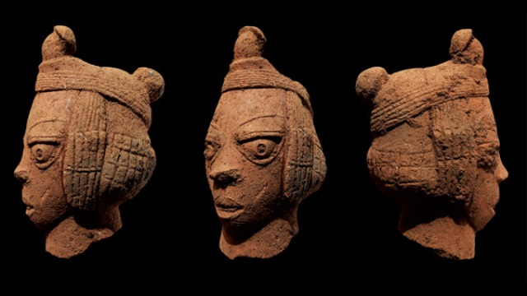
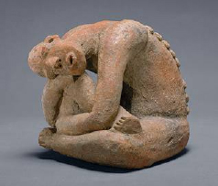
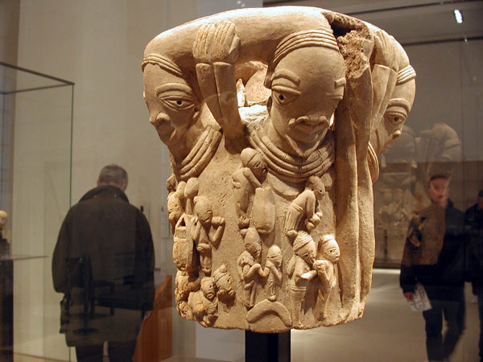
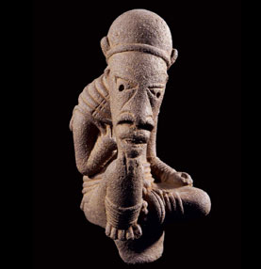
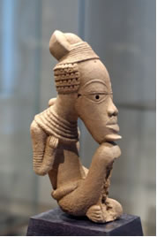

Slide 12
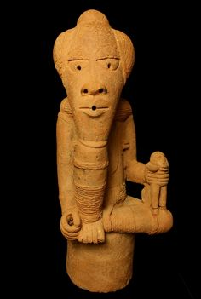
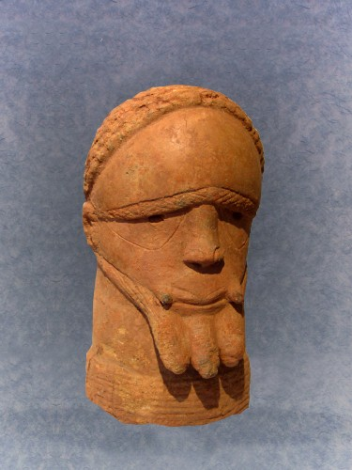
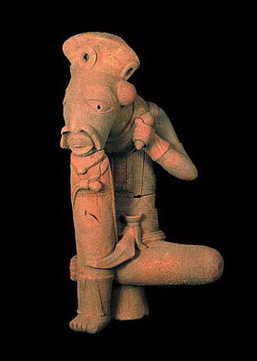
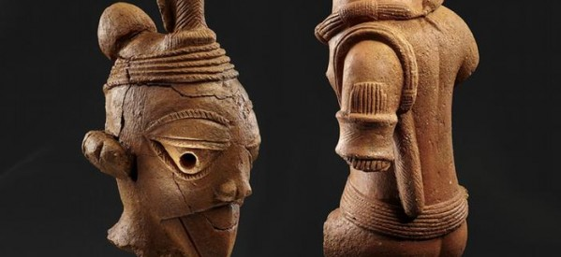

Slide 13
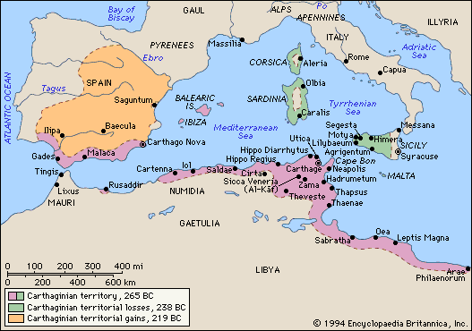
Carthage
Key Terms
Elishat
Hanno Magnus
Foundation
Independence
The Magonids
Hanno Magnus
Constitution
Religion

Slide 14
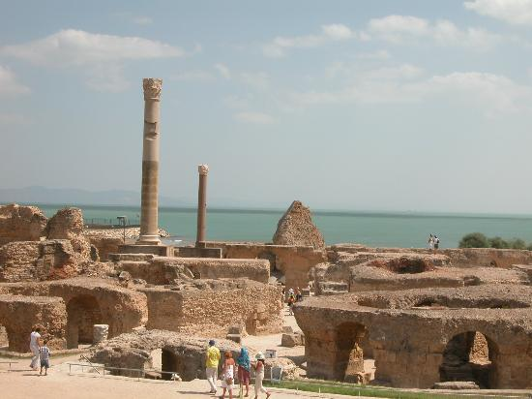
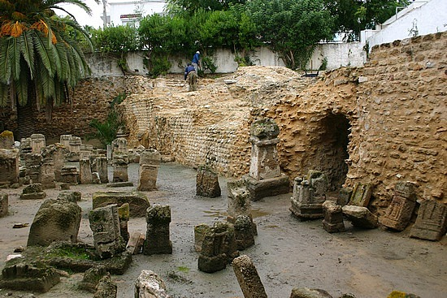

Slide 15
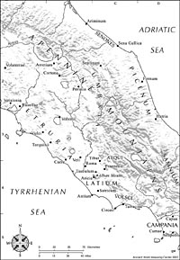
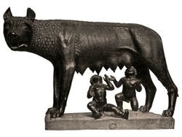
The Roman Republic (509-200 BCE)
Origin
Myth
History
Key Terms
Romulus

Slide 16
The Roman Republic (cont’d)
The Roman Government
Key Terms
consul

Slide 17
The Roman Republic (cont’d)
Roman Imperialism
Great Latin War (340-338)—Latium conquered
Late 4th-early 3rd cent.—Italy conquered
First Punic War (264-241)
Second Punic War (218-201)
Key Terms
Hannibal

Slide 18
The Persians
The Achaemenid Empire (550-420 BC)
Cyrus the Great (559-530)
Cambyses II (530-522)
Darius the Great (521-486)
First War between Persia and Greece
Battle of Marathon (490)
Xerxes the Great (486-465)
Second War between Persia and Greece
Battles of Thermopylae and Salamis (480)
Key Terms
Achaemenid Empire
Cyrus the Great

Slide 22
The Persians (cont’d)
Ancient Persian Religion
Early Religion
Zoroastrianism
Zarathustra (Zoroaster)
The Gathas
God = Ahura Mazda (“Wise Lord”)
Attributes = Amesha-Spentas
Devil = Angra Mainya
Zoroastrian Dualism
Key Terms
Zoroastrianism

Slide 23
The Jews Under Persian Rule
The Postexilic (a.k.a. Persian) Period (538-332 BCE)
Exiles return home
Yehud a Persian province
Beginnings of Judaism
Bible compiled; Torah created
Second Temple constructed in 515

Slide 25
The Hebrew Bible
Key Terms
Torah
Name
Gr. biblion (book) from Byblos; Lat. biblia = books
Parts
Torah (aka Pentateuch, Five Books of Moses)
Prophets (aka Neviim)
2 parts = Former Prophets and Latter Prophets
Writings (aka Hagiography, Ketuvim)
3 parts = Wisdom Literature, Megillot, Historical Books
Primary History = Torah + Former Prophets
Secondary History = 1 + 2 Chronicles, Ezra, Nehemiah

Slide 26
The Hebrew Bible (cont’d)
Canon
Apocrypha
People of the Bible
Hebrews, Israelites, Judahites, Jews, Israelis
Key Terms
canon

Slide 27
The Primary History
Authorship
Rabbinic Tradition: Great figures from the past each contributed their own books to the history.
Moses was the author of the Torah; Joshua wrote Joshua; Samuel wrote Judges & Samuel, Jeremiah wrote Kings.
The Documentary Theory: Every book in the Primary History (except perhaps Leviticus) was composed by a number of authors. The originally separate works of these authors were combined in a series of editorial steps into a continuous, united work.
The full process of composition and editing took approximately six centuries (12th to 5th century BC).

Slide 31
Greek Classical Period (cont’d)
Greek Theater
The Cult of Dionysius and the Origins of Drama
The Golden Age of Greek Theater
Athenian Drama Competitions
How Plays were Performed
Tragedy
Definition
The Three Unities
Aeschylus, Sophocles, Euripides
Comedy
Old Comedy
Aristophanes
New Comedy
Menander
Key Terms
catharsis

Slide 34
The Greek Philosophers
The Early Philosophers
The Sophists
physis (nature) vs. nomos (custom)
Socrates (c. 468-399)
Life
Elenctic Method
Moral and Religious Viewpoints
Trial
Key Terms
Socrates

Slide 35
The Greek Philosophers
Key Terms
Plato
rationalism
empiricism
Plato (c. 428-347)
Life
Works
Dialogues
Theory of Knowledge
rationalism vs. empiricism
Theory of Forms
On the Immortality of the Soul
Platonic dualism
Political Theory

Slide 36
Alexander the Great (336-323)
As a Boy
The Macedonian Army
Alexander’s Greek Conquests (335)
Key Terms
Alexander the Great

Slide 38
Alexander the Great (cont’d)
Alexander Against Persia (334-330)
Alexander in Parthia and Bactria (330-327)
Alexander in India (327-325)
The Road Home (325-323)
Alexander’s Death (323)

Slide 40
The Hellenistic Kingdoms
Battles of Alexander’s Successors

Slide 42
Hellenistic Kingdoms (cont’d)
Characteristics of the Hellenistic Monarchies
General Remarks
Macedonia
Seleucid Empire
Kingdom of the Ptolemies
Key Terms
Seleucid Empire
Kingdom of the Ptolemies

Slide 43
Hellenistic Philosophies
Skepticism
Pyrrho (c. 365-270)
Epicureanism
Epicurus (c. 340-270)
Stoicism
Zeno of Citium (c. 335-263)
Key Terms
Skepticism
Epicureanism
Stoicism

Slide 44
6th Century India
Revolt Against Brahmanical Religion
The Beginnings of Jainism
Mahavira (c. 599-527)
Mahavira’s Teachings
The Beginnings of Buddhism
Siddhartha Gautama (c. 563-483)
Teachings of the Buddha
Impermanence
No-self
Suffering
Key Terms
Mahavira
Siddhartha Gautama

Slide 45
Mauryan India (322-185 BCE)
Chandragupta Maurya (322-298)
vs. the Nandas
vs. the Seleucids
Kautilya, Arthashastra
Pataliputra
Ashoka (268-232)
Kalinga War
ahimsa
Mauryan Decline
Key Terms
Chanakya (Kautilya)
Ashoka

Slide 48
Zhou China (cont’d)
The Warring States Period (481-221 BCE)
Sunzi and The Art of War
Economy
Shang Yang and Legalism
Daoism (philosophical)
The Dao
Wu-wei
Confucian Debate
Mencius vs. Xunzi
Key Terms
legalism
Daoism
Laozi

Slide 51
The First Chinese Empire
Qin Dynasty (221-206 BCE)
Wars of Unification
The Legalist State
Key Terms
Shi Huang Di

