Slide 1
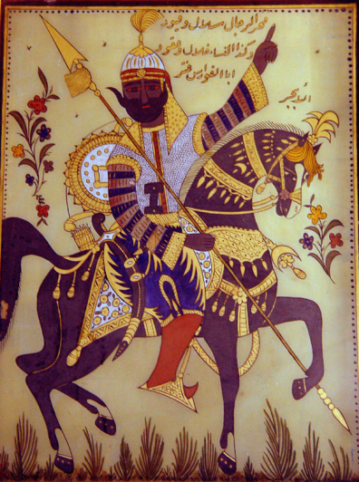
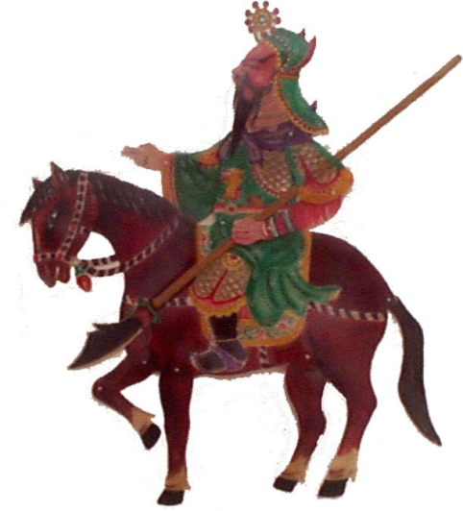
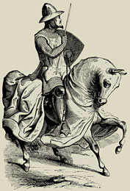
Middle Classical Period
200 BCE – 200 CE

Slide 2
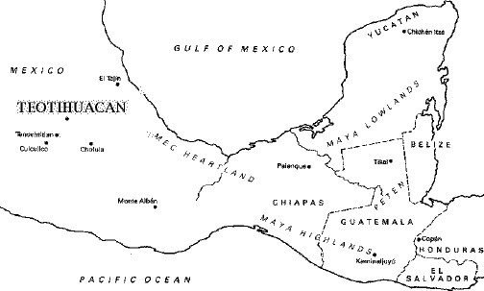
Central America
Teotihuacan (c. 200 BCE-600 CE)
Key Terms
Teotihuacan

Slide 3
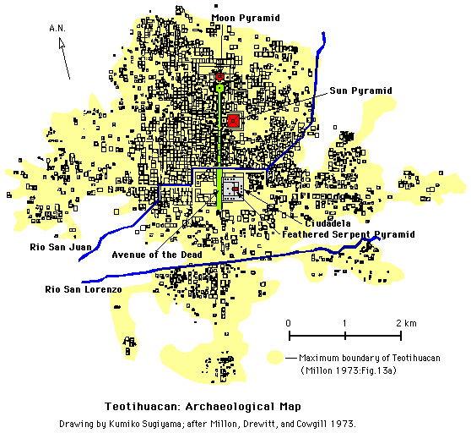
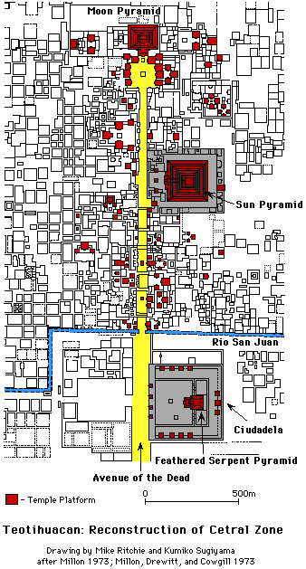

Slide 4
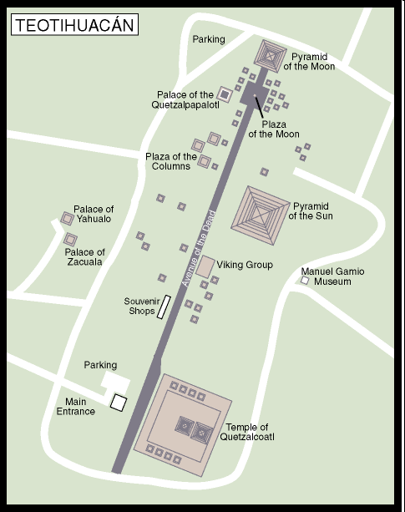
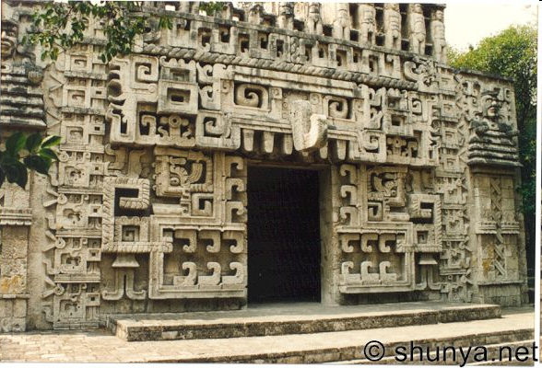
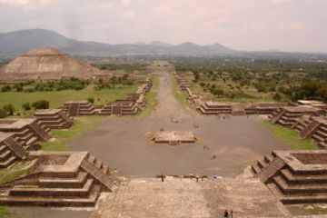

Slide 5
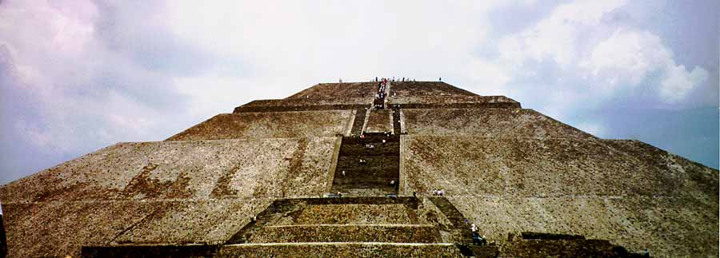

Slide 6
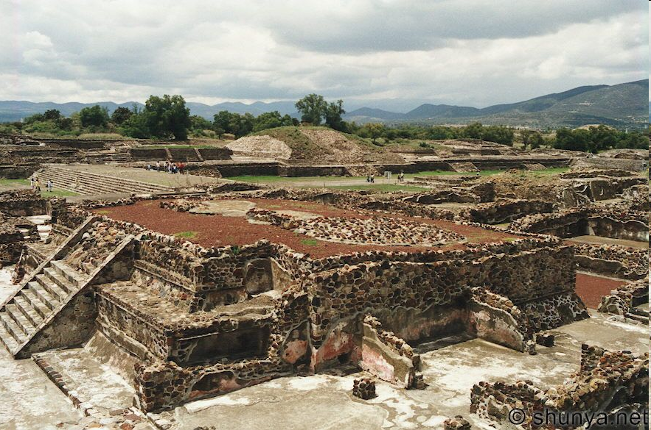
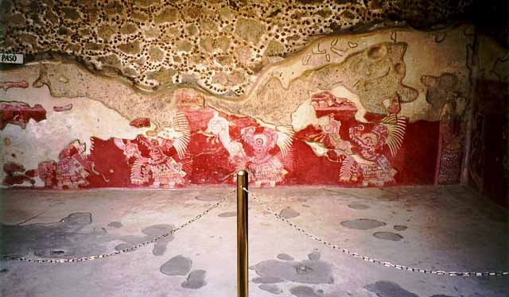
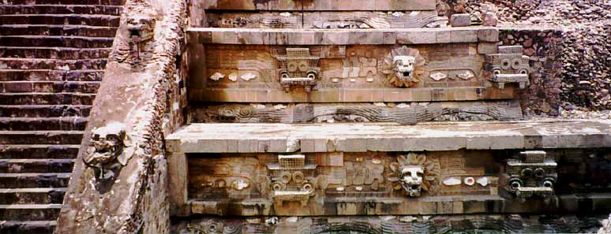

Slide 7
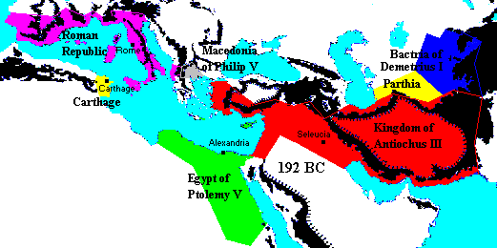
The Roman Republic (200-27)
Roman Imperialism
Seleucids driven out of Asia Minor 189
Macedonia and Greece annexed 146
Carthage destroyed 146

Slide 8
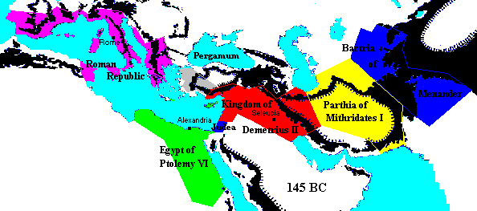

Slide 9
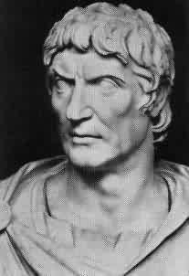
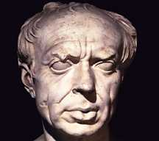
The End of the Roman Republic
The Roman Revolution (133-27 BCE)
optimates and populares.
Tiberius and Gaius Gracchus
Gaius Marius (156-86)
Lucius Cornelius Sulla (r. 82-78)
Key Terms
Lucius Cornelius Sulla

Slide 10
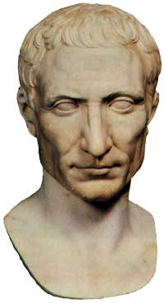
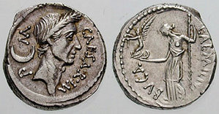
The End of the Republic (cont’d)
Julius Caesar
Consulship (59)
Wars in Gaul (58-52)
Civil Wars (51-47)
Dictatorship (47-44)
Assassination (44)
Key Terms
Julius Caesar
First Triumvirate
Cleopatra VII

Slide 11
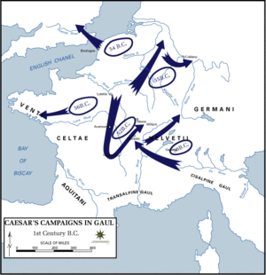
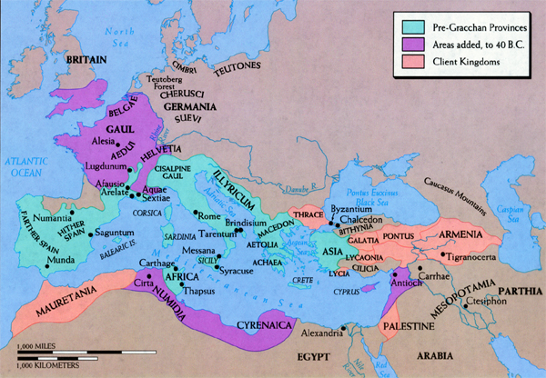

Slide 12
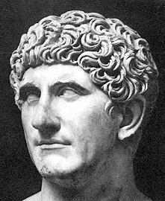
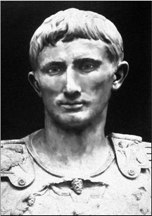
The End of the Republic (cont’d)
The Rise of Antony and Octavian
Rivalry Between Antony and Octavian (44-43)
The Second Triumvirate (43-38)
Civil War Between Antony and Octavian (38-31)
Octavian made Emperor (Augustus) (27)
Key Terms
Second Triumvirate
Augustus Caesar

Slide 13
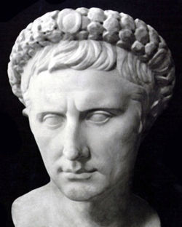
The Empire Under Augustus (27 BCE-14CE)
Government
The Senate
The Assemblies
The Magistrates
The Army
Patronage of Literature
Virgil’s Aeneid

Slide 14
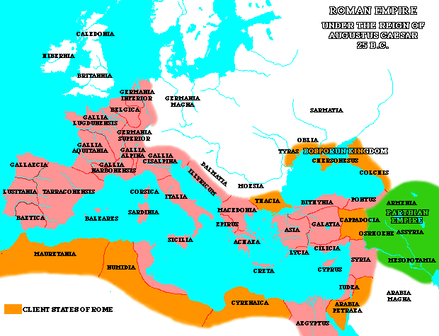

Slide 15
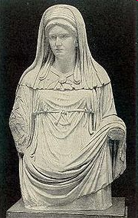
Life in Ancient Rome
The Roman Family
Roman Women
Roman Religion

Slide 16
Judea Since the Hebrew Bible
Macedonian Control of Judea
Ptolemaic Rulership (300-200)
Seleucid Rulership (200-166)
Maccabean Revolt (166-160 BCE)
Antiochus IV
Judah Maccabee
Key Terms
Maccabean Revolt
Hanukkah

Slide 17
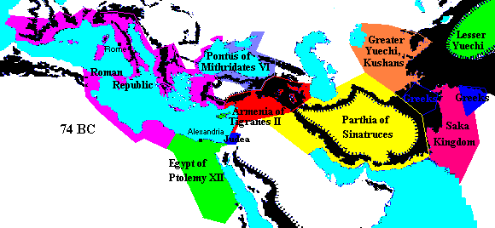

Slide 18
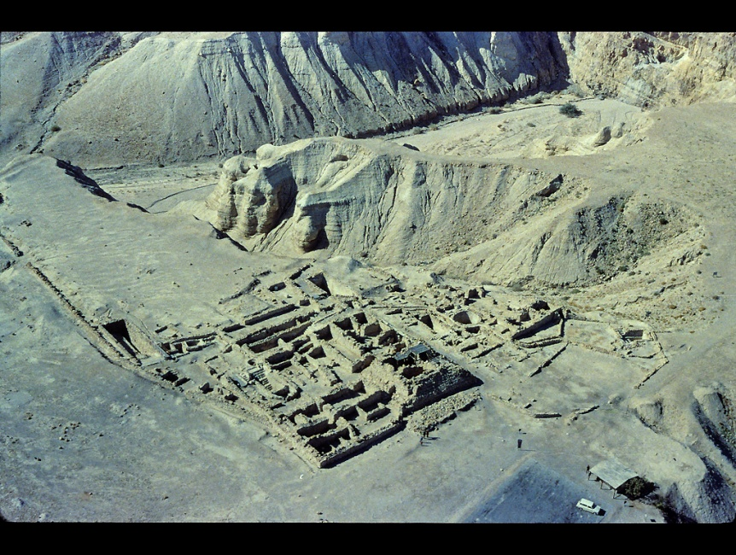
Judea Since the Hebrew Bible (cont’d)
Hasmonean Dynasty (140-63 BCE)
History
Sects of Judaism
Sadducees
Hasidim
Pharisees
Essenes
Key Terms
Sadducees
Pharisees
Essenes
Qumran

Slide 19
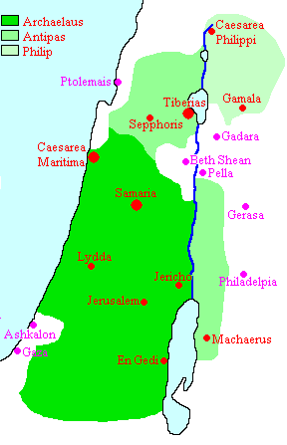
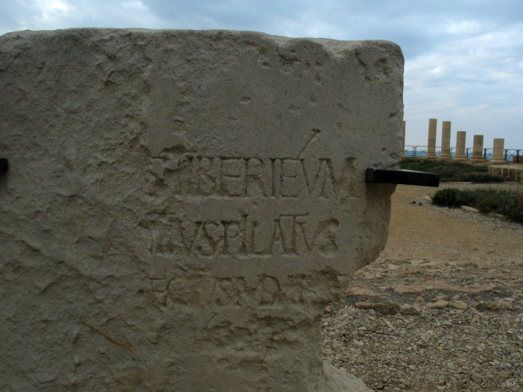
Judea in the Time of Jesus
Herod the Great (r. 37-4 BCE)
Pontius Pilate (r. 26-36 CE)
Key Terms
Herod the Great
Pontius Pilate

Slide 20
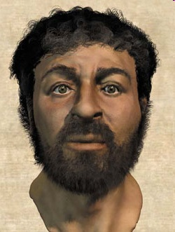
The Historical Jesus
Materials for Jesus Research
Exploration of the world in which Jesus lived
Non-Christian sources
Jewish sources
Pagan sources
Christian sources
Canonical sources
Non-canonical sources
Reconstruction of a 1st Century Galilean man

Slide 21
The Historical Jesus (cont’d)
Criteria for Determining Probability
Methodological Principles
Closer to the event = better
Beware of later ideas
Beware of bias
Criteria
Independent Attestation
Similarity
Dissimilarity
Accidental Information
Contextual Credibility

Slide 22
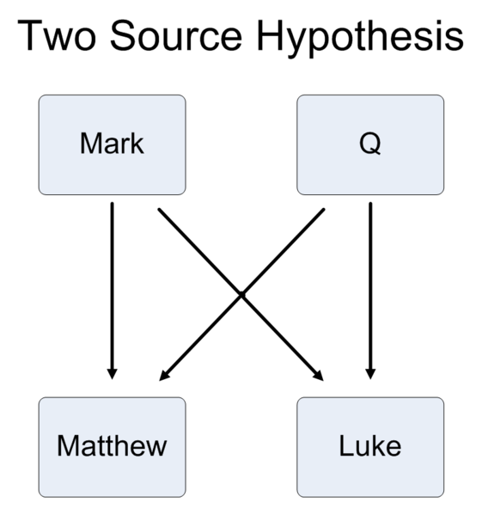

Slide 23
The Historical Jesus (cont’d)
Probable Facts about Jesus
Lived and taught in Judea/Galilee during the early 1st century CE.
Grew up and spent most of his time in Nazareth.
Gained a reputation as a healer, exorcist and preacher.
Had a brief association with John the Baptist.
Attracted disciples from the poor, uneducated and most unrespected segment of Galilean society.
Predicted the fall of Jerusalem to the Romans.
Attracted hostility from certain Jewish groups.
Around 36 CE Jesus executed based upon charges of being a revolutionary.

Slide 24
Core Teachings of Jesus
Two most important commandments: 1) love God; 2) love neighbor as self (Mark 12:28-34)
Religious purity is moral, not ceremonial (Mark 7:1-15)
Forgive all wrongs done to you (Mark 11:25)
A life of self-denial is more rewarding than a life of self-gratification (Mark 8:34-37)
Be humble (Mark 10:42-45)
Give to those in need (Mark 10:21)
People don’t need to be lectured; they need to be helped (Mark 2:15-17)

Slide 25
The Jesus Movement
What did Jesus’ disciples call themselves?
The Way, The Disciples, The Saints, The Nazoreans
Judaism and the Gentiles
A Jewish Jesus Movement
The Gentile Problem
Judaizers vs. Hellenists
Key Terms
Judaizer
Hellenist

Slide 26
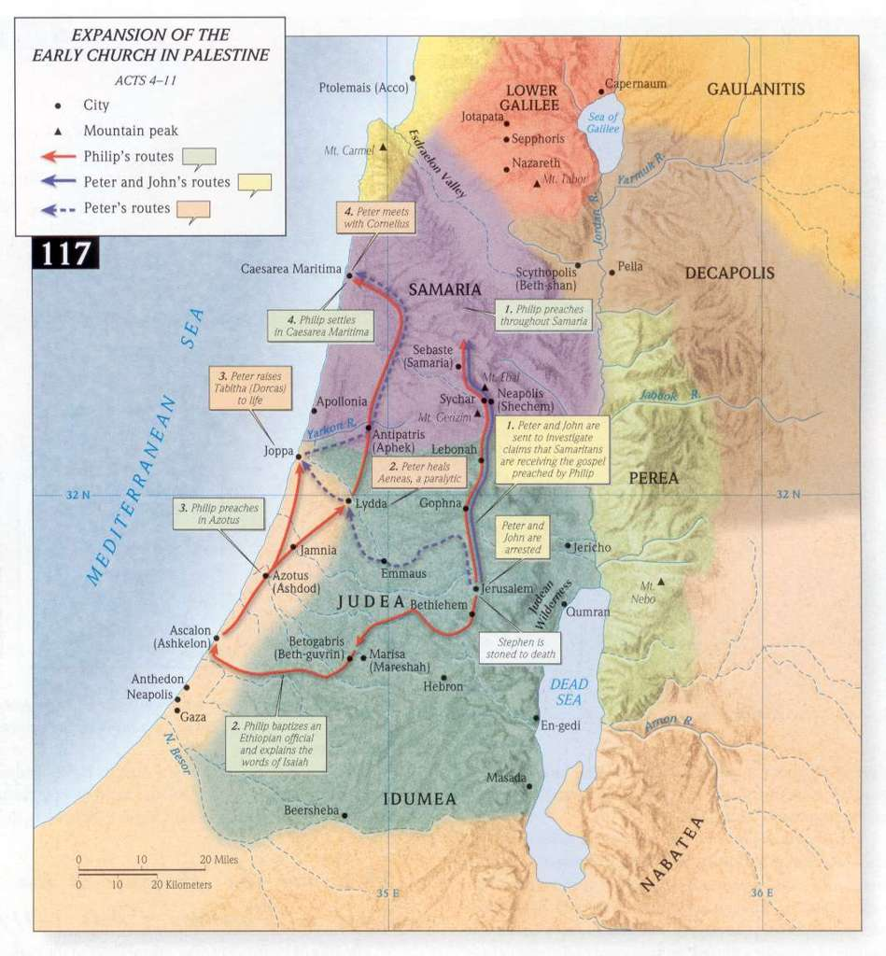

Slide 27
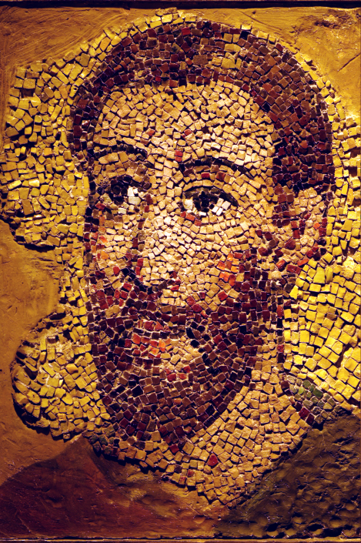
The Apostle Paul
Sources for Paul
Authentic Pauline Letters
Romans, 1 & 2 Corinthians, Galatians, Philippians, 1 Thessalonians, Philemon
Deutero-Pauline Letters
Ephesians, Colossians, 2 Thessalonians
Pseudo-Pauline Letters
1 & 2 Timothy, Titus (Pastorals)
The Book of Acts
written c. 80 CE
covers the years 36-61 CE
Key Terms
Paul the Apostle

Slide 28
The Apostle Paul (cont’d)
His Life
Born in the first decade of the first century in Tarsus
Given name was Saul
Native language was Greek
Raised as a Pharisee
Worked with the Sadducees against followers of Jesus
Claimed to have had a vision of Jesus and became a convert
Traveled as a missionary
Eventually arrested and executed in Rome c. 64 CE

Slide 29
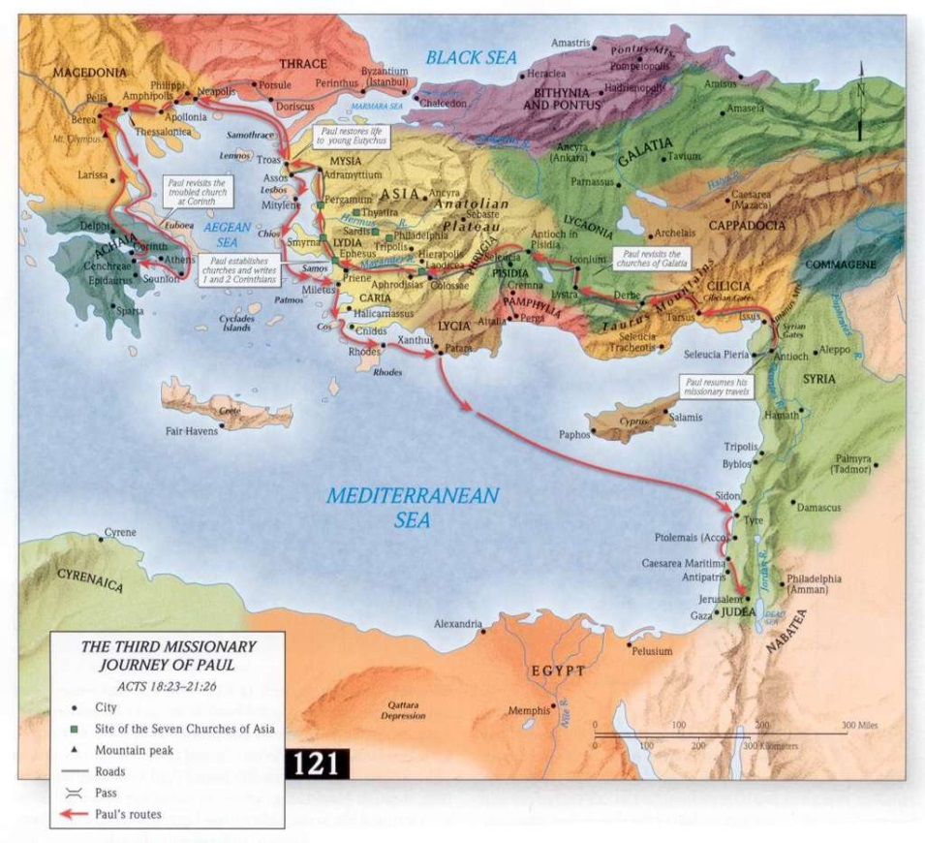
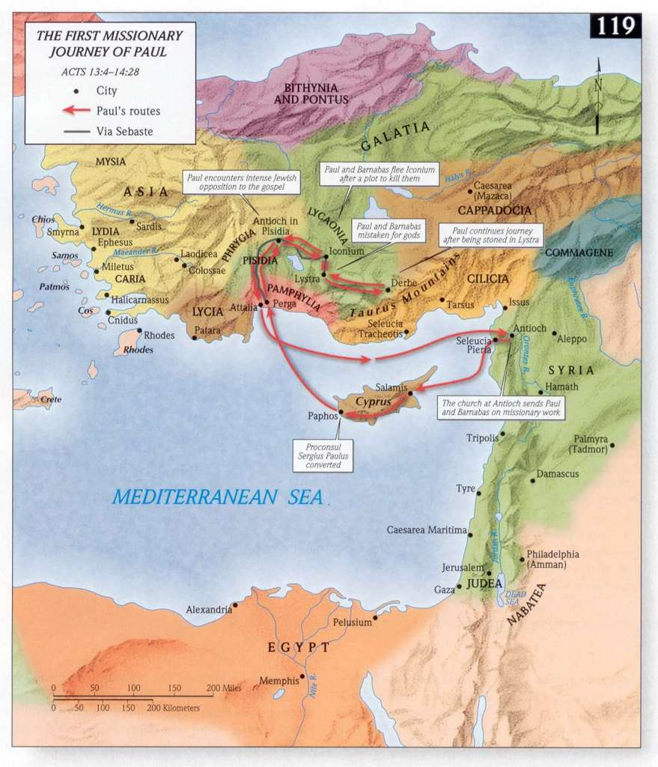
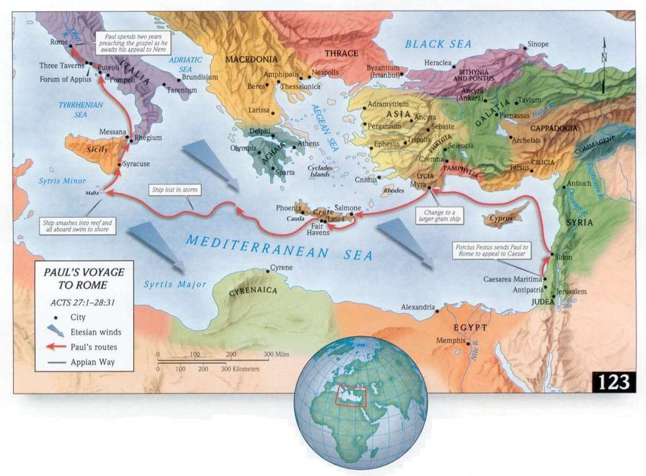

Slide 30
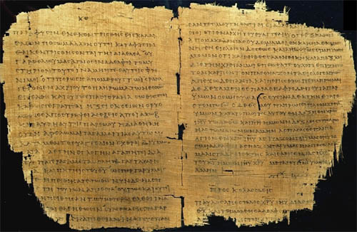
The Apostle Paul (cont’d)
His Ideas
Following Torah unnecessary for Gentile converts
Justification by faith
Participation in the death and resurrection of Jesus

Slide 31
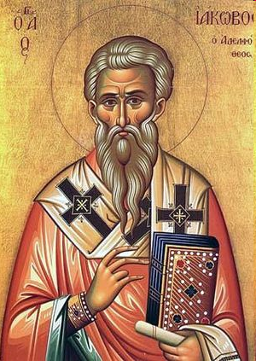
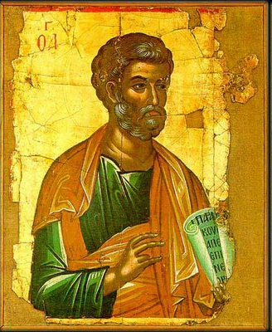
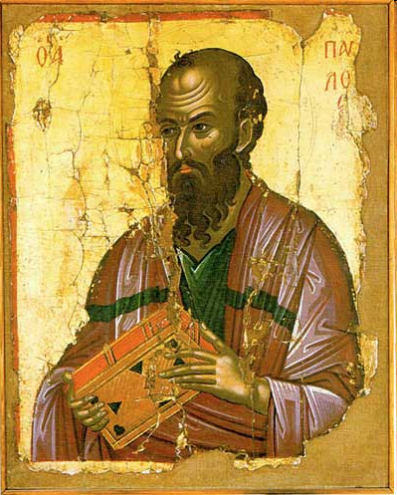
Three Factions of the Early Jesus Movement
JAMES’ JUDAIZERS
PETER’S COMPROMISERS
PAUL’S HELLENISTS
“Circumcision Party”
Pro-Temple
Pro-Torah
Want Gentiles circumcised
No Temple
No Torah
No circumcision
Middle position
Wants Gentiles to observe basic laws, but not circumcision.

Slide 32
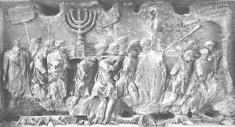
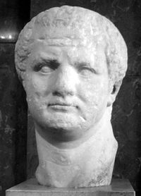
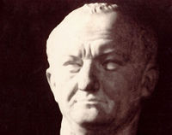
The First Jewish Revolt (66-73 CE)
Events of the War
Nero, Vespasian, Titus, Masada
The Book of Revelation
Effects of the Fall of Jerusalem on Judaism and Christianity
Key Terms
First Jewish Revolt

Slide 33
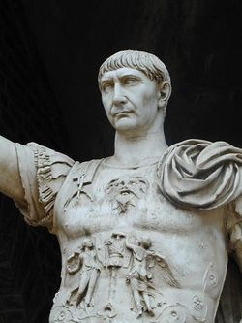
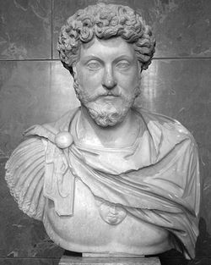
The Good Emperors
Trajan (98-117)
Marcus Aurelius (161-180)
Key Terms
Trajan
Marcus Aurelius

Slide 34
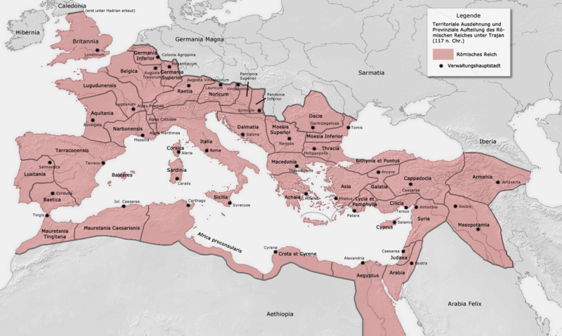

Slide 35
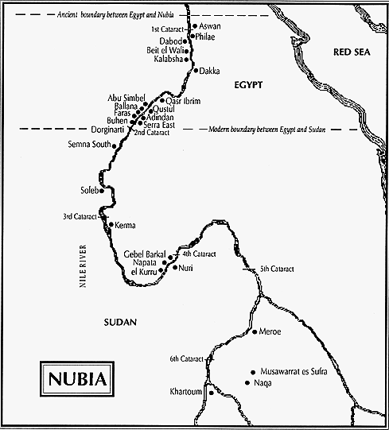
Kingdom of Meroë (c. 275 BCE-300 CE)
Arqamani (275-250 BCE)
Kandake Amanirenas (35-20 BCE)
Key Terms
Meroe
Amanirenas

Slide 36
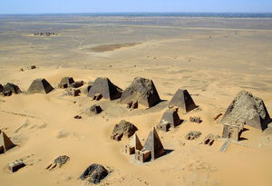
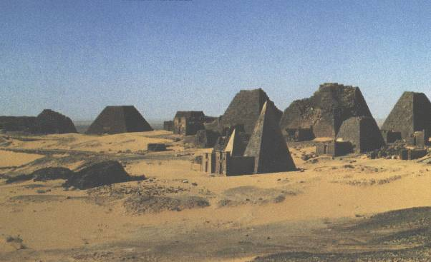

Slide 38
States of Inner Asia
The Parthian Empire (190 BCE-220 CE)
Arsaces (246-211 BCE)
Mithridates I (171-138 BCE)
Key Terms
Parthians
Mithridates I

Slide 40
States of Inner Asia (cont’d)
The Kushan Empire (45-225 CE)
Introduction
Kanishka I (127-147 CE)
Mahayana Buddhism
The Fourth Buddhist Council
Decline
Key Terms
Kanishka I

Slide 41
Kushan Empire (cont’d)
Developments in Buddhism
Theravada Buddhism
Mahayana Buddhism
bodhisattvas
Three-Body Doctrine
The Lotus Sutra
Key Terms
bodhisattva

Slide 42
Theravada | Mahayana
Individual effort leads to enlightenment | Working towards enlightenment
For the self only | Should also include all living beings
Strives for wisdom first | Compassion is the highest virtue
Centers on meditation, and requires personal dedication such as being a monk or nun | Encourages practice in the world and among the general community
Followed as a teaching or philosophy | Followed with reference to higher beings, more like a religion
Early work written in Pali (eg kamma, dhamma) | Early texts are in Sanskrit (eg karma, dharma)

Slide 44
The Han Empire
Earlier Han Dynasty (202 BCE-8 CE)
Liu Bang (202-195)
Mouton and the Xiongnu
Empress Lu Hou (195-180)
Wu Di (140-87)
Key Terms
Xiongnu
Wu Di

Slide 46
Han Empire (cont’d)
The Silk Road
Han Scholarship, Art, and Technology
Han Religion
Ancestor Worship
Han Confucianism
Key Terms
Dong Zhongshu

Slide 47
Han Empire (cont’d)
Daily Life in Han Times
Han Decline and the Usurpation of Wang Mang (8-23 CE)
Later Han Dynasty (28-220 CE)
Liu Xiu (28-57)
Ming (58-75)
Wang Chong
Period of Eunuch Ascendancy
Key Terms
Wang Chong

