Slide 1
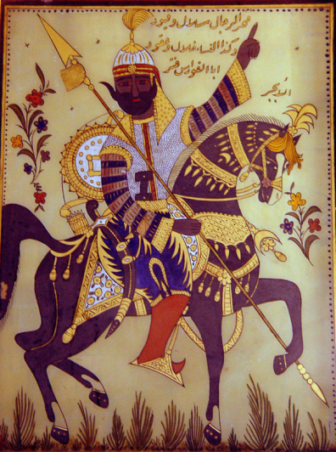
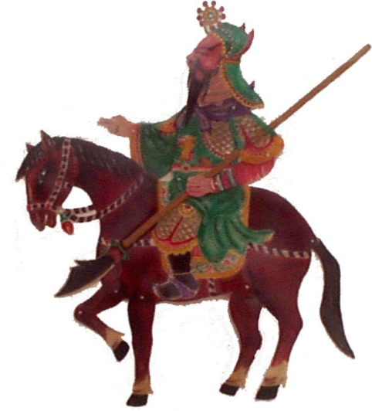
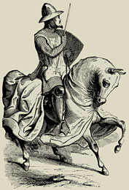
The Late Classical Period
200-600 CE

Slide 2
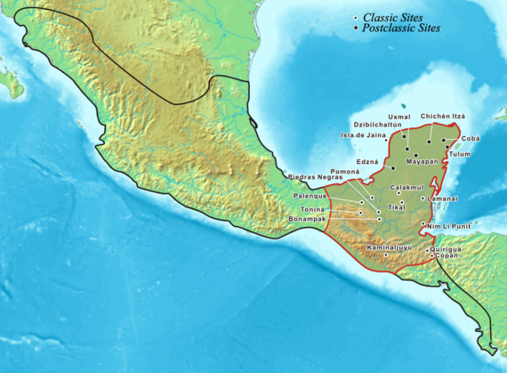
Early Maya Civilization (c. 300-600 CE)
Government
Tikal
Yax Ehb’ Xook
Calakmul
Copan
K’inich Yax K’uk Mo’ (416-437)
Key Terms
k’uhul ajaw
K’inich Yax K’uk Mo’

Slide 3
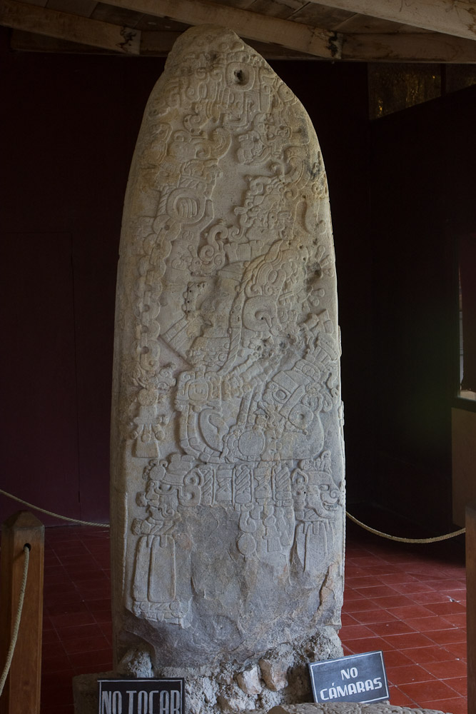
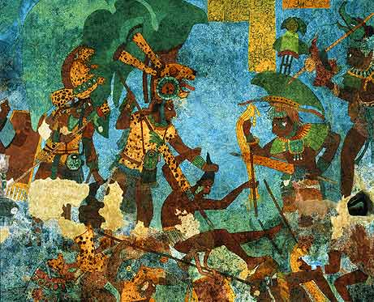

Slide 4
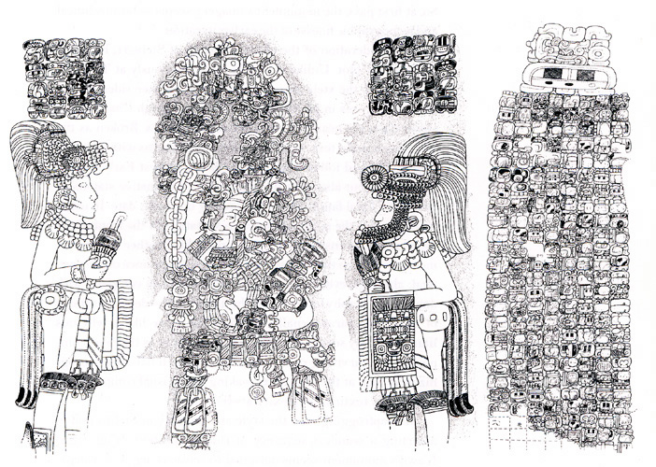

Slide 5
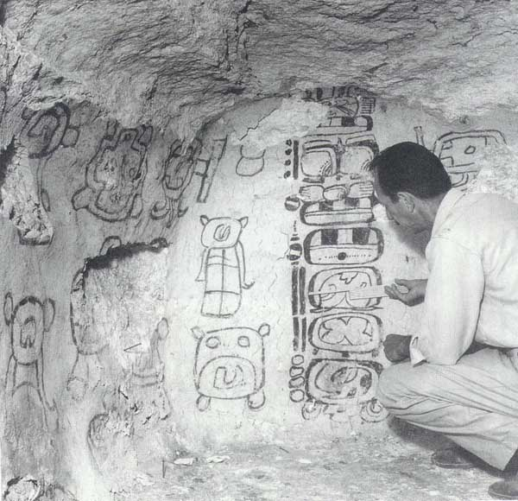

Slide 6
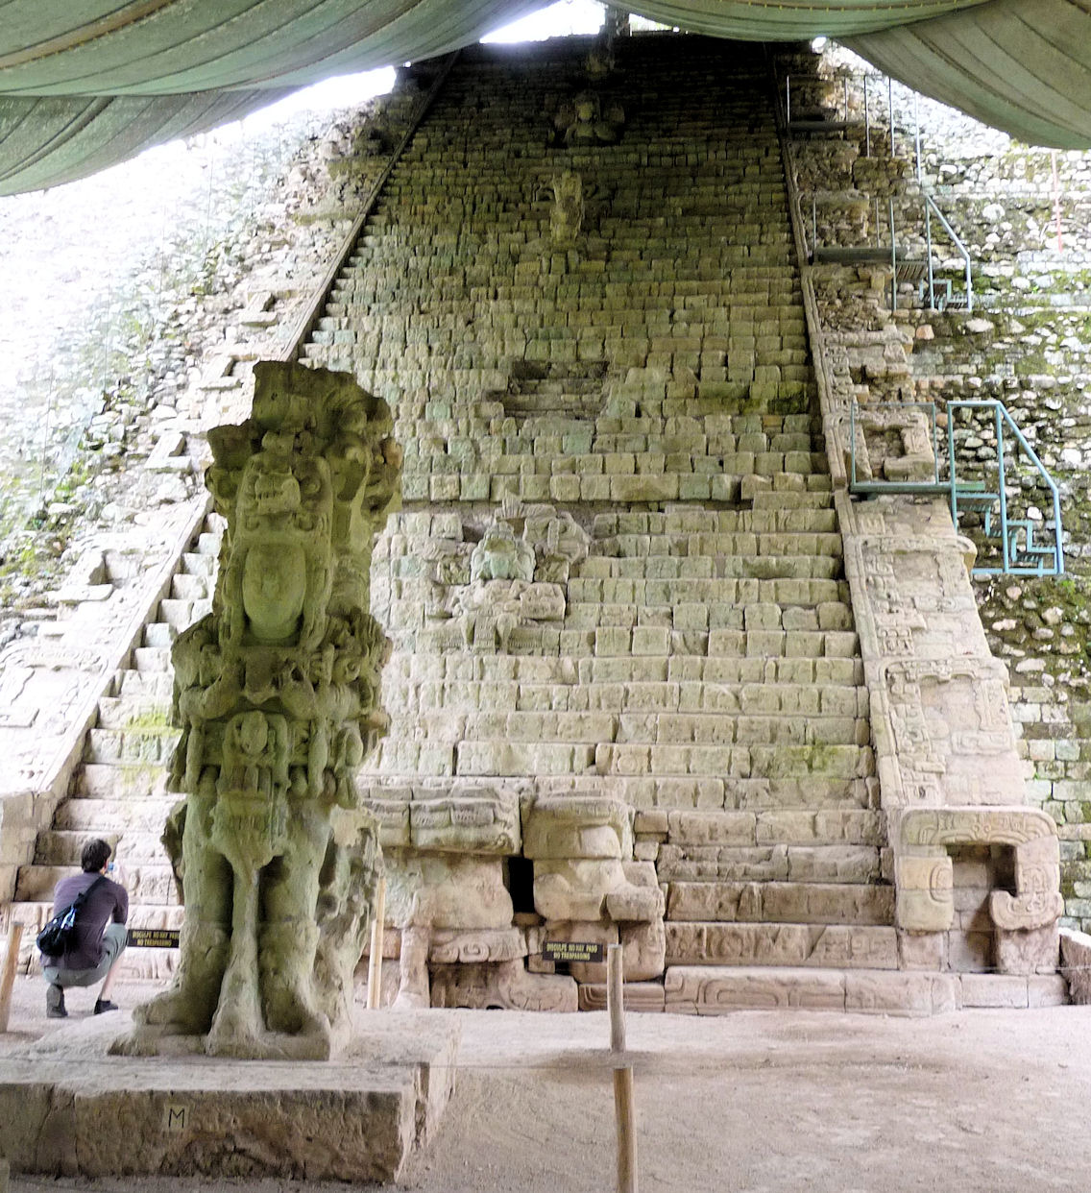
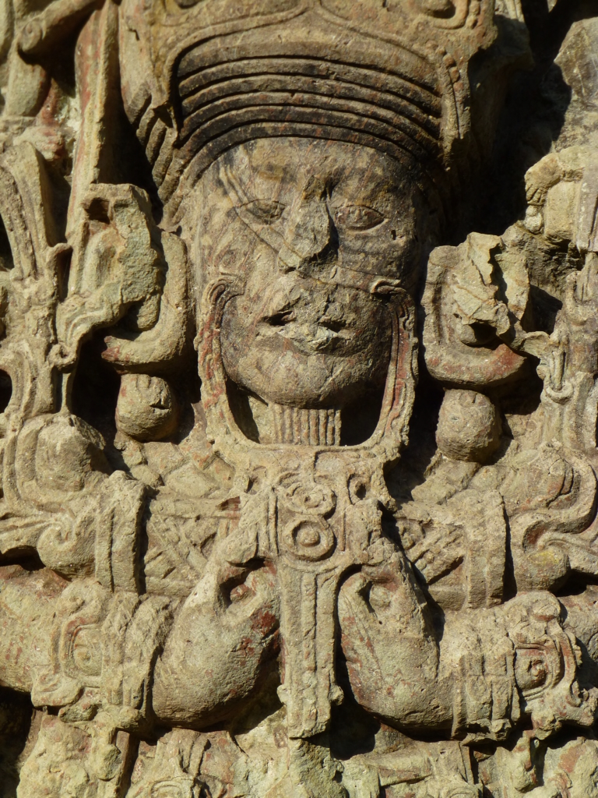
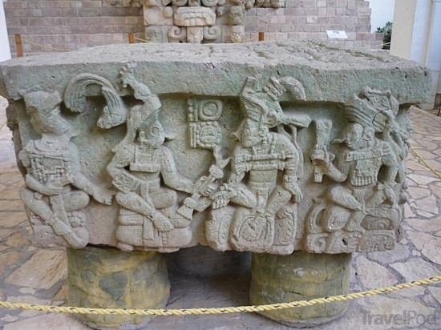

Slide 8
The Later Roman Empire (c. 200-476 CE)
The Rise of Christendom
Roman Economic Decline
Christian Success
Neo-Platonism and Criticism of Christianity
The Decian Persecution (249-251)
Key Terms
Neo-Platonism
Decius

Slide 9
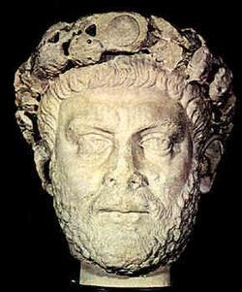
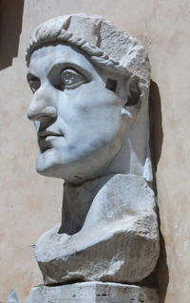
Later Roman Empire (cont’d)
The Rise of Christendom (cont’d)
Diocletian (284-305)
Reorganization of Empire
The Great Persecution
Constantine (312-337)
Emperorship
Edict of Milan (313)
Byzantium/Constantinople
Arianism
Council of Nicea (325)
Re-imagining the Relationship Between Church and State
Key Terms
Diocletian
Constantine
Edict of Milan
Arianism
Council of Nicea

Slide 10
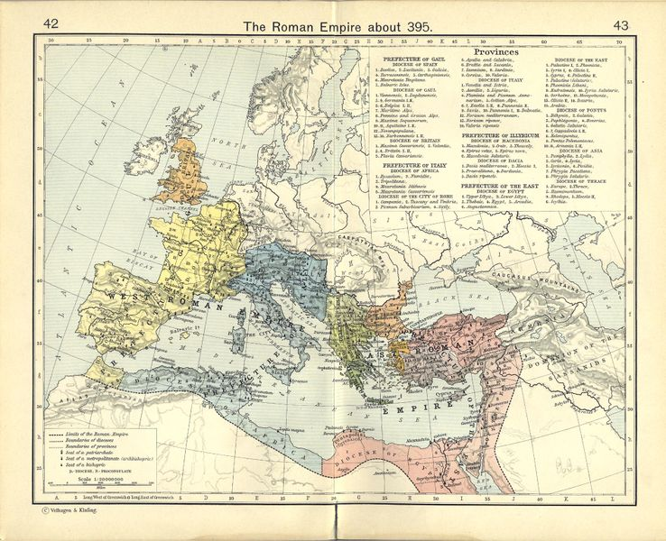

Slide 11
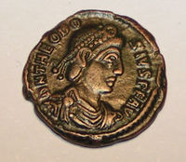
Later Roman Empire (cont’d)
The Loss of Religious Freedom
Migrating Barbarians
Theodosius I (379-395)
Christian Intellectuals
Ambrose
Augustine vs. Pelagius
New Church-State Developments
Separation of East and West
Key Terms
Theodosius I
Ambrose
Augustine

Slide 12
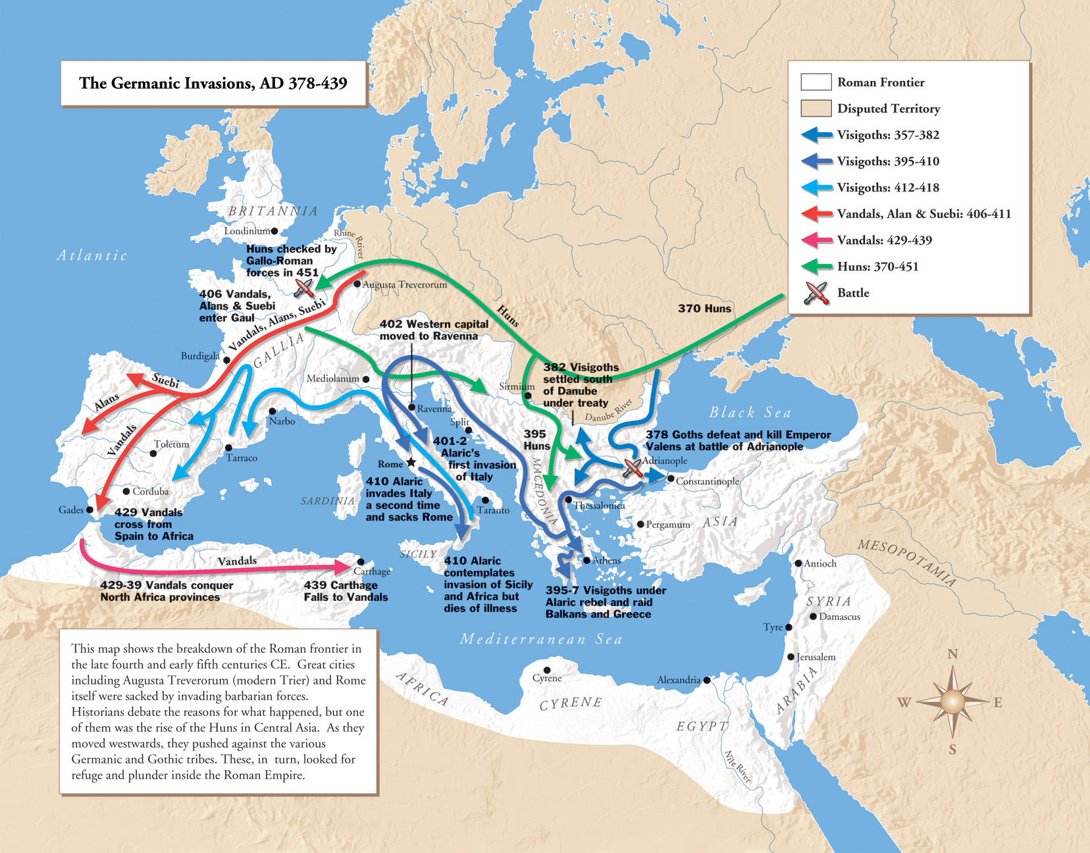

Slide 13
Later Roman Empire (cont’d)
The Western Empire
Honorius (395-423)
Sacking of Rome by Visigoths (410)
Romulus Augustulus (475-476)
Key Terms
Romulus Augustulus

Slide 14
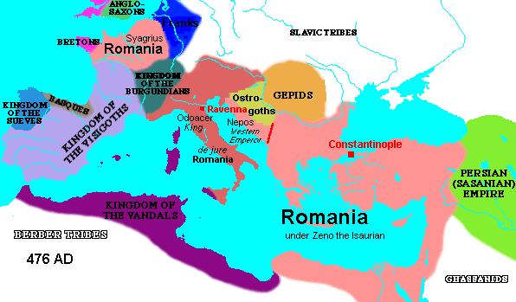

Slide 15
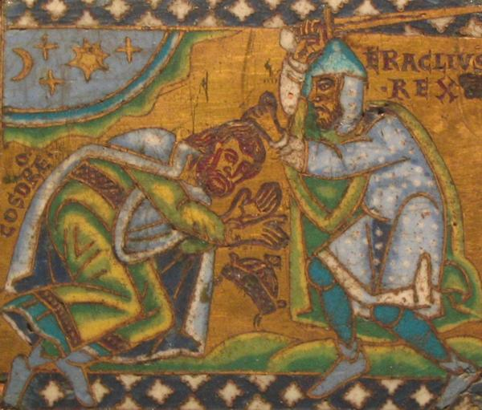
The Byzantine Empire
Overview
Justinian I (527-565)
Heraclius I (610-641)
Byzantine Christianity
Byzantine Philosophy
The Slavs
Key Terms
Byzantine Empire
Justinian I
Heraclius I

Slide 16
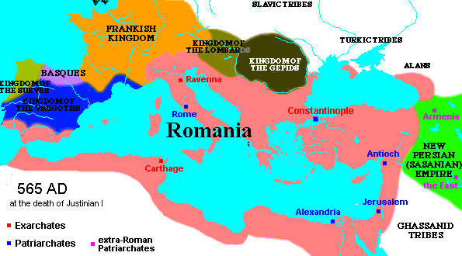

Slide 17
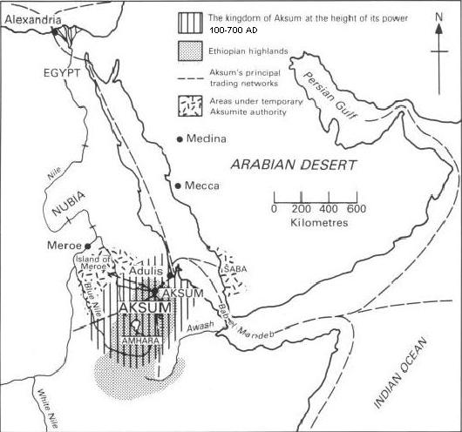
Aksum (c. 100-700 CE)
History
Ezana (c. 330-356 CE)
Legends
Key Terms
Aksum
Ezana
Menelik
Bazen

Slide 18
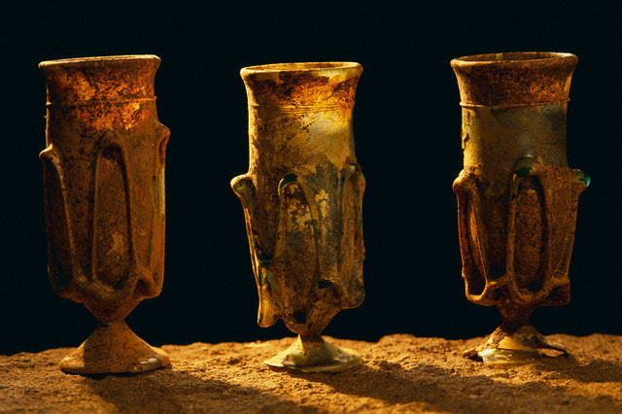
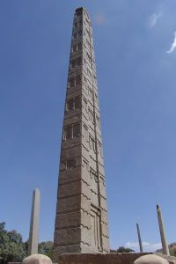
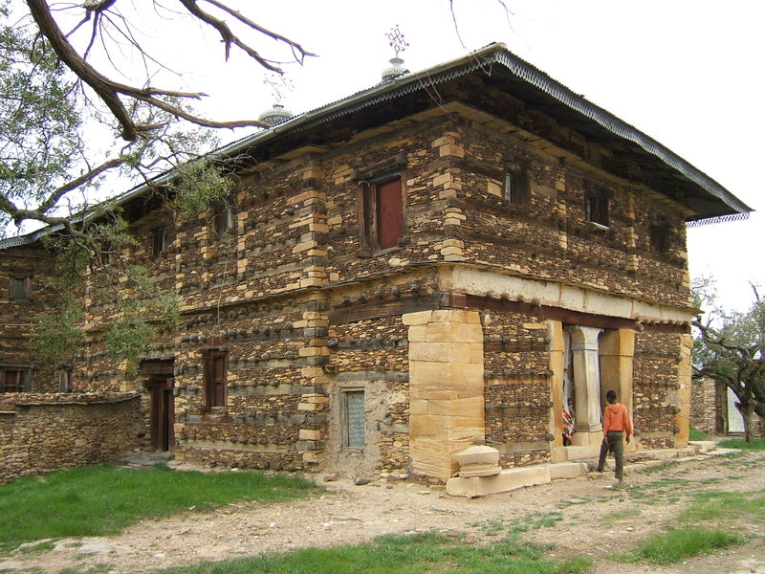

Slide 19
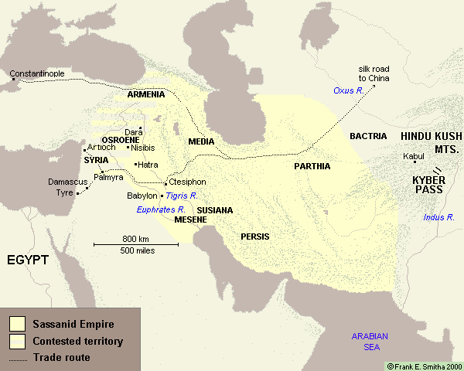
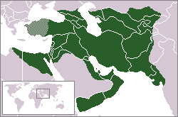
Sassanid Empire (224-651 CE)
Khosrau I (531-579)
Manichaeism
Key Terms
Sassanid Empire
Khosrau I
Manichaeism
Mazdak

Slide 20
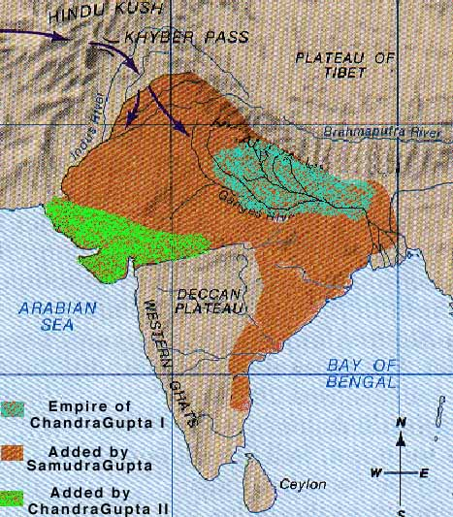
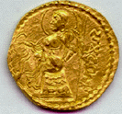
Gupta India (c. 320-600 CE)
Beginning of Empire
Samudra Gupta (335-380)
Collapse
Key Terms
Samudra Gupta

Slide 21
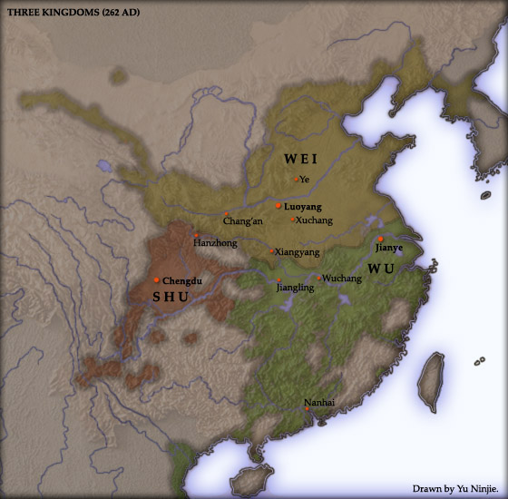
Chinese Middle Ages (220-589 CE)
The Three Kingdoms (220-265)
Western Jin Dynasty (265-316)
Eastern Jin Dynasty (317-420)
Southern and Northern Dynasties (420-589)
Key Terms
Zhuge Liang
The 16 Kingdoms

Slide 22
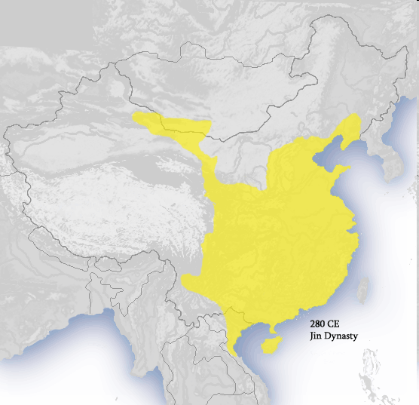
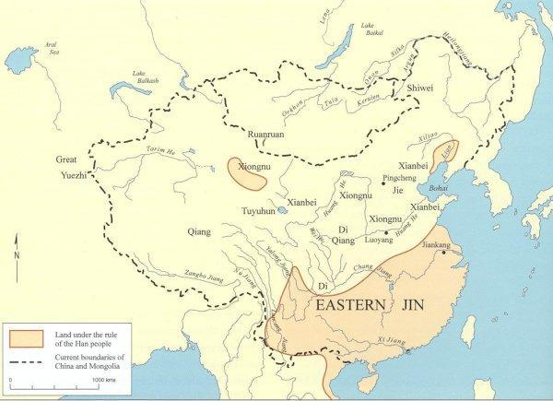

Slide 23
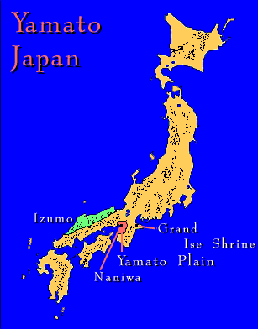
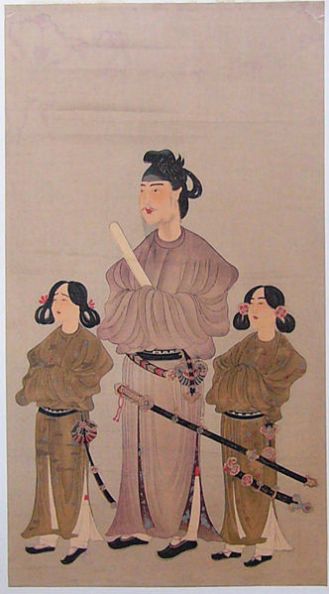
Yamato Japan (250-710 CE)
Kofun Period (250-538)
Asuka Period (538-710)
Shotoku (574-622)
The Taika Reform
Shintoism
Key Terms
Shotoku
Tenji
Shintoism

Slide 24
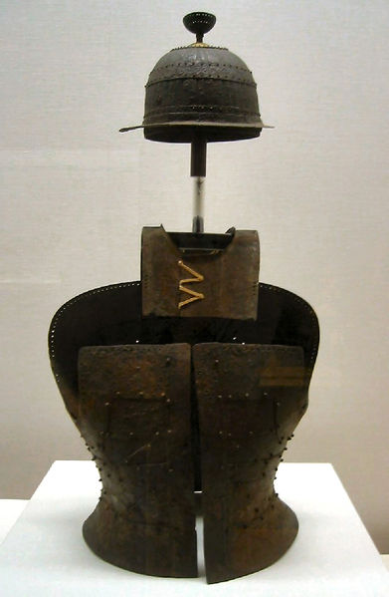
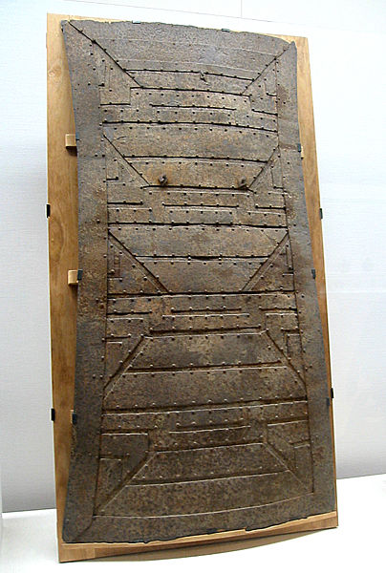
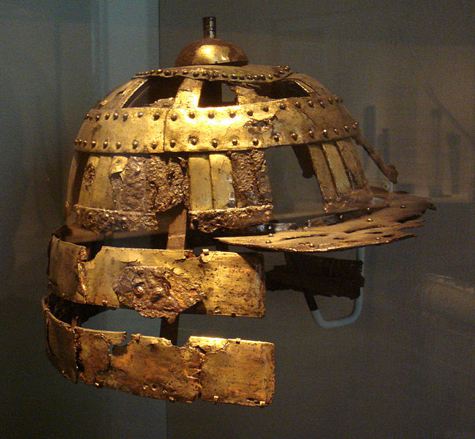
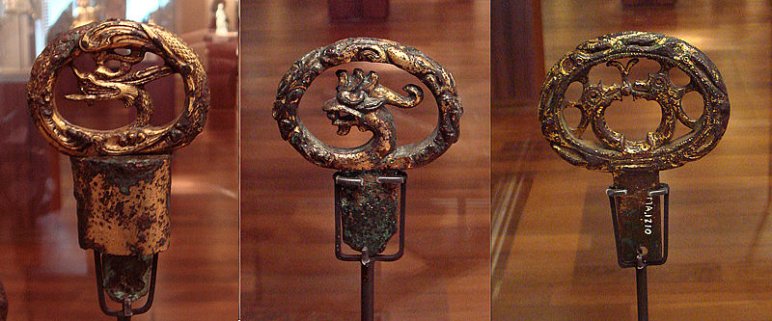
Kofun armor
Kofun sword hilts

Slide 25
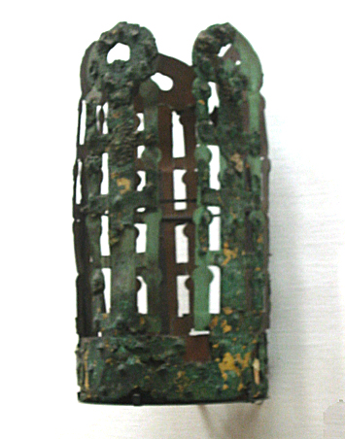
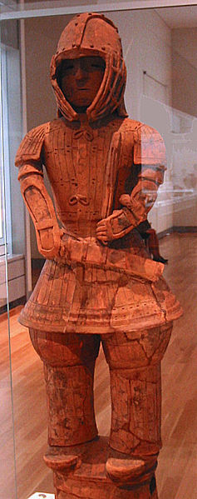
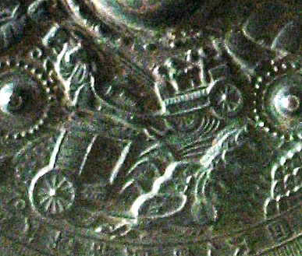
Kofun crown
Kofun funerary figure
detail of bronze mirror

Slide 26
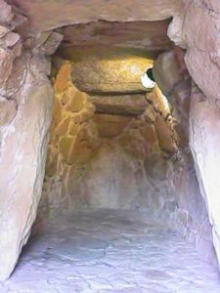
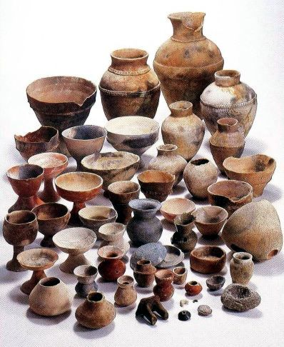
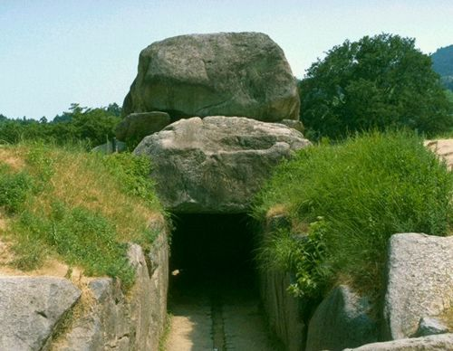
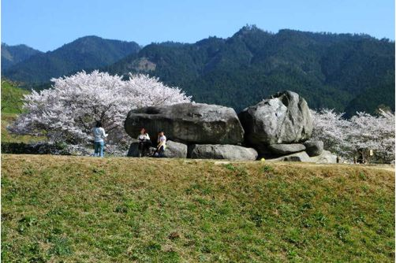
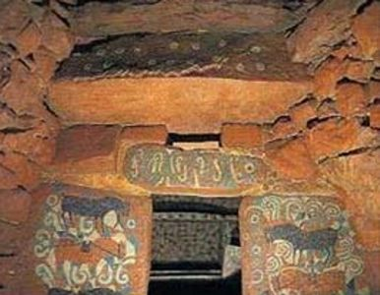
Remains of Asuka

Slide 27
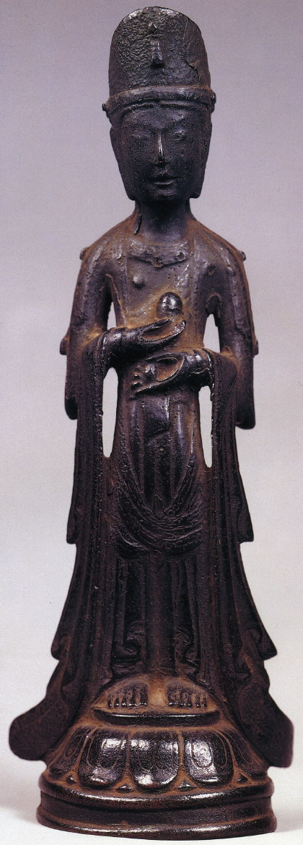
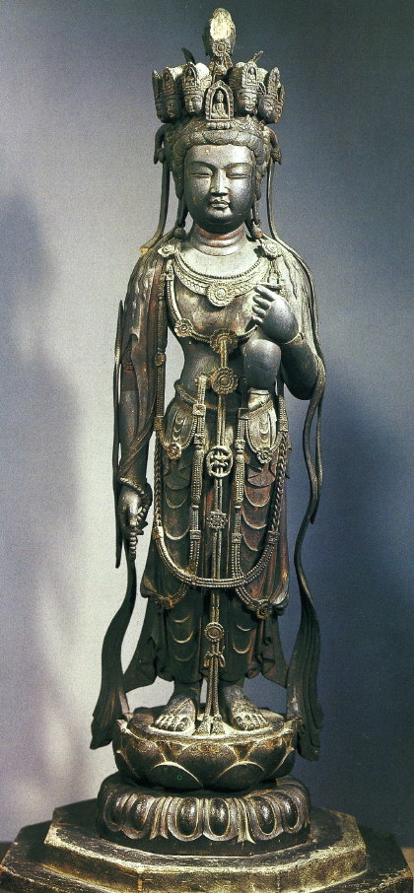
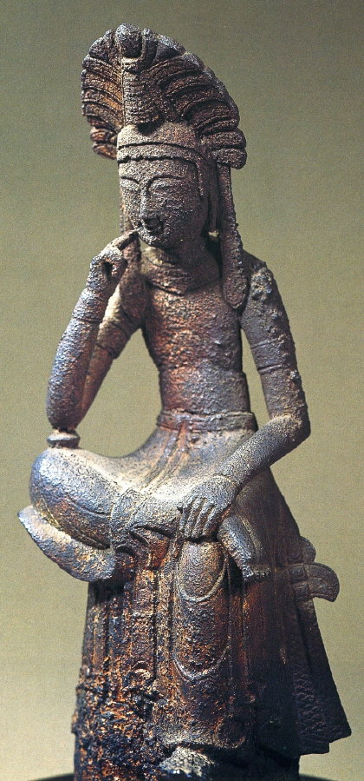
Asuka Buddhist bronze figurines

