Slide 1
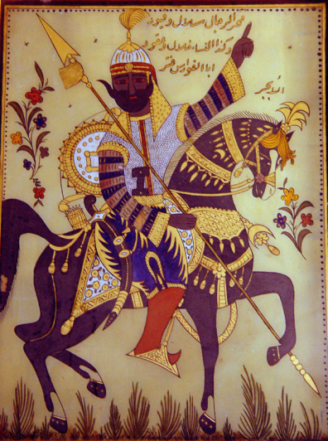
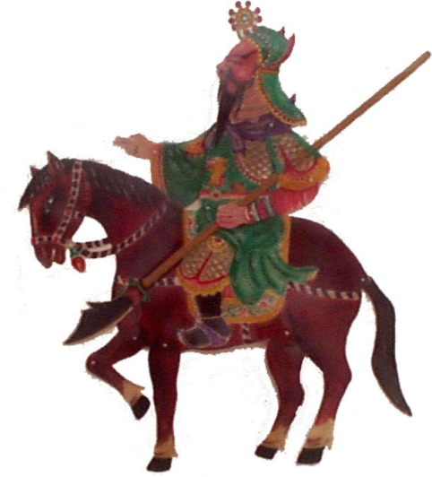
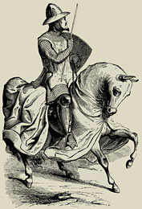
The Postclassical Period
600-1300 CE

Slide 2
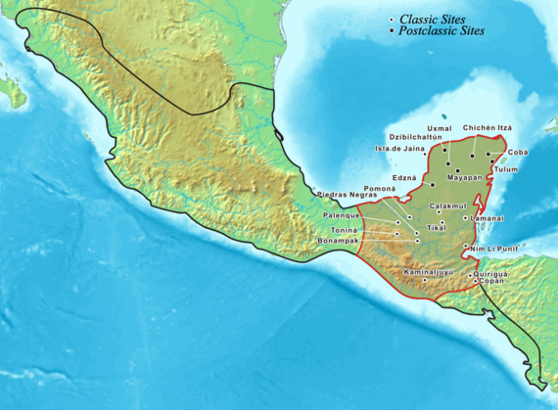
Later Maya Civilization (c. 600-900 CE)
Ascendancy of Calakmul (562-695)
Resurgence of Tikal (682-768)
Palenque Dynasty
Pacal I (615-683)
Religion
Key Terms
Pacal the Great
Popul Vuh

Slide 3
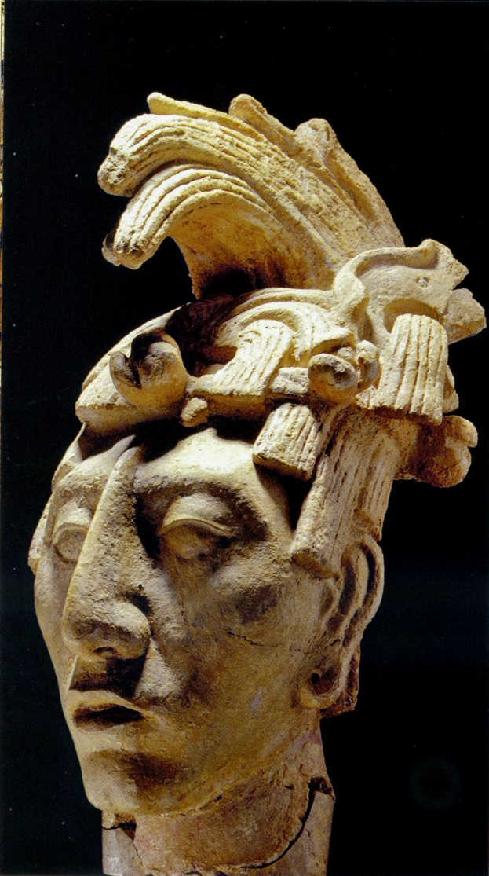
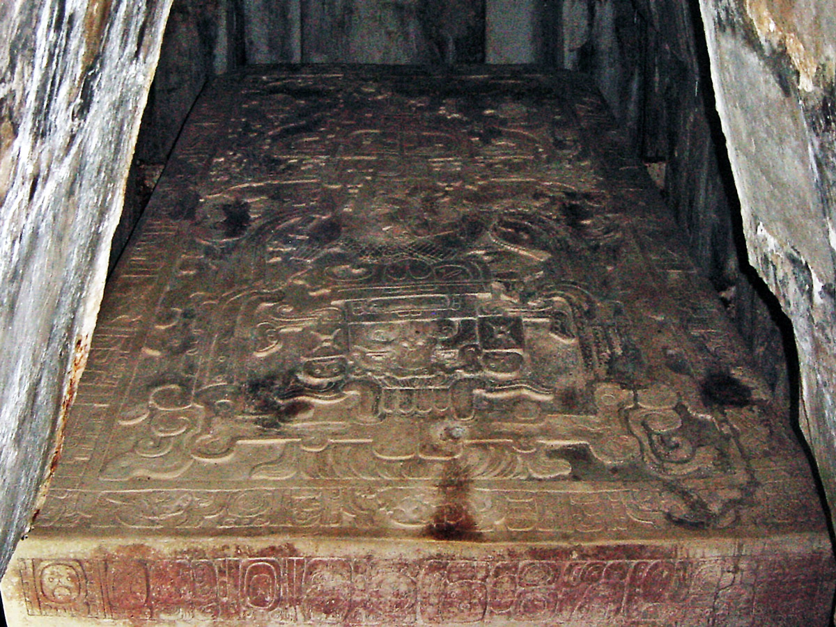

Slide 4
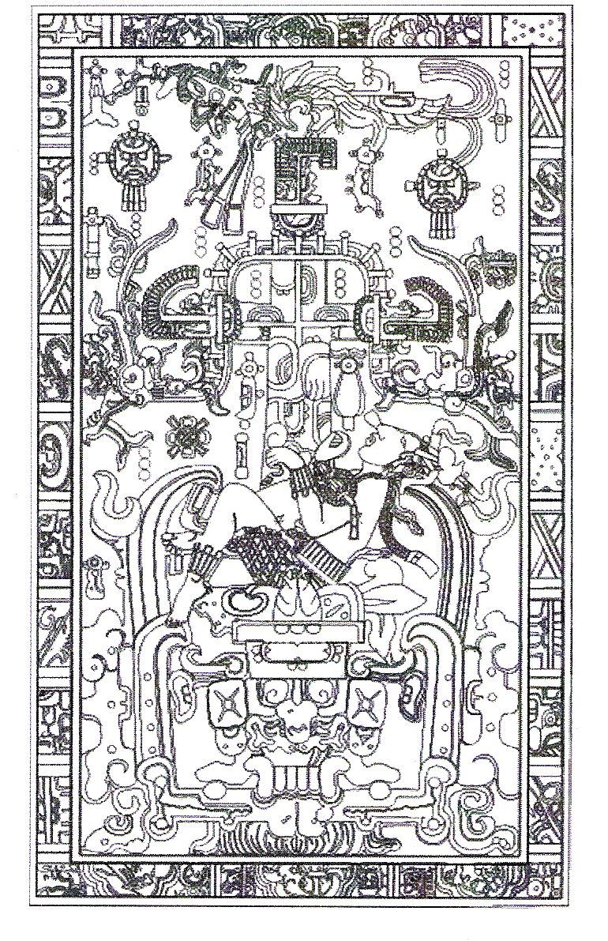
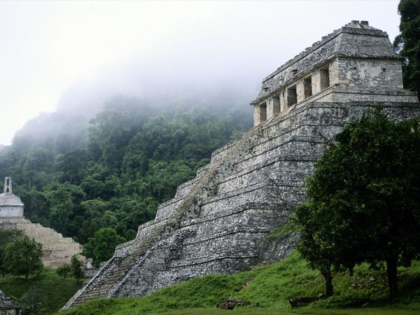
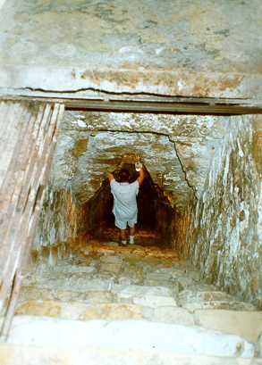

Slide 5
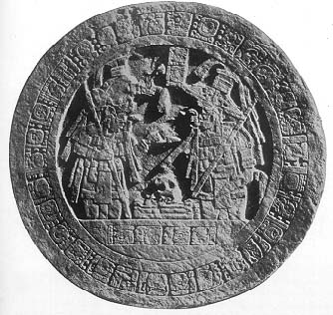
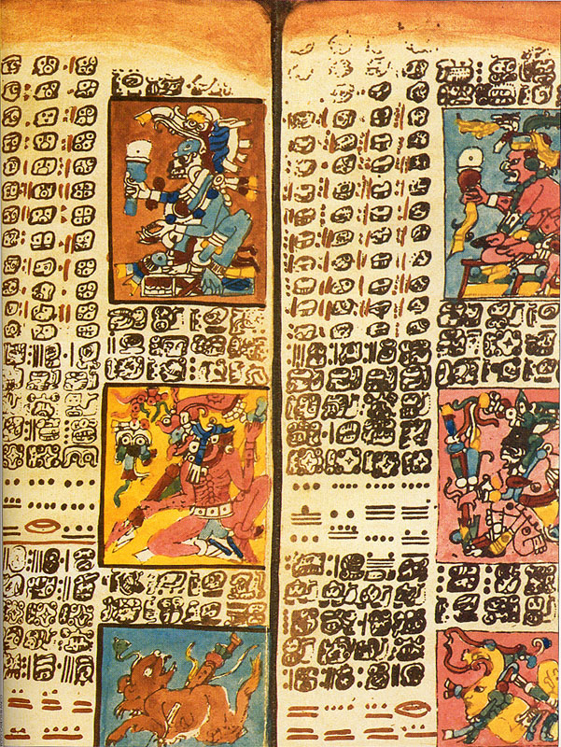
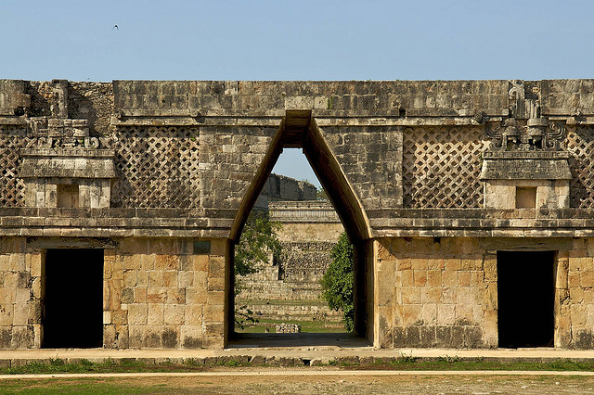

Slide 6
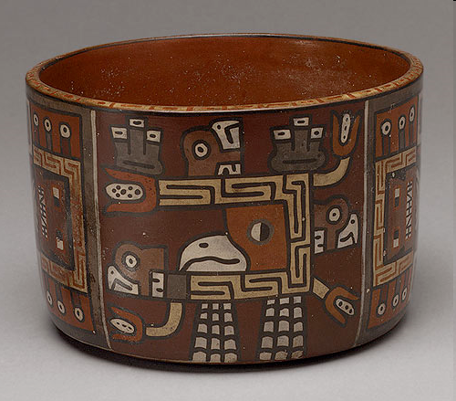
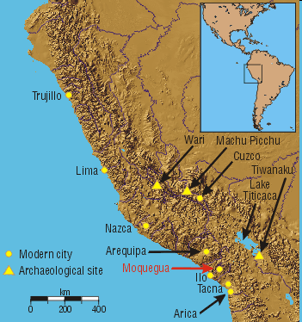
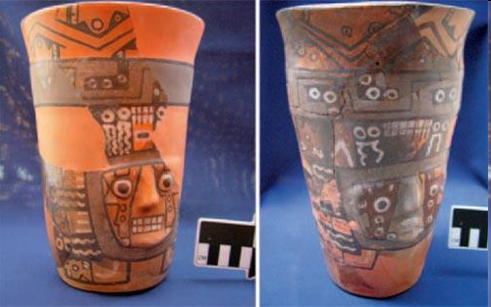
Andean Civilization
Key Terms
Wari
The Wari Empire (c. 700-1000 CE)

Slide 7
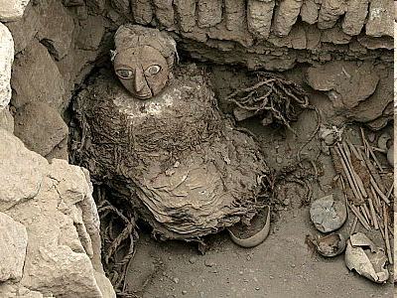
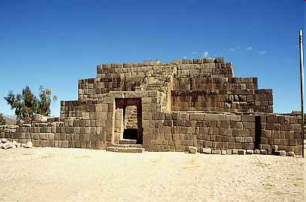
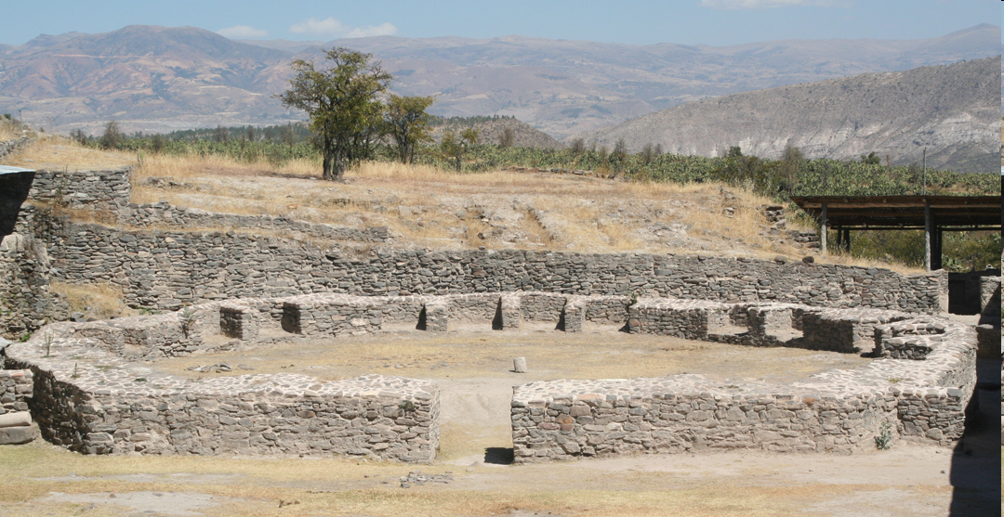

Slide 8
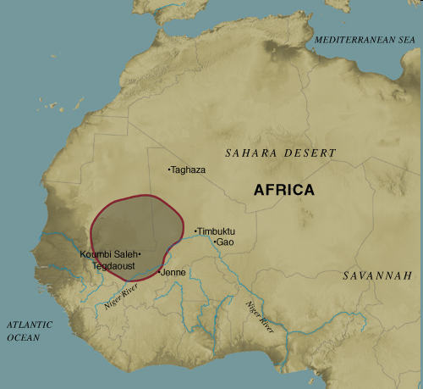
The Ghana Empire (c. 790-1240) (aka Wagadou)
Growth
Government
Legal System
Kumbi Saleh
Decline and Fall
Key Terms
Ghana Empire

Slide 9
The European Dark Ages (c. 500-1000 CE)
General Concepts
Middle Ages divided into 3 periods:
Early: 500-1000 (Dark Ages)
High: 1000-1300
Late: 1300-1500
Life in the Dark Ages
Religion
Learning and Schooling

Slide 10
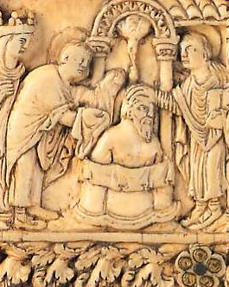
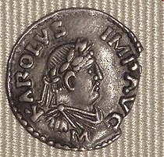
The Dark Ages (cont’d)
Kingdom of the Franks
Clovis (481-511)
Carolingian Empire (751-840)
Charlemagne (768-814)
Carolingian “Renaissance”
End of the Carolingian Period
Key Terms
Clovis
Charlemagne

Slide 11
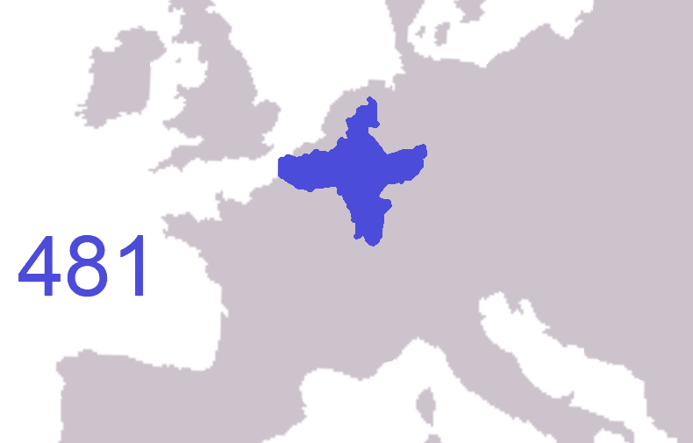

Slide 12
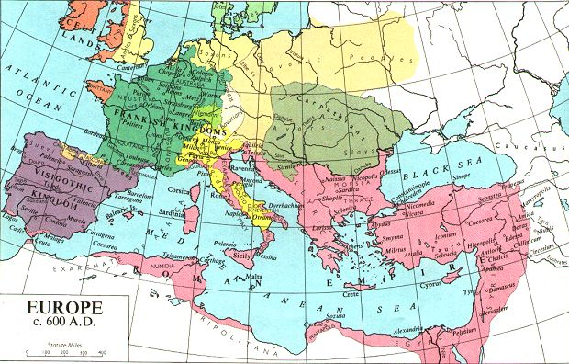

Slide 13
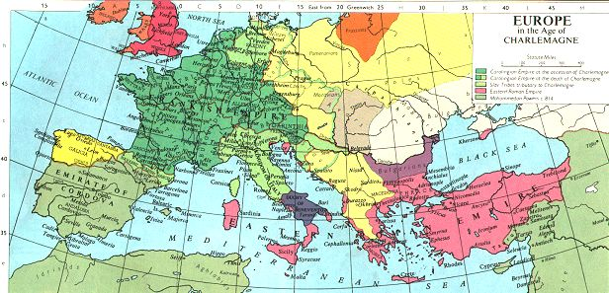

Slide 14
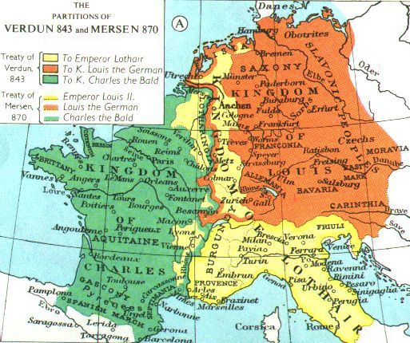

Slide 15
Y1K
Changes between Charlemagne and the Year 1000
Post-Carolingian Invasions
Pre-millennial Frenzy
Agriculture
Feudalism
Technology and Science
Revival of Manufacturing
Guilds
Emergence of Capitalism
Rise of Towns
Key Terms
feudalism
guild

Slide 16
The Crusades
First Crusade (1095-1099)
Second Crusade (1147-1149)
Third Crusade (1188-1192)
Fourth Crusade (1202-1204)
Children’s Crusade (1212)

Slide 17
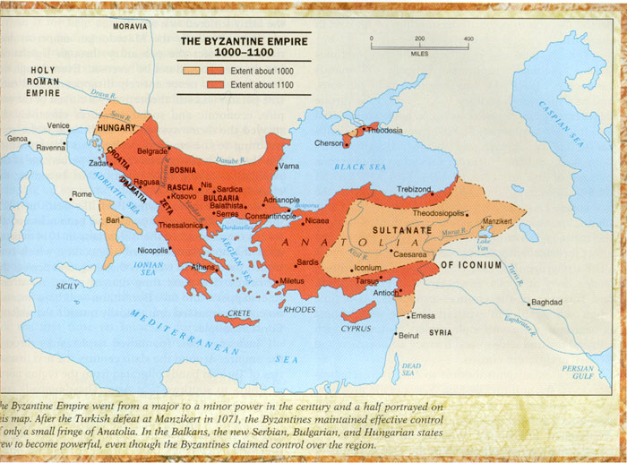

Slide 18
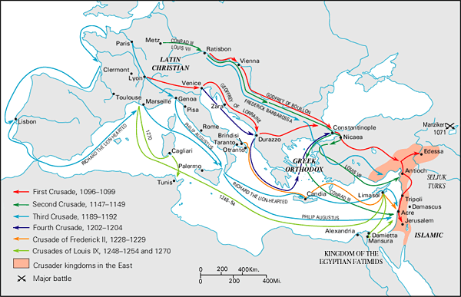

Slide 19
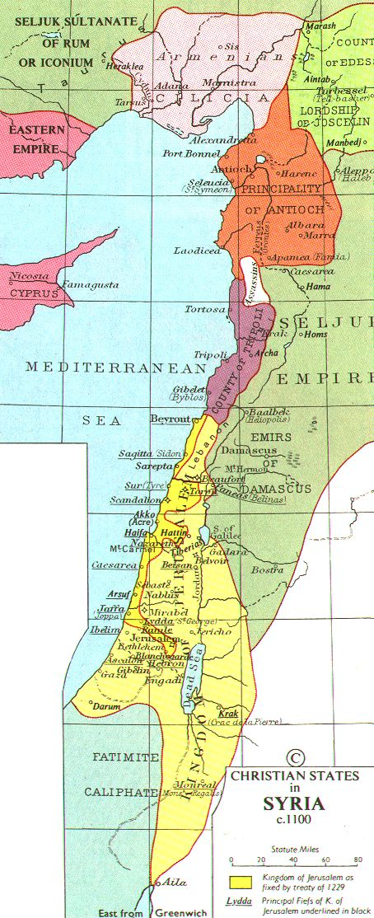
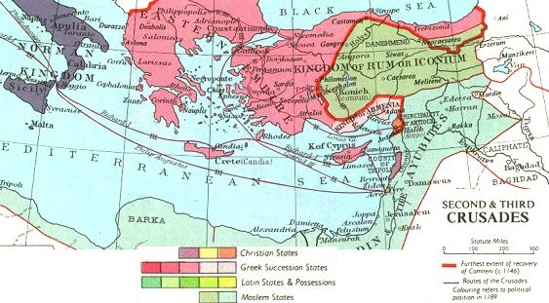

Slide 20
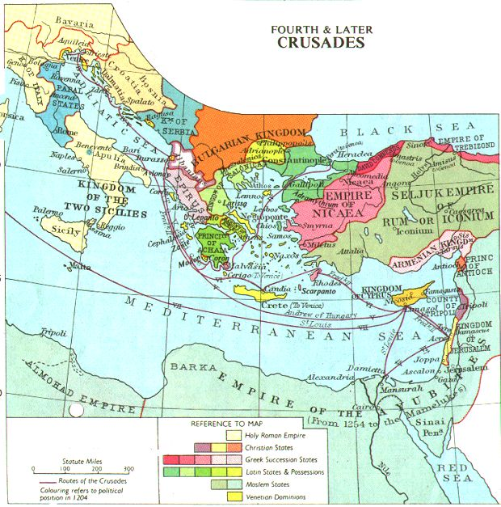

Slide 21
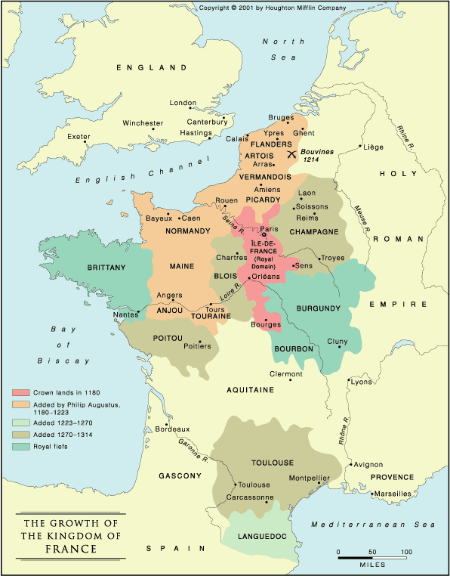
France
The Capetian Dynasty (987-1328)
Hugh Capet (987-996)
Philip II Augustus (1180-1223)
Key Terms
Philip II Augustus

Slide 22
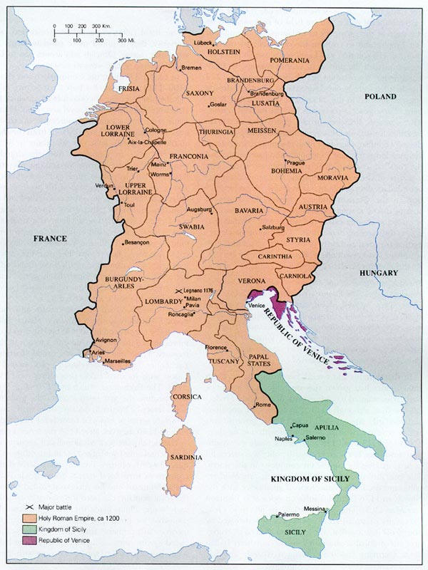
Germany
Otto the Great (936-973)
Heinrich IV (1050-1106)
Pope Gregory VII (1088-1099)
Friedrich II Hohenstaufen (1212-1250)
Key Terms
Heinrich IV

Slide 23
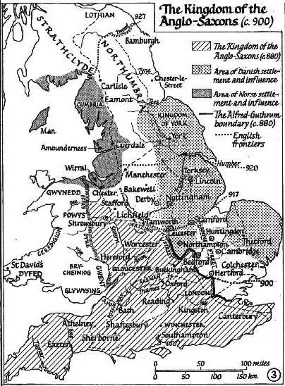
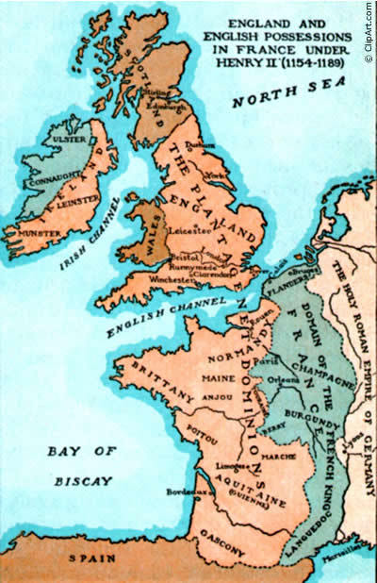
England
Alfred the Great (871-901)
William the Conqueror (1066-1087)
Battle of Hastings (1066)
Henry II (1154-1189)
Eleanor of Aquitaine
Richard the Lionheart (1189-1199)
John (1199-1216)
Magna Carta
Key Terms
William the Conqueror
Magna Carta

Slide 24
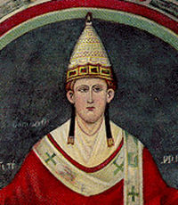
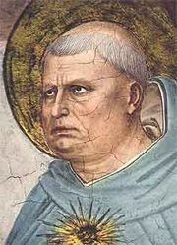
Pope Innocent III (1198-1216)
both names are key terms
Thomas Aquinas (1225-1274)

Slide 25
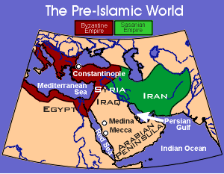
The Rise of Islam (610-1268 CE)
Pre-Islamic Arabia
Political Organization
Religion
Mecca

Slide 26
The Rise of Islam (cont’d)
Muhammad
Early Life
Call to Prophecy
Flight from Mecca to Medina
As Leader of the Islamic Community
Key Terms
Ka’ba
Hadith

Slide 27
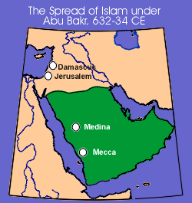
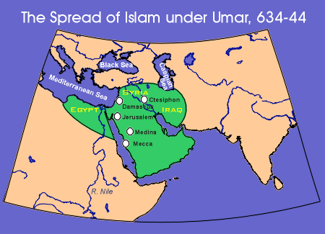
The Rise of Islam (cont’d)
The Rashidun Caliphate
Abu Bakr (632-634)
‘Umar (634-644)
‘Uthman (644-656)
‘Ali (656-661)
Key Terms
‘Umar
jihad
‘Ali
First Fitna

Slide 28
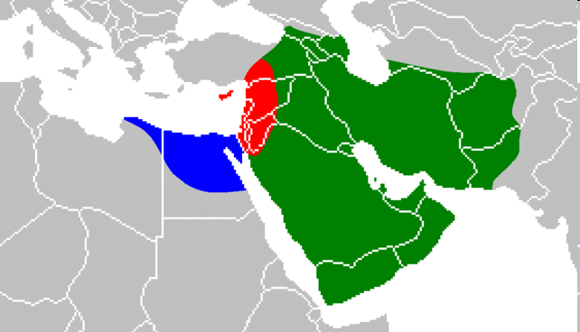
The Rise of Islam (cont’d)
Shi‘a and Sunni
Key Terms
Shia
Sunni
Shariah
Green: region under the control of ‘Ali
Red: region under the control of Mu‘awiyah
Blue: region under the control of Amr

Slide 29
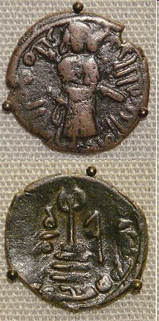
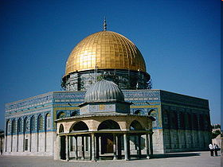
The Rise of Islam (cont’d)
The Ummayad Caliphate (661-750)
Mu‘awiyah I (661-680)
‘Abbasid Revolt
Key Terms
Mu‘awiyah I

Slide 30
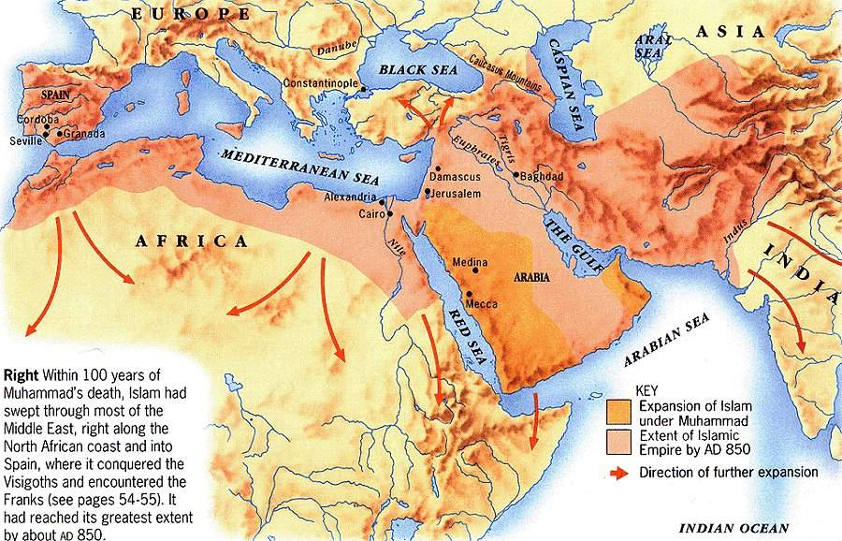

Slide 31
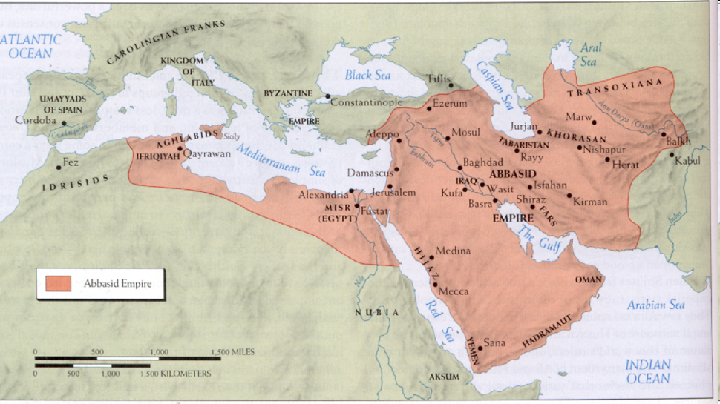
The Rise of Islam (cont’d)
The ‘Abbasid Caliphate (758-1258)

Slide 32
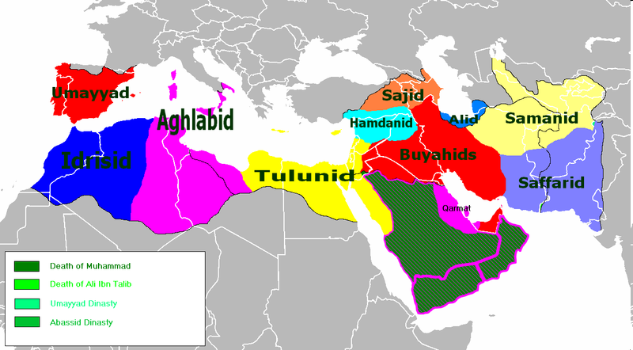

Slide 33
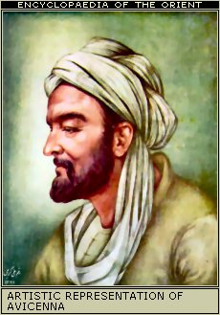
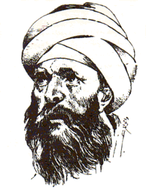
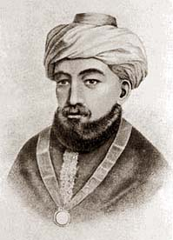
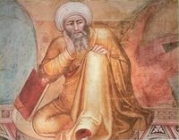
Middle Eastern Philosophy
Ibn Sina (Avicenna) (980-1037)
Al-Ghazali (1058-1111)
Ibn Rushd (Averroes) (1126-1198)
Maimonides (Rambam) (1135-1204)
All four names are key terms

Slide 34
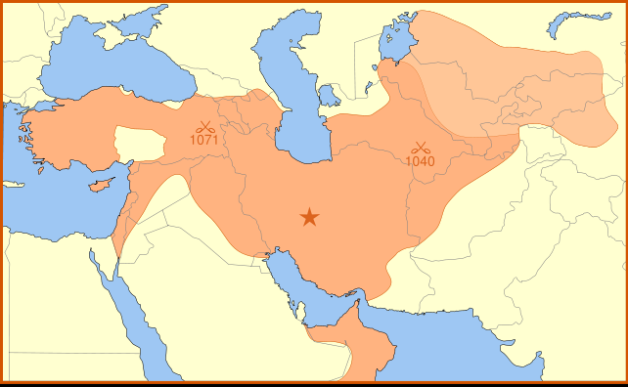
The Seljuq Empire (1037-1194)
Formation
Conquest of the Abbasids
The Sultanate of Rum
Key Terms
Tughril Beg

Slide 36
Coin of Tughril
A Seljuq hunting scene, from Kitab al Diryaq (the Book of Antidotes) by Pseudo-Gallen, probably from Iraq, mid 13th century.

Slide 37
Imperial China
Sui Dynasty (598-617 CE)

Slide 38
Imperial China
T’ang Dynasty (617-907 CE)
Taizong (627-649)
Empress Wu (684-705)
Xuanzong (713-756)
Decline of the T’ang
Key Terms
Xuanzong

Slide 39
Imperial China
The Song Dynasty (960-1279)
The Autocratic Emperor
Agricultural and Commercial Revolution
Status of Women
The Tribute System
Relations with Korea and Vietnam
Confucian Revival
Hu Yüan
School of Mind vs. School of Principle
Fall of the Song
Key Terms
Neo-Confucianism

Slide 40
Mongol Empire (1206-1294)
Genghis Khan (r. 1206-1227)
Warriors and Warfare
Conquest of China
Yuan Dynasty
Khanbalik (Beijing)
Kublai Khan (r. 1271-1294)
Conquest of Persia
Conquest of Russia
Effects of the Mongol Conquests
Key Terms
Genghis Khan

Slide 42
Japan
Nara and Heian Periods (710-1185 CE)
Economic, Social and Administrative Developments
Cultural Developments and Establishment of Buddhism
Kojiki and Nihongi
Tendai and Shingon Buddhism
The Fujiwara Regency
Rise of the Military Class
Samurai
The Genpei War (1180-1185)
Key Terms
Shogun

Slide 43
Southeast Asia
Funan
Cambodian Empire
Srivijaya
Key Terms
Cambodian Empire
Srivijaya

